Slide 1
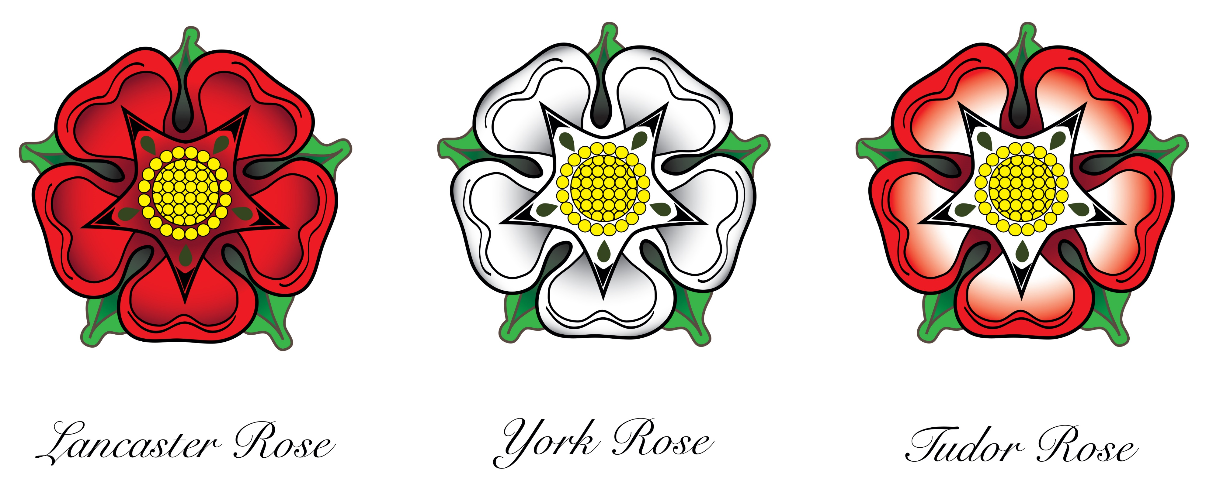
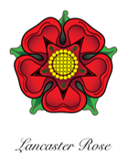
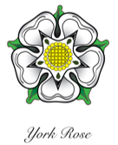
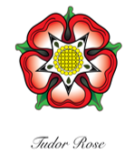
The War of the Roses
The House of Plantagenet
The House of Plantagenet had three main periods (the Angevins, the Plantagenets and the Houses of Lancaster and York). The Plantagenets ruled England for 331 years. The first Plantagenet King was Henry II (r1154 – 1189) and the last Plantagenet King was Richard III (r1452 – 1485).
Edward III was a king in the middle period. He died in 1377. Edward III had five sons, including Edward of Langley (the Duke of York) and John of Gaunt (the Duke of Lancaster) and three daughters. Unfortunately, his eldest son (Edward of Woodstock, known as The Black Prince), who should have become king after him, had already died. Instead the throne passed to the Black Prince’s eldest son, who became King Richard II. Richard II was 10 years old when he became king. His reign had lots of troubles – in part because Richard was an unpleasant king and made lots of enemies. Eventually his cousin, Henry, deposed him in 1399 and became Henry IV.
Henry IV (r1399 – 1413)
Henry IV was the son of John of Gaunt and was part of the House of Lancaster. When Henry deposed Richard II and became king himself, this started a family feud about who should be king. Should it be John of Gaunt’s children or Edward of Langley’s children? Henry IV died in 1413 from a skin condition.
Henry V (r1413 – 1422)
Henry IV’s son became king. He was also called Henry and became Henry V. He signed a treaty with France which meant he would also become the King of France when their king died – but Henry died first, from dysentery, by just a few weeks.
Henry VI (r1422 – 1461)
Henry V’s son became king. He was also called Henry and became Henry VI. Henry VI was just 9 months old when he became king. He was crowned in Westminster Abbey in 1429 and again in Paris in 1431 – the only monarch ever to be crowned in both countries. He was deposed in 1461.
Edward IV (r1461 – 1470)
Edward IV was a descendant of Edward of Langley and now the throne passed to the other side of the family – the House of York.
Henry VI (r1470 – 1471) again
Henry VI took the throne again in 1470, but was deposed the next year. He was taken to the Tower of London and was killed there in 1471.
Edward IV (r1471 – 1483) again
Edward IV Took the throne back from Henry VI. Edward died in 1483 and the throne passed to his son - almost.
Edward V (rApril – June 1483)
Edward was aged 12 years old when his father died and he became king. Edward had a brother called Richard. There were rumours that their father was already married when he married their mother. This would mean his marriage was illegal – and Edward could not become king. The throne was offered to Edward IV’s brother (also called Richard) instead. The young king and his brother, Prince Richard, were taken to the Tower of London and never seen again. The mystery of The Princes in the Tower remains to this day - although it was likely they were killed.
Richard III (r1483 – 1485)
Richard III was the last Plantagenet King and the last King of the House of York. Shakespeare wrote a play about him.
Henry VII (r1485 – 1509)
Henry Tudor’s mother was from the House of Lancaster and his father was the half-brother of Henry IV. Henry’s father had fought against the Yorkist and Henry had been in exile in Brittany, an area of France. He returned to England in 1485 and fought Richard III at the Battle of Bosworth Field. Richard III was killed and Henry Tudor became King Henry VII. He married Elizabeth of York, Edward IV’s daughter which united the Houses of Lancaster and York – the War of the Roses was at and end. Henry was the last English monarch to take the throne through battle. Richard III was the last of the Plantagenet Kings – Henry VII was the first monarch in the House of Tudor.

