Slide 1
Phonics WC 25.1.21

Slide 2
Monday 25th January oo- long

Slide 3
oo

Slide 4
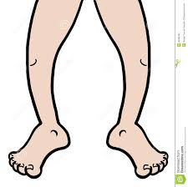
moon

Slide 5
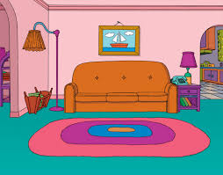
room

Slide 6
zoom

Slide 7
I see them on zoom.

Slide 8
I sleep in the room.

Slide 9
Tuesday 26th January oo- short

Slide 10
oo

Slide 11
book

Slide 12
look

Slide 13
hook

Slide 14
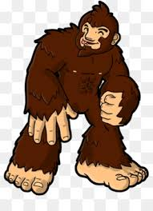
He has a big foot.

Slide 15
Look at that book.

Slide 16
Wednesday 27th January ar

Slide 17
ar

Slide 18
car

Slide 19
bar

Slide 20
hard

Slide 21
I got a card.

Slide 22
We see a fast car.

Slide 23
Thursday 2th January or

Slide 24
or

Slide 25
horn

Slide 26
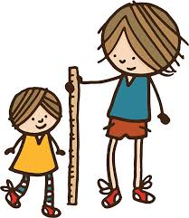
short

Slide 27
torch

Slide 28
I need a fork.

Slide 29
Did he see the thorn?

Slide 30
Friday 29th January Re-cap

Slide 31
oo

Slide 32
oo

Slide 33
ar

Slide 34
or

Slide 35
was

Slide 36
He was short.

Slide 37
The cat was on the moon.

Slide 38
Was the book in the car?

