Slide 1
Welcome to Year 2!

Slide 2
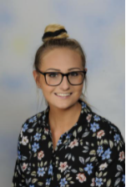
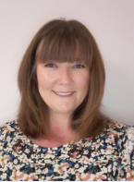
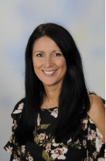
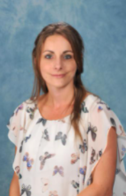
Staff
2JH | 2LA | 2WS
Miss Hawkins (Year 2 Lead) TA – Miss Chen | Mrs Arnold (Monday – Thursday) Mrs Stringer (Friday) TA – Miss Dunbar | Mrs Wood (Monday, Tuesday and Friday) Mrs Stringer (Wednesday, Thursday) TA – Mrs Jacobs 1:2- Mr Pearson

Slide 3
Attendance
100% attendance = no learning missed
95% attendance = half a day every fortnight. 2 weeks in a school year.
90% = half a day every week. 4 weeks in a school year.
85% = 1 and a half days missed every fortnight. 6 weeks in a school year.
80% = 1 day every week. 8 weeks in a school year.
Children who achieve 100% attendance are almost twice as
likely to be ARE than those with 95% attendance. They are four
times more likely to be working above average than those with
below 90%.

Slide 4
School Day
School begins at 8:30 – your child will enter through the class room door and they may arrive from 8:25 onwards.
Lateness has the same impact as attendance over time so please be punctual.
Between 8:30 and 9:00 children will be working on key skills for Maths and English– if they’re late they will miss this!
Reading, Writing, Spelling and Maths will be daily in the mornings
Collect your child at 3:10 from their classroom doors. Please
bear with us whilst we learn your faces!

Slide 5
Uniform
Please ensure that your child comes to school with correct and neat uniform.
PE uniform:
This can be worn on our PE days which are Tuesdays and Fridays in Autumn 1.
Please ensure children are wearing a Talbot PE t-shirt and black shorts or bottoms. No logo tracksuits please.

Slide 6
School Systems
Class dojo to support behaviour
House Points to reward exceptional work and effort

Slide 7
Year 2 Topics
Autumn 1 – Fire! Fire!
Autumn 2- Icy Lands
Spring 1 – Pirates
Spring 2 - … and Islands
Summer – Around the World in 80 Days

Slide 8
Provisional trips and visits
Autumn 1-
Visit from Dorset Fire and Rescue Service
Spring 1-
Visit from Poole Museum to learn about Pirates!
Summer 1-
Brownsea Island
These trips and visits are all provisional at the movement but we will ensure to give you notice before for any payments we may need to make these exciting trips go ahead.

Slide 9
Home Learning
Weekly home learning:
15 minutes of Numbots
15 minutes of Spelling Shed
Reading at least 3 times a week

Slide 10
What can you do to help?
Ensure you read and question – school books 3x a week, home books, library books, captions and labels, instructions, recipes
Times tables and counting activities
Telling the time
Helping with cooking – weighing, measuring
Using money – pay in the shops, on the bus etc
Writing postcards, Christmas cards, thank you cards,
birthday cards
Learn the common exception words
Ensure they are getting a good night’s sleep
Spend time as a family – days out and lovely activities etc

Slide 11
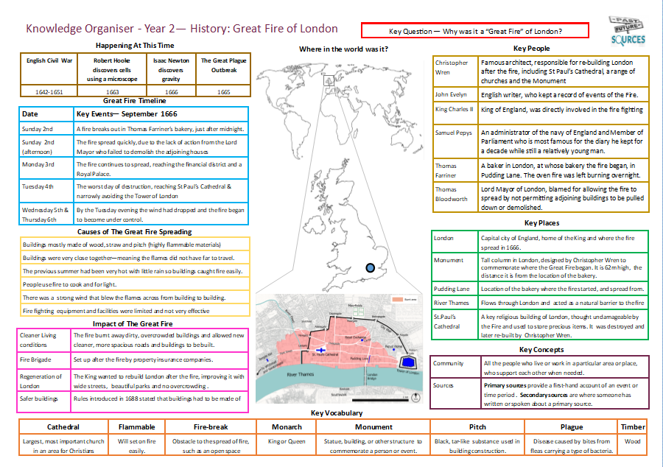
Curriculum
For each topic covered we will be putting a knowledge organiser on the school website. This will show you the knowledge that we will be teaching in school and the vocabulary we will be using. You may find it useful to refer to these with your child at home.

Slide 12
SATs
SATs are statutory for Year 2 children
They will take place throughout May – please avoid booking holiday for this time
Maths x 2
Reading x 2
SPAG
There will be an evening later in the year to go through
the testing process in more detail

Slide 13
Year 2 Assessment Framework Reading

Slide 14
Year 2 Assessment Framework Writing

Slide 15
Year 2 Assessment Framework Maths

Slide 16
Queries / Messages
If you have any queries or questions, or any messages for your child’s teacher e.g. they are being picked up by Nanny, then you can email them to the address below. This email will be checked throughout the day and will cut down the face to face contact and help support social distancing.
year2yeargroup@talbot.poole.sch.uk

