Slide 1
Welcome to Year 6
Mr Saunders, Mrs Rayner, Mr Tatham, Mrs Lamparelli, Miss Luna, Mrs Gomes, Miss Elston, Mr Cheng
Talbot Primary School

Slide 2
Please bring your child in as promptly as possible – Accelerated Reader starts straight away!
If you need to speak to a teacher please make an appointment through the office OR contact us via the Year 6 email year6teachers@talbot.poole.sch.uk
PE Kits, water bottles and uniform needs to be named - so hopefully we can get it back to its rightful owner!
Morning snack is a fruit or vegetables and water to drink.

Slide 3
Attendance - School starts at 8.30 a.m. and finishes at 3.10p.m.
Lateness = Lost Learning *(Figures below are calculated over a school year)
5 minutes late each day | 3 days lost!
10 minutes late each day | 6.5 days lost!
15 minutes late each day | 10 days lost!
20 minutes late each day | 13 days lost!
30 minutes late each day | 19 days lost!

Slide 4
Dates for the Diary
PE: Thursday and Fridays through the school year. PE kit to be worn into school on these days. Please send children in with Talbot PE Kit.
Swimming: Fridays up until Christmas, starting next week.
Forest School: Wednesday up until October Half Term

Slide 5
Communication
Class Dojo
A letter is being sent out this week providing more details.
If you have a concern, speak to one of us

Slide 6
Expectations
High standards in terms of behaviour, attitude to learning, and presentation of oneself and ones work.
Weekly homework completed (Friday 8.30 am to Friday 8.30 am).
Half Termly Accelerated Reader targets achieved by all children.
Being role models of the Talbot Ten behaviours.

Slide 7
Homework
Spelling Shed – 15 games
TT Rockstars – 15 games
Reading – daily
We are preparing our children for Year 7 where they will receive a large amount of homework which will be non-negotiable.

Slide 8
Trips
Autumn
Poole Harbour Bird Watching
Spring
Tank Museum
Summer
Worth Matravers
Old Harry Rocks
Forest School Residential Experience
£180 approximately TBC. – Payment Plans will be made available.

Slide 9
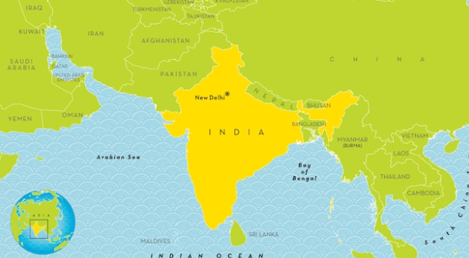
Topics

Slide 10
SATs: 8th May – 11th May
Monday 8th: GPS 1 + 2
Tuesday 9th: Reading
Wednesday 10th: Maths 1 + 2
Thursday 11th: Maths 3
We will provide a more detailed update closer to the time

Slide 11
Any questions?
Year 3 + 4 and 5/6 spelling words to be uploaded onto the school website

