Slide 1
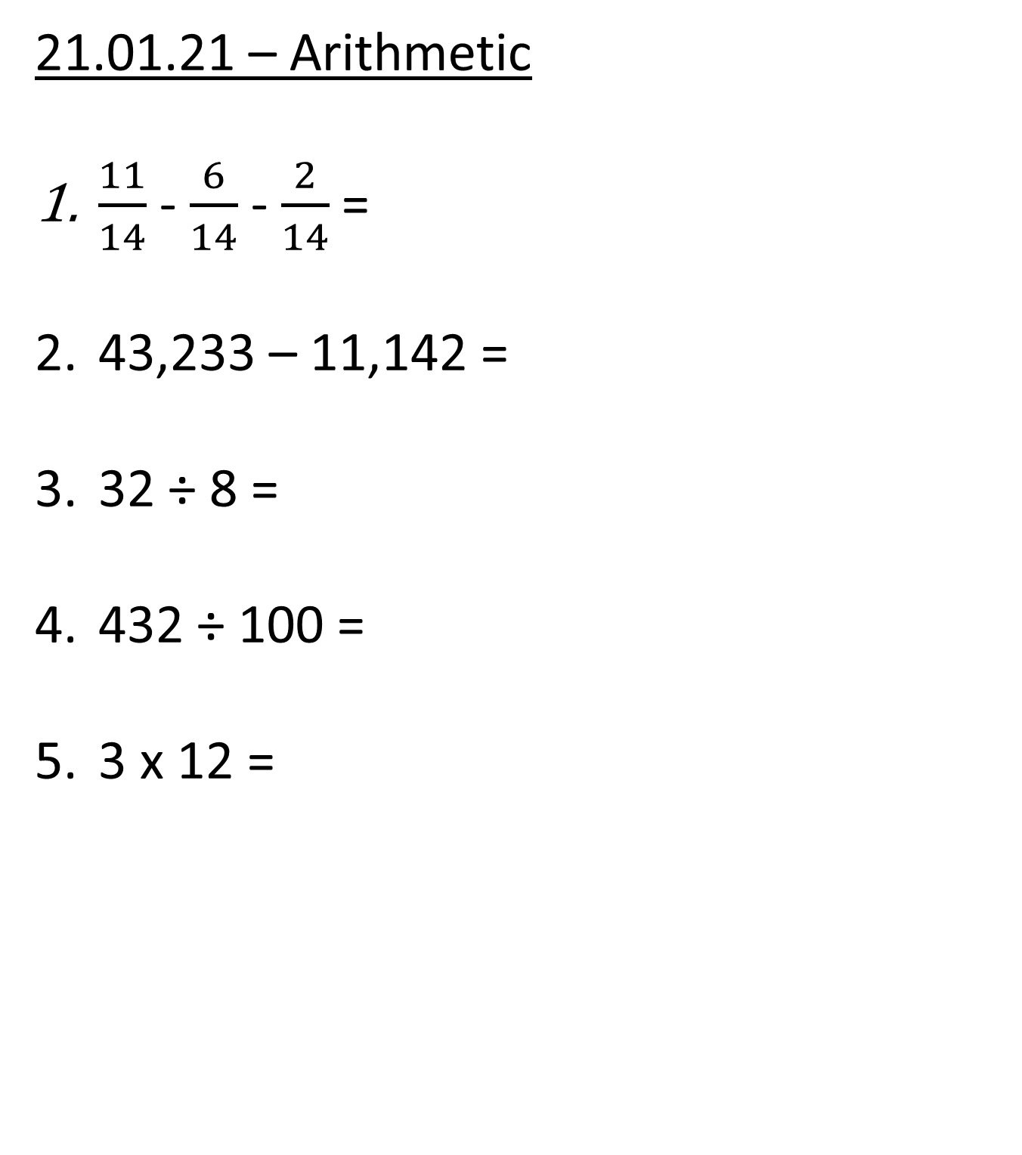
21.01.21 – Arithmetic
$\frac{11}{14}$ - $\frac{6}{14}$ - $\frac{2}{14}$ =
43,233 – 11,142 =
32 ÷ 8 =
432 ÷ 100 =
3 x 12 =

Slide 2
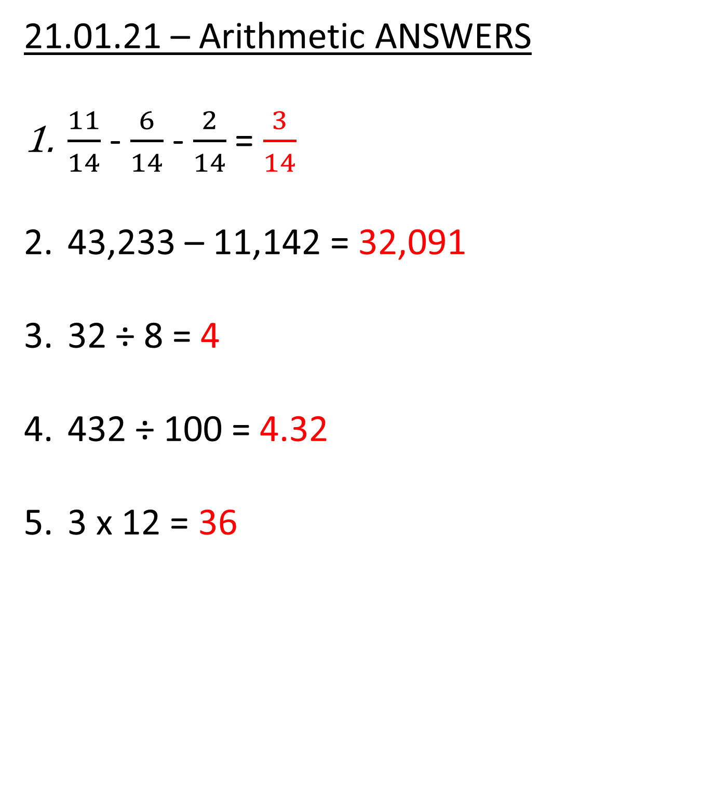
21.01.21 – Arithmetic ANSWERS
$\frac{11}{14}$ - $\frac{6}{14}$ - $\frac{2}{14}$ = $\frac{3}{14}$
43,233 – 11,142 = 32,091
32 ÷ 8 = 4
432 ÷ 100 = 4.32
3 x 12 = 36

Slide 3


Slide 5
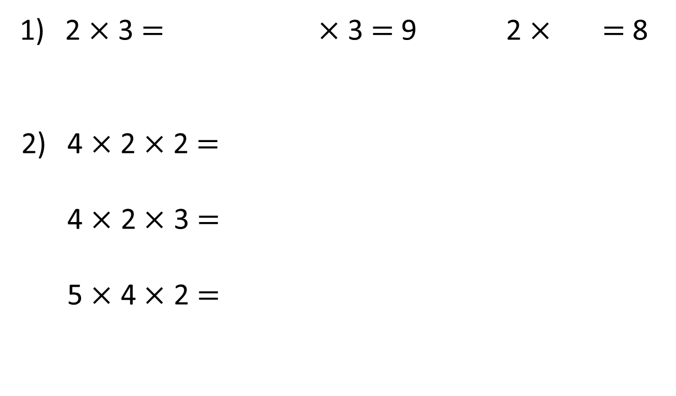
2 $×$ 3 $=$ $×$ 3 $=$ 9 2 $×$ $=$ 8
4 $×$ 2 $×$ 2 $=$
4 $×$ 2 $×$ 3 $=$
5 $×$ 4 $×$ 2 $=$

Slide 6
6
2 $×$ 3 $=$ $×$ 3 $=$ 9 2 $×$ $=$ 8
4 $×$ 2 $×$ 2 $=$
4 $×$ 2 $×$ 3 $=$
5 $×$ 4 $×$ 2 $=$
3
4
16
24
40

Slide 8






Ron puts 3 different coloured cubes into a box.
He covers his eyes and picks a cube out.
What could Ron have picked?
Yellow
Red
Blue
3 possibilities

Slide 9
Ron now has two boxes.
He picks one cube out of each box.
What combinations could Ron pick?
Yellow
/ Green
Yellow
/ Black

Slide 10
Ron now has two boxes.
He picks one cube out of each box.
What combinations could Ron pick?
Yellow
/ Green
Yellow
/ Black
Red
/ Green
Red
/ Black

Slide 11
Ron now has two boxes.
He picks one cube out of each box.
What combinations could Ron pick?
Yellow
/ Green
Yellow
/ Black
Red
/ Green
Red
/ Black
Blue
/ Green
Blue
/ Black
6 possibilities

Slide 12

Ron adds a third cube to the second box.
What combinations could Ron pick now?
Have a think
Orange
/ Yellow
Orange
/ Red
Orange
/ Blue
Yellow
/ Green
Yellow
/ Black
Red
/ Green
Red
/ Black
Blue
/ Green
Blue
/ Black
9 possibilities

Slide 13
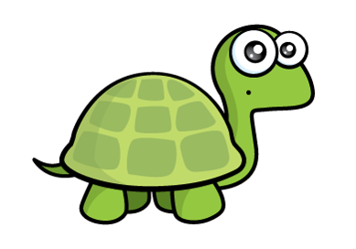
Ron moves the cubes.
There are the same number of cubes so there will still be 9 combinations.
Orange
/ Yellow
Orange
/ Red
Orange
/ Blue
Have a think
Yellow
/ Green
Yellow
/ Black
Red
/ Green
Red
/ Black
Blue
/ Green
Blue
/ Black
9 possibilities

Slide 14
Ron moves the cubes.
There are the same number of cubes so there will still be 9 combinations.
8 possibilities

Slide 15
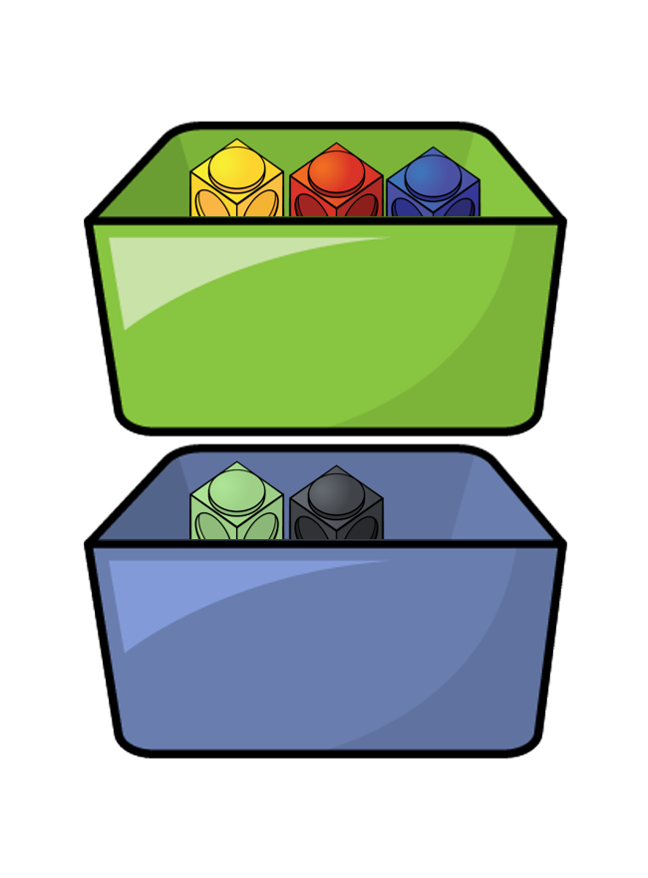


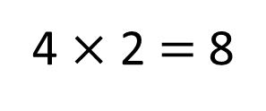
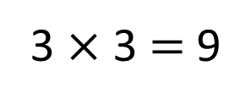
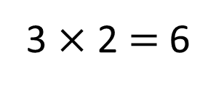
What do you notice?
3
6 possibilities
3 $×$ 2 $=$ 6
2
Have a think
3
9 possibilities
3 $×$ 3 $=$ 9
3
4
8 possibilities
4 $×$ 2 $=$ 8
2

Slide 16
Have a go at the questions 1 – 4 on the worksheet

Slide 17



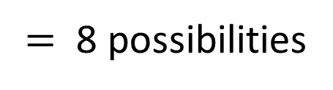
Ice cream | Sauce
Vanilla | Blueberry
Chocolate | Raspberry
Strawberry
Mint
Have a think
4
$$×$$
2
$=$ 8 possibilities
Va / Bl
Va / Ra
Ch / Bl
Ch / Ra
St / Bl
St / Ra
Mi / Bl
Mi / Ra

Slide 18



Ice cream | Sauce | Topping
Vanilla | Blueberry
Chocolate | Raspberry
Strawberry
Mint
Ice cream | Sauce
Vanilla | Blueberry
Chocolate | Raspberry
Strawberry
Mint
Flake
Sprinkles
4
$$×$$
2
$$×$$
2
$$=$$
16 possibilities
Va / Bl
Va / Ra
Ch / Bl
Ch / Ra
Va / Bl / Fl
Va / Ra / Fl
Ch / Bl / Fl
Ch / Ra / Fl
Va / Bl / Sp
Va / Ra / Sp
Ch / Bl / Sp
Ch / Ra / Sp
St / Bl
St / Ra
Mi / Bl
Mi / Ra
St / Bl / Fl
St / Ra / Fl
Mi / Bl / Fl
Mi / Ra / Fl
St / Bl / Sp
St / Ra / Sp
Mi / Bl / Sp
Mi / Ra / Sp

Slide 19
Ice cream | Sauce | Topping
Vanilla | Blueberry
Chocolate | Raspberry
Strawberry
Mint
Ice cream | Sauce
Vanilla | Blueberry
Chocolate | Raspberry
Strawberry
Mint
Flake
Sprinkles
Wafer
4
$$×$$
2
$$×$$
3
$$=$$
24 possibilities

Slide 20
Have a go at the rest of the questions on the worksheet

