Slide 1

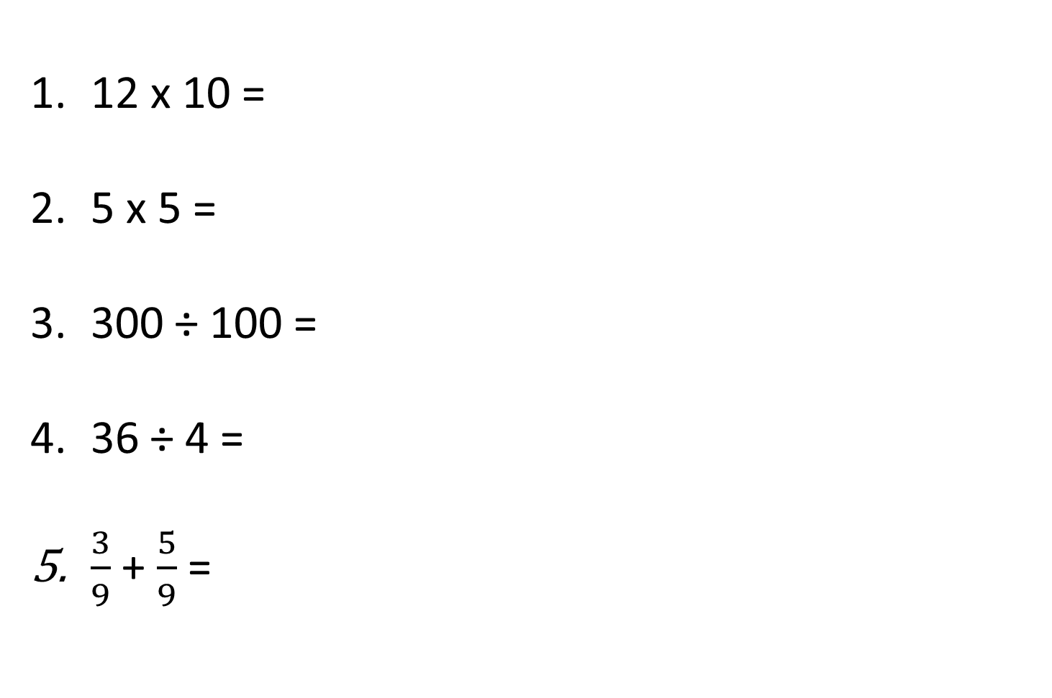
25.01.21 – Arithmetic
12 x 10 =
5 x 5 =
300 ÷ 100 =
36 ÷ 4 =
$\frac{3}{9}$ + $\frac{5}{9}$ =

Slide 2
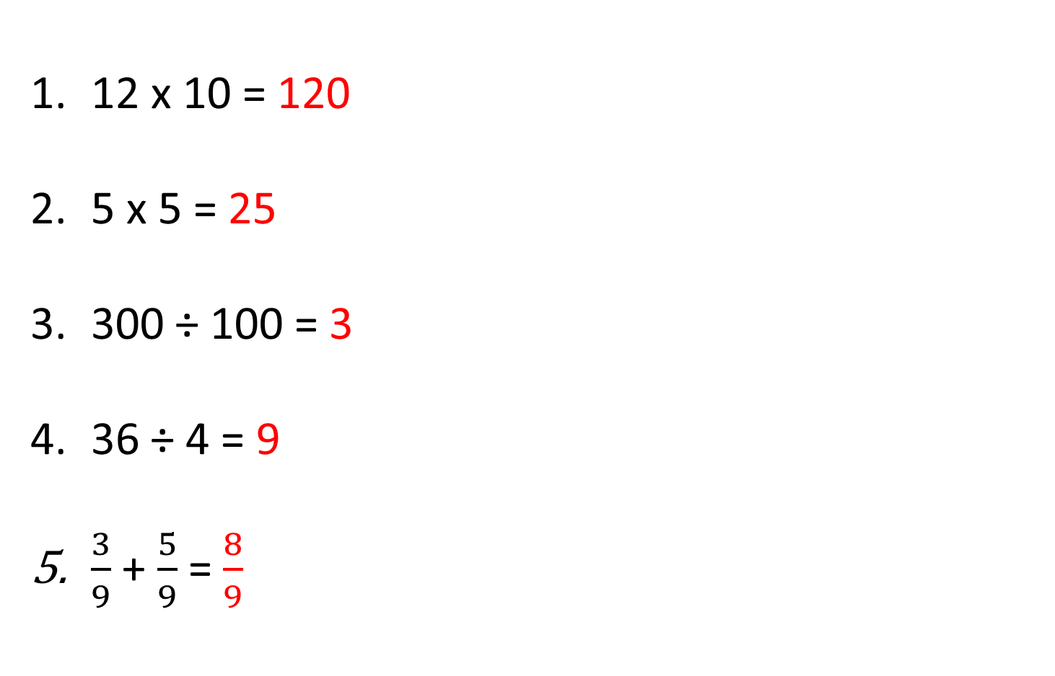
25.01.21 – Arithmetic ANSWERS
12 x 10 = 120
5 x 5 = 25
300 ÷ 100 = 3
36 ÷ 4 = 9
$\frac{3}{9}$ + $\frac{5}{9}$ = $\frac{8}{9}$

Slide 3
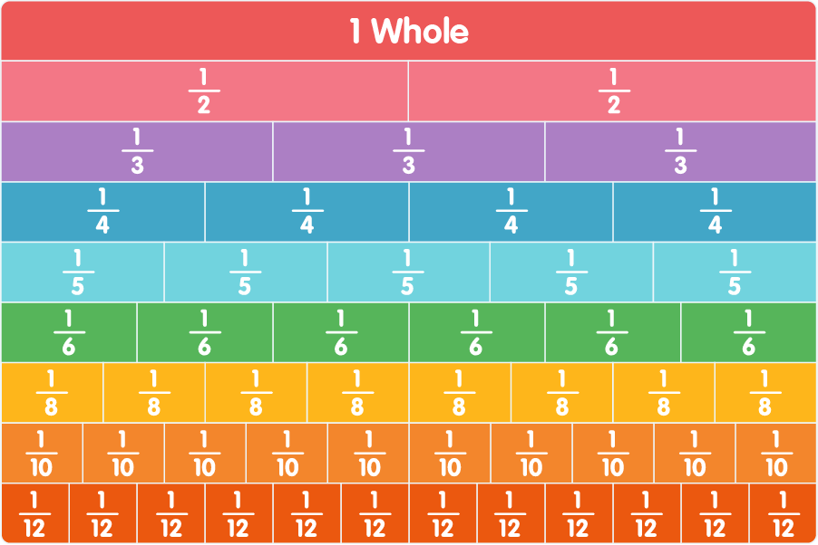
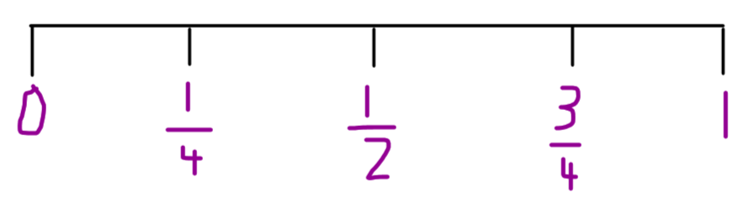
25.01.21 – LI: To understand unit and non-unit fractions
A fraction is a division of a whole into a number of equal parts.
A fraction is a number.

Slide 4
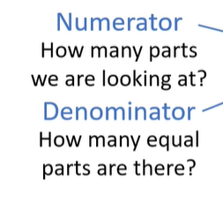
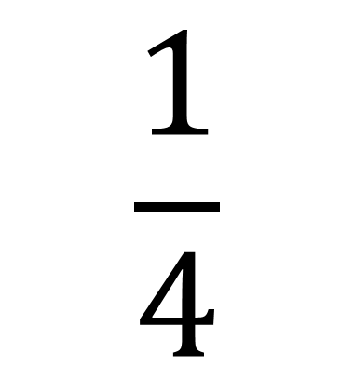
25.01.21 – LI: To understand unit and non-unit fractions
What is a fraction?
$$\frac{1}{4}$$

Slide 5


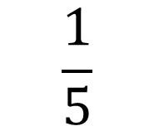
25.01.21 – LI: To understand unit and non-unit fractions
$$\frac{1}{5}$$
Unit fraction – numerator is 1
$$\frac{3}{5}$$
Non-unit fraction – numerator is greater than 1

Slide 6
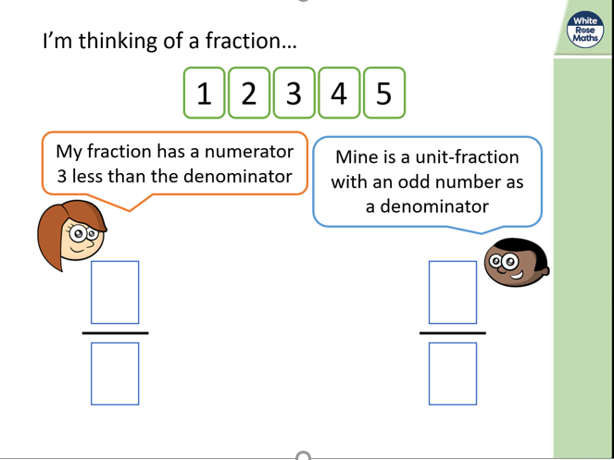
25.01.21 – LI: To understand unit and non-unit fractions

Slide 7
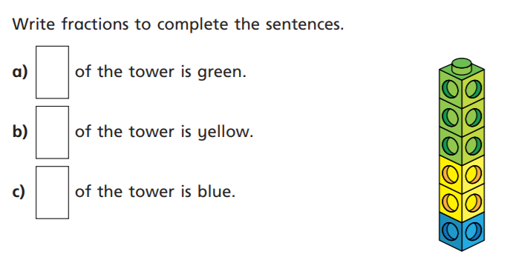
25.01.21 – LI: To understand unit and non-unit fractions
Main Sheet

Slide 8
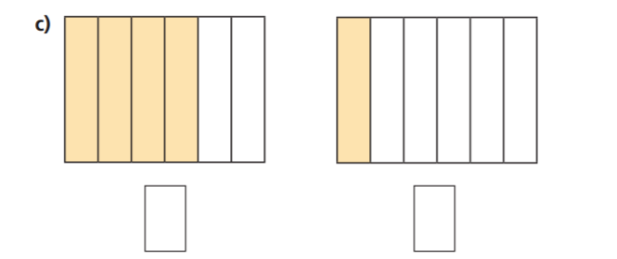
25.01.21 – LI: To understand unit and non-unit fractions
Main Sheet – what do the fractions represent?

