Slide 1
LI: To understand the roles I take on in different situations

Slide 2
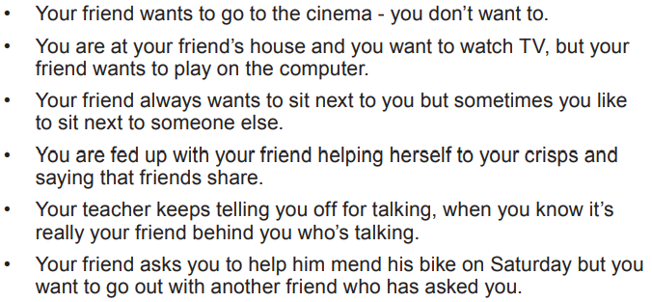
Read the scenarios above. Think about and discuss how you would handle these situations.

Slide 3
Now I want you to imagine you are an animal.
Not too far a stretch for some of you…

Slide 4

You can choose from the following options:
What characteristics would your animal have?
How would it behave?

Slide 5
Imagine your animal, with its qualities and characteristics, will be applied to them as a human. How would your animal act and feel as a human?
So for instance, the EAGLE might fly high above things to see them from a different viewpoint
The BULL might get angry and charge around breaking things and smashing the place up

Slide 6
Choose one of the scenarios from earlier. How might your animal behave and react in this situation?
Now think about a different animal. How would they do things differently?

Slide 7
How did the animals react/behave?
Would they all react the same?
This is what it is like in friendship groups. We all take on different roles and have different qualities and characteristics, as well as different ways of solving problems.
Which animal are you most like? How does that affect the way that you deal with difficult situations? Sometimes you might act like a different animal depending on who you are with.
Do you recognise any of your friends as different animals?
Which type of animal do you like being friends with and why?

Slide 8
TASK
Fill out the animal characteristic template for one of the animals – it can be one of the ones that you chose to think about before.

