Slide 1
The intrepid adventures of Icy the Ice cube

Slide 2
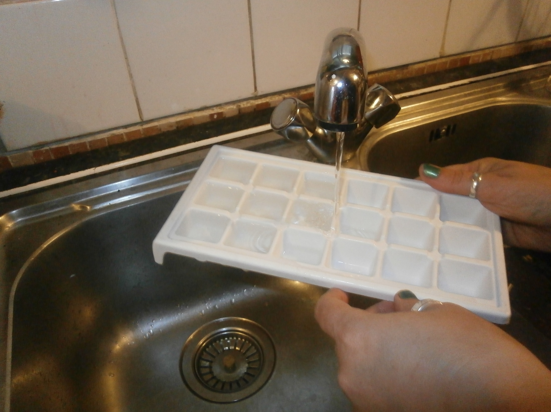
One fine summer’s day, an inquisitive scientist had a hankering for a cold drink. In order to fulfil this request, the scientist required something to make the drink colder….
What on earth could they be doing?
What state is present?

Slide 3
WHERE DID THE SCIENTIST PUT THE ICE CUBE TRAY?
WHY?

Slide 4
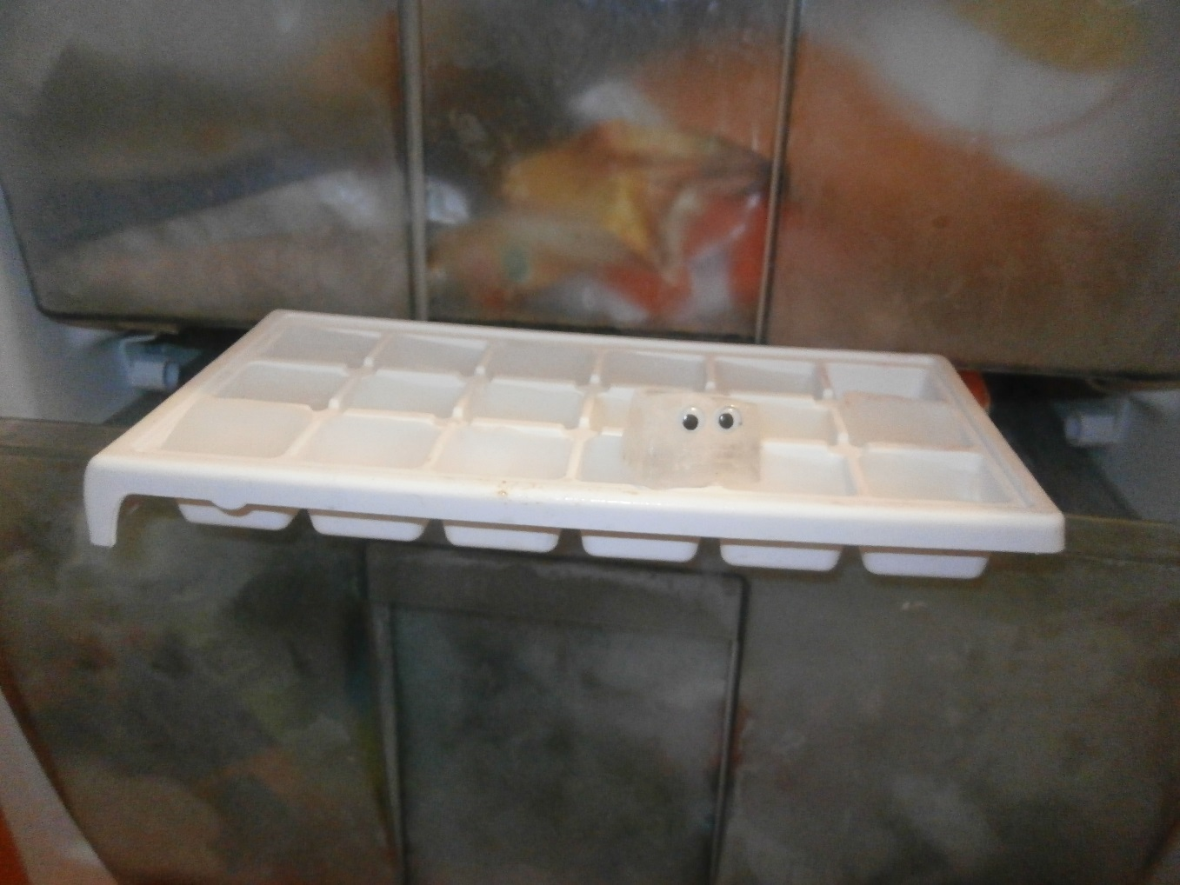
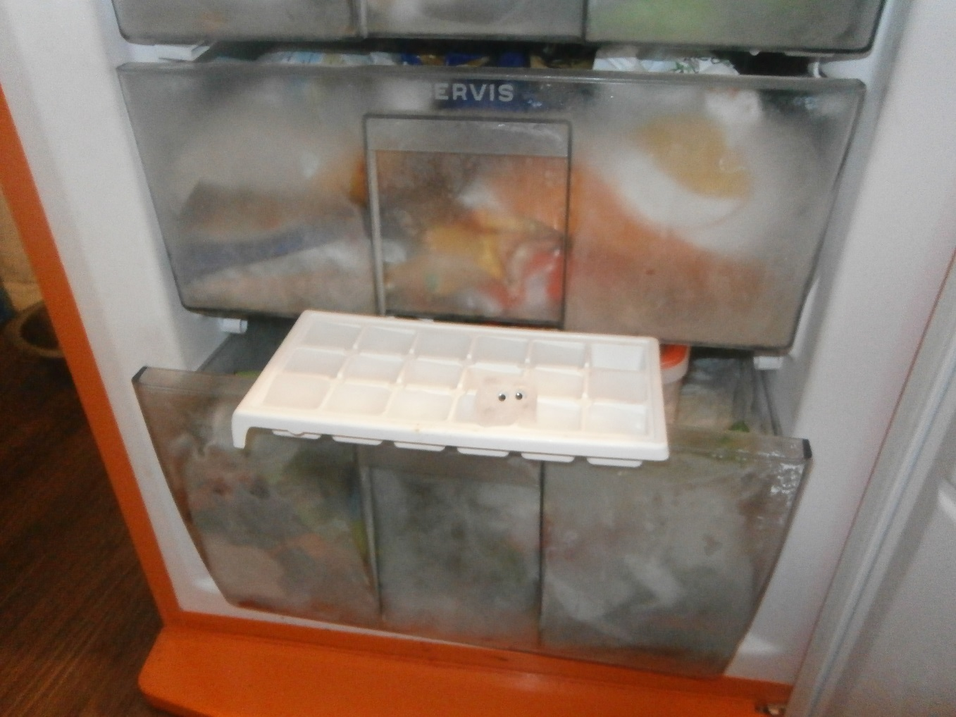
And as if by magic….
(It’s never magic, it’s SCIENCE!)
ICY THE ICE CUBE WAS BORN.

Slide 5
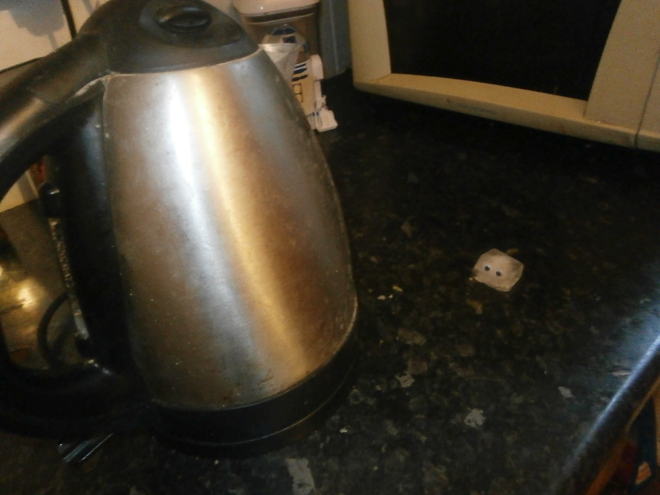
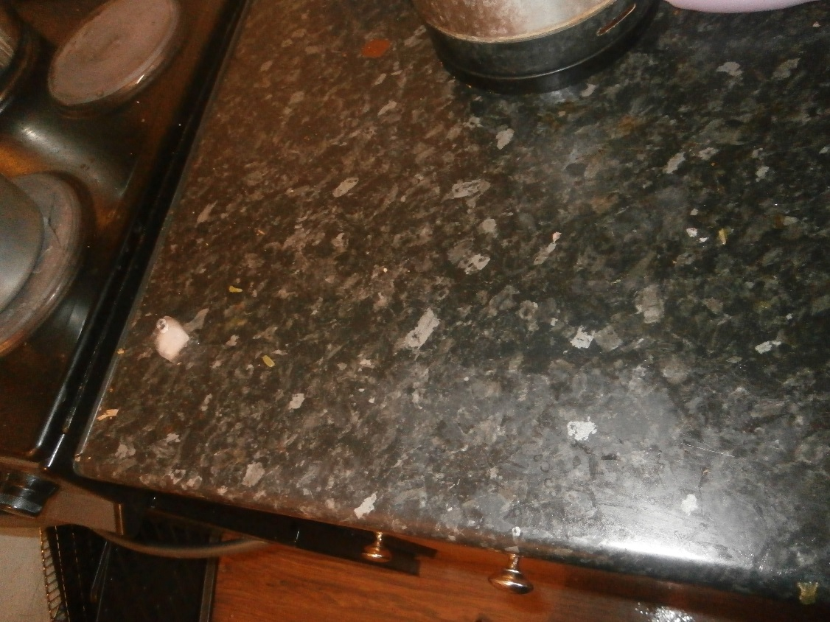
Immediately, Icy decided to investigate his surroundings…
Cautiously he manoeuvred around the kitchen and silently approached the kettle….
Thinking better of it he carried on searching.
He noticed that he was leaving a trail behind him.
Why was that?

Slide 6
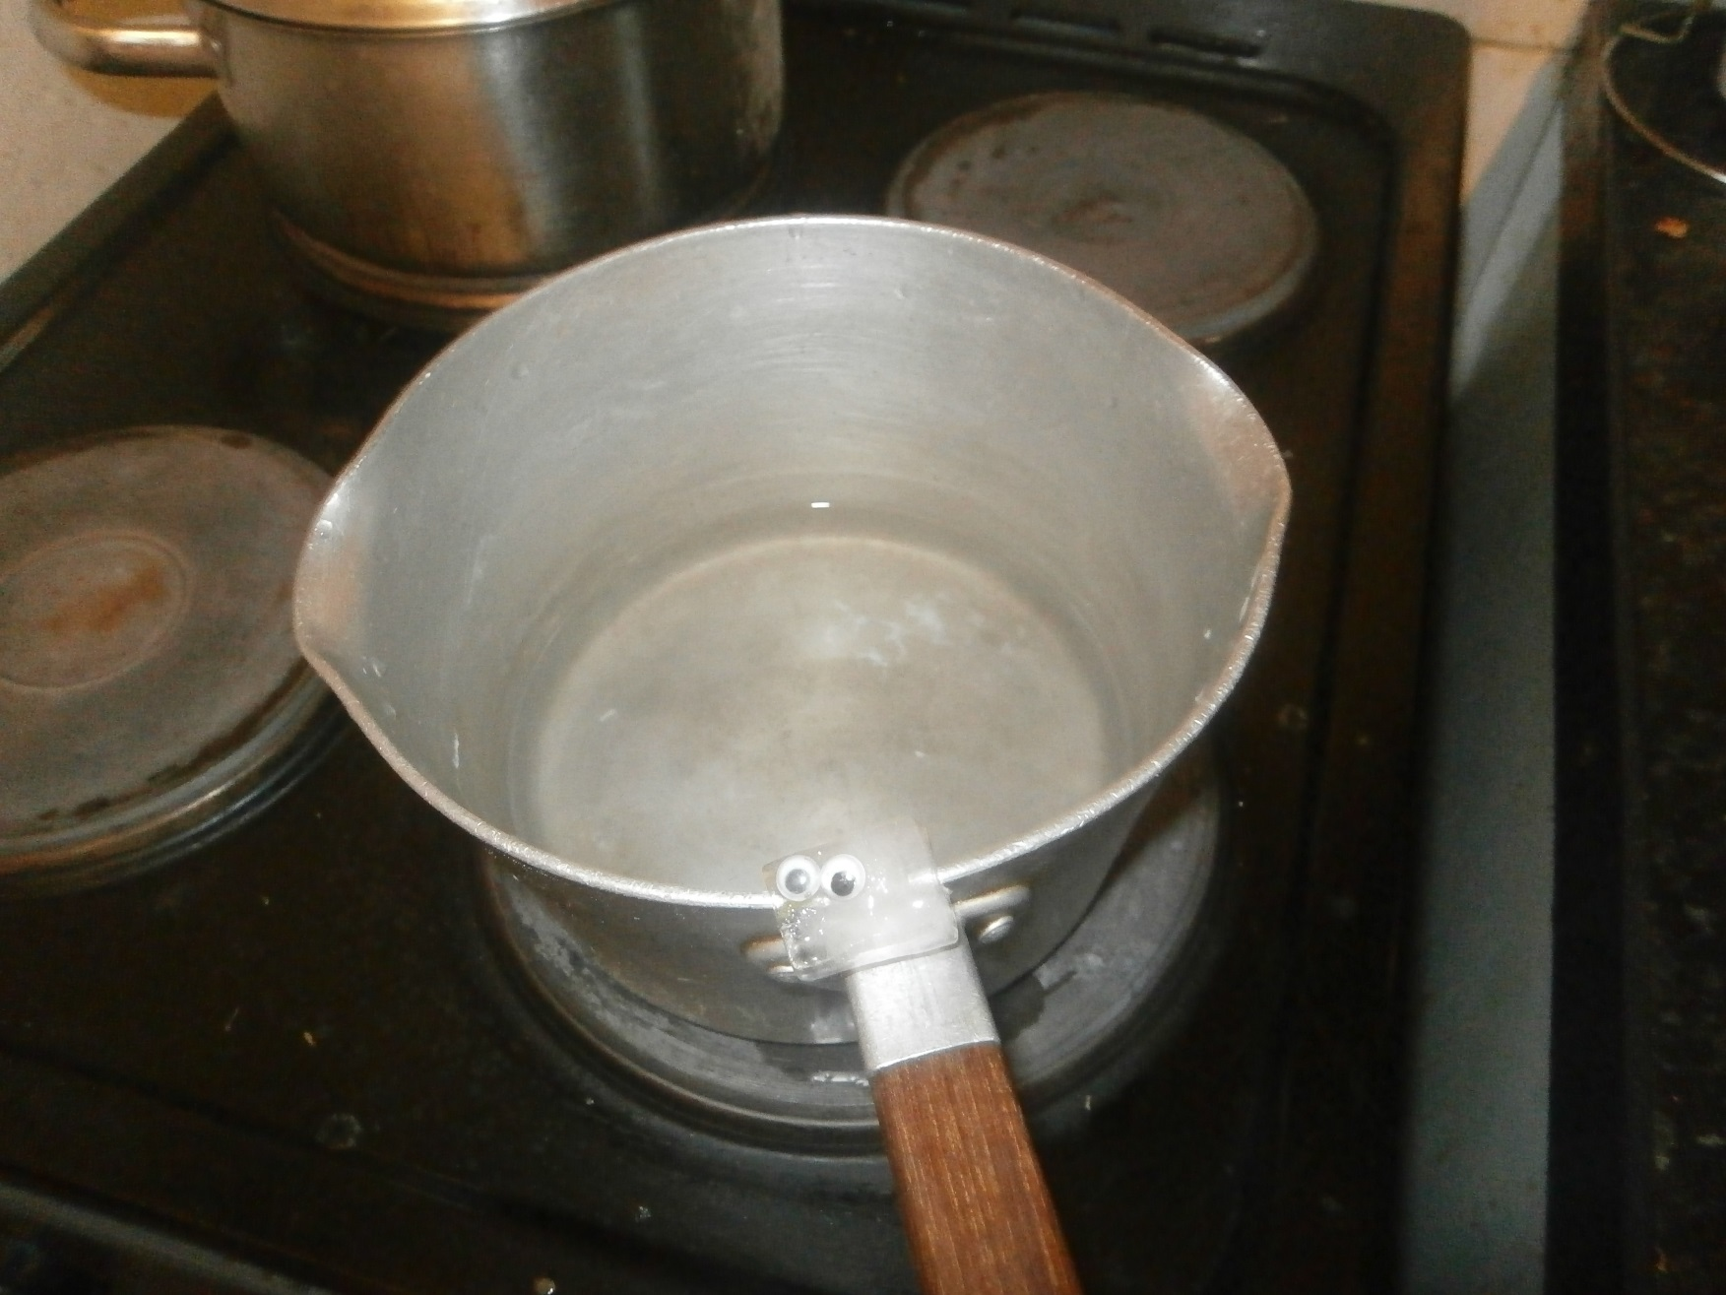
Next, Icy spotted a saucepan of water on the cooker.
What was happening to the water?

Slide 7
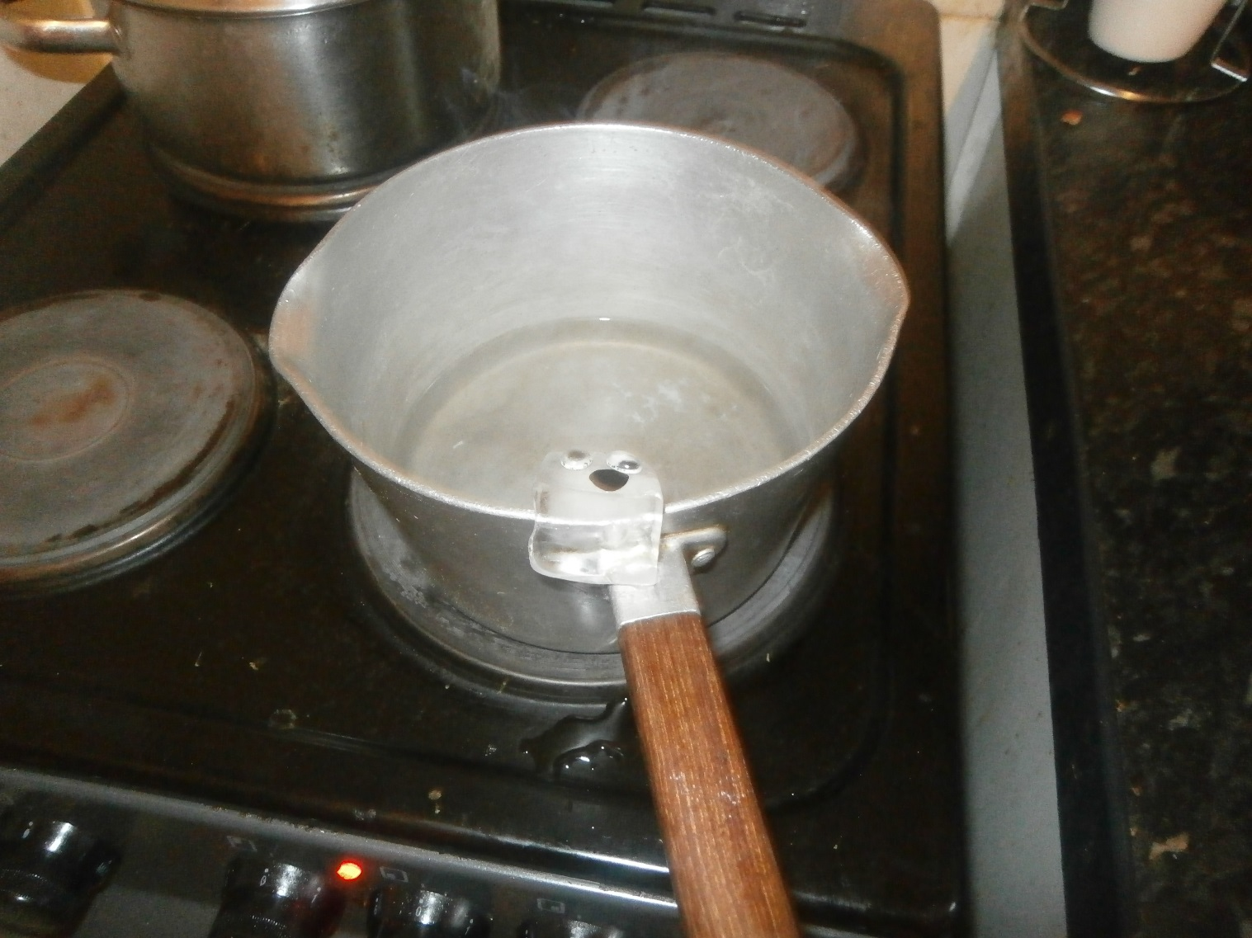
Oh No!
DISASTER! Icy slipped!

Slide 8
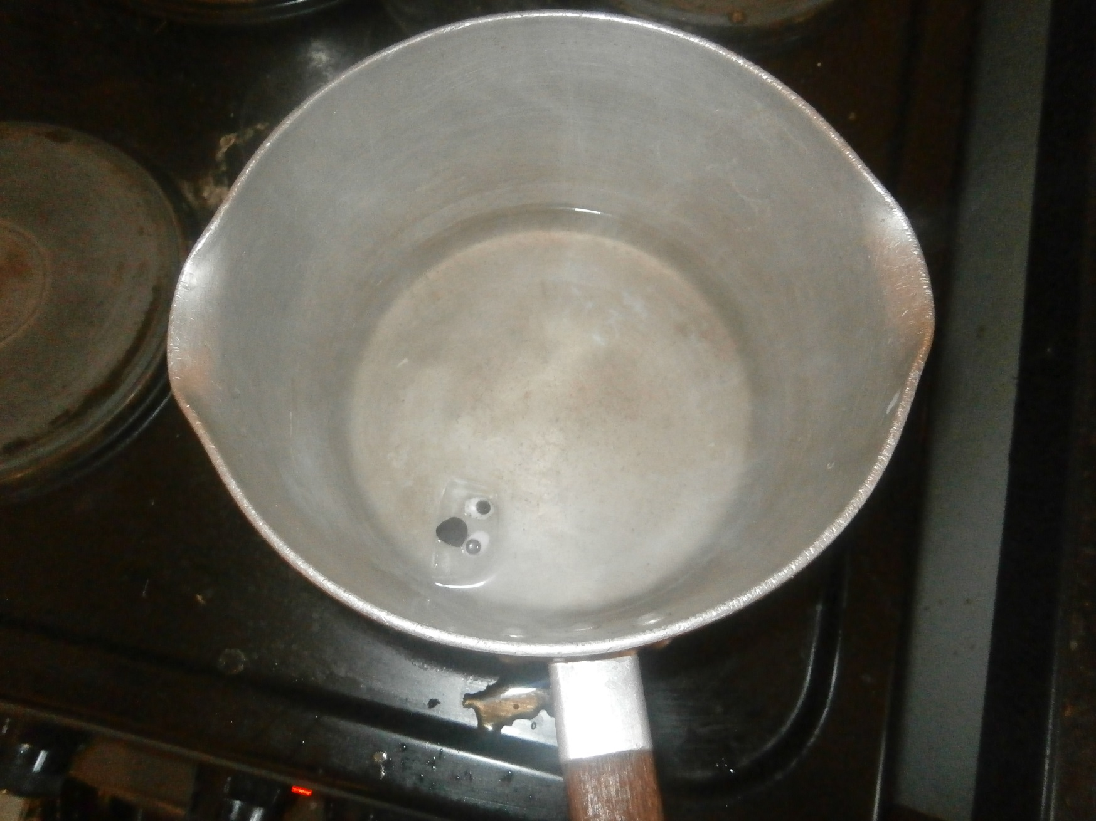
What was happening to him?
Why?

Slide 9
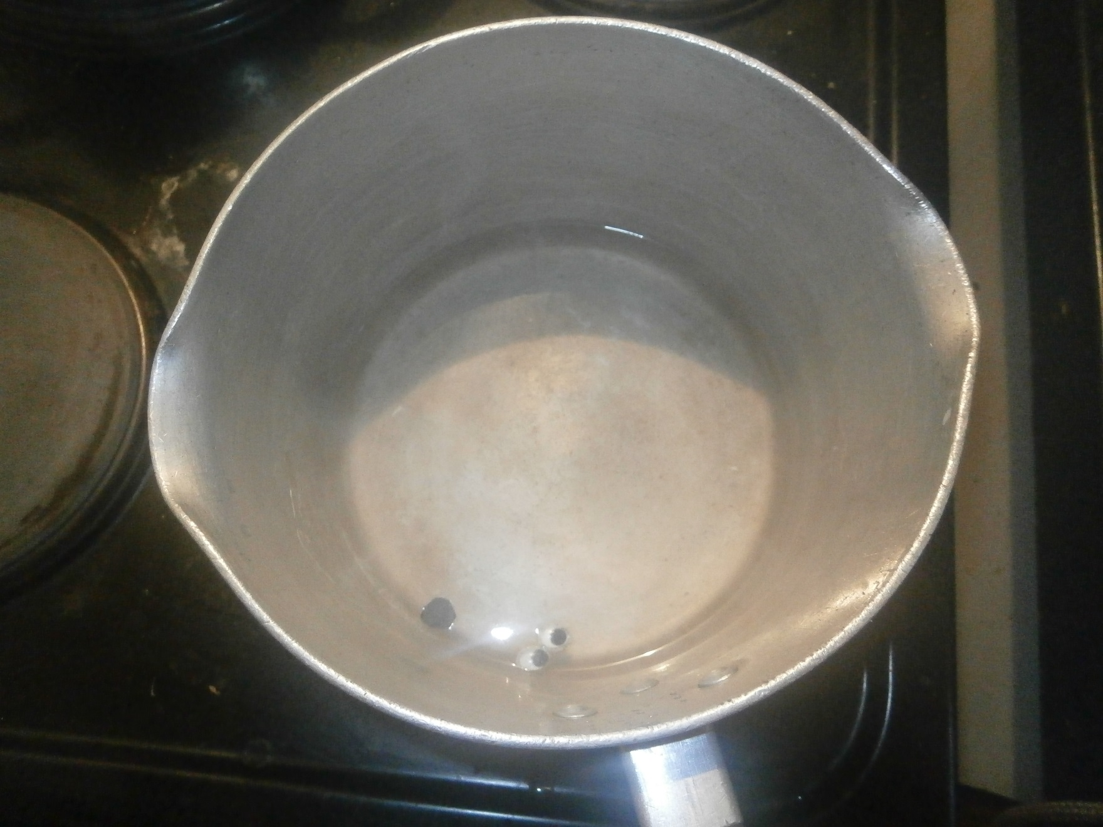
AHHHHHHHH!

Slide 10

Sadness washed over the kitchen like a blanket of doom.
Icy was no more.
What had happened to him?
Was he really dead?
What would happen to him now?
The saucepan continued to boil, the scientist placed a lid over it.

Slide 11
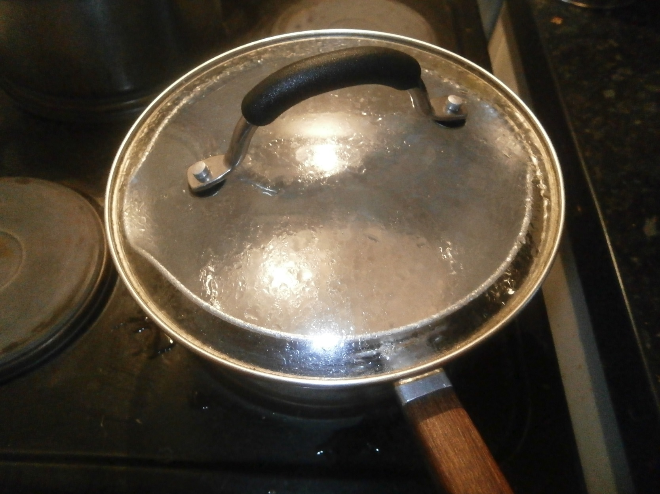
What was forming on the inside of the saucepan’s lid?
Why was this?
What was this process called?

Slide 12
Liquid becomes a solid
Freezing
Condensing
Gas becomes a liquid
Melting
Solid becomes a liquid
Boiling
Liquid becomes a gas

