Slide 1

Welcome to
Talbot Primary School

Slide 2



Little Wandle Letters and Sounds

Slide 3
Little Wandle Letters and Sounds is the scheme of learning that we use to teach children to read at Talbot Primary School.
This programme consists of 5 phases that begin in Pre-school and finish in Year 2.

Slide 4
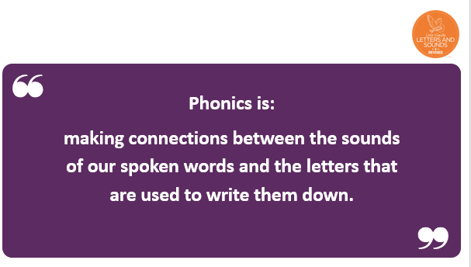

Slide 5
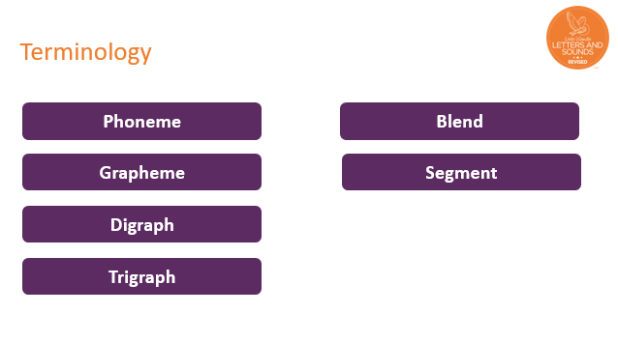

Slide 6
By the time your child started school they would have been familiar with the foundations of reading these include
Rhyming
Alliteration
Oral blending

Slide 7
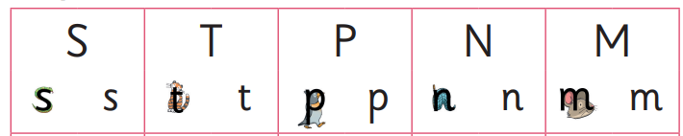
Once your child begins their Reception year, they will begin to learn to read words
We start by teaching phonemes.
Phonemes are the sounds that letters make

Slide 8
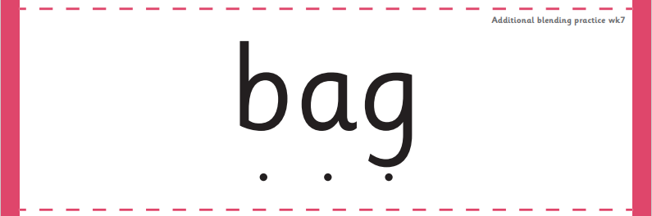
Once the children have learnt enough phonemes, we start to blend the phonemes to make words.

Slide 9
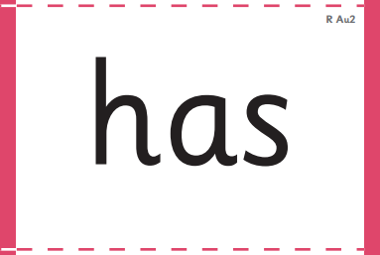
Tricky words are also taught.
The phonemes in tricky words cannot be blended as they do not sound the same as they look.

Slide 10
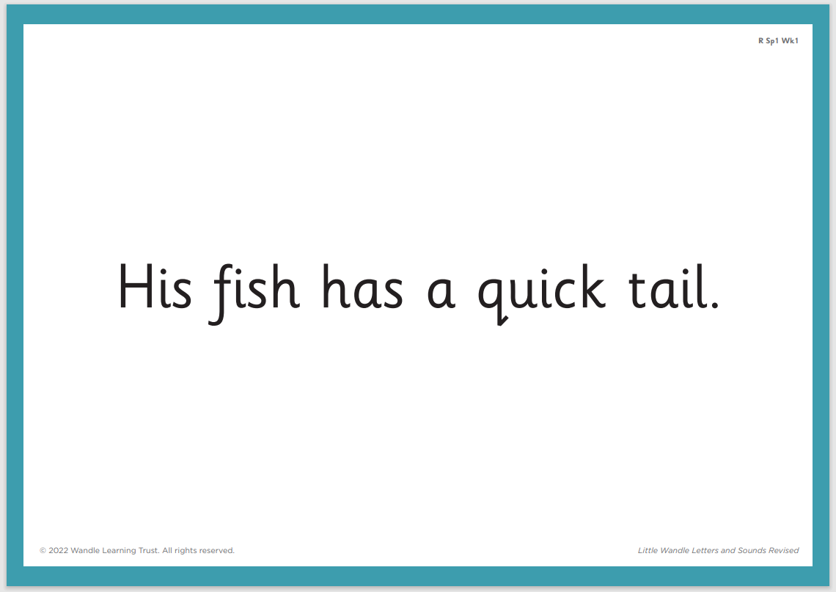
Once the children can read enough words, we begin to read captions and sentences.

Slide 11
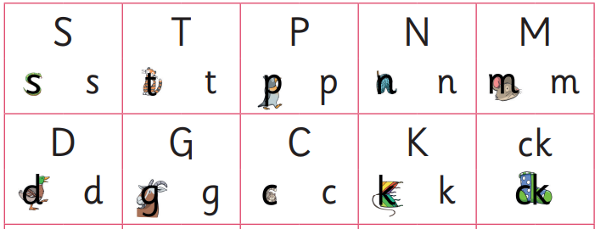
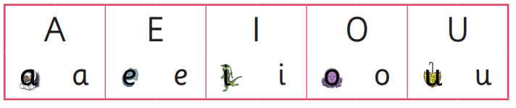

These phonics sessions take place daily at 9am
One phoneme is taught a day from Monday to Thursday then all are reviewed on a Friday.
The children have already learnt these phonemes and are already beginning to blend words.

Slide 12
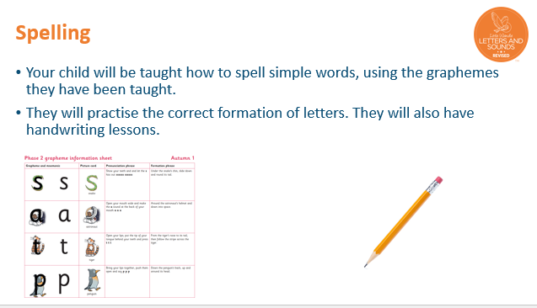


Slide 13
Keep Up
To ensure that no child falls behind we deliver daily keep up sessions that revisit taught phonemes.

Slide 14


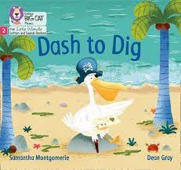
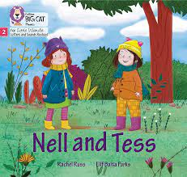
Every Wednesday your child will bring home a reading book that is matched to their individual reading needs.
The children will read these books three times a week at school before they bring them home.
The books should be read fluently, this does not mean the books are too easy, it means that the children are confident readers.

Slide 15


Slide 16
Please share these books with your child at least 3 times a week to allow them to show off the skills that they have learnt at school.

Slide 17
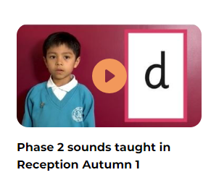
Parent’s section
Please visit the parent’s section on the Little Wandle Website.

Slide 18
Any questions?

Slide 19
Thank you for coming

