Slide 1
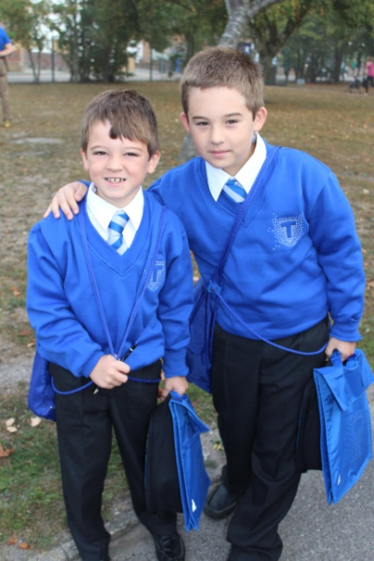
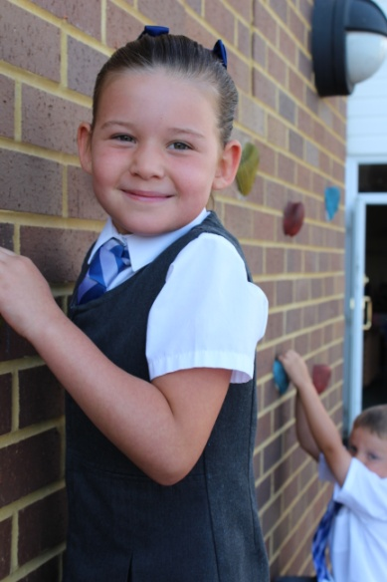
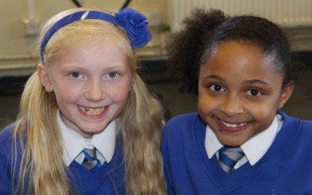

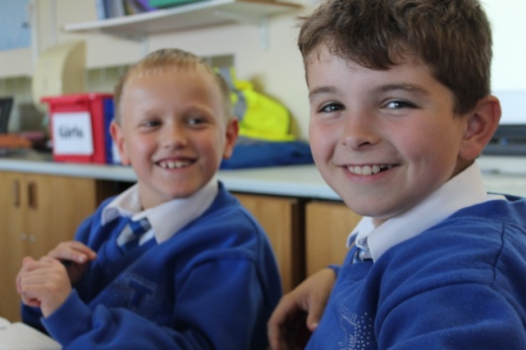
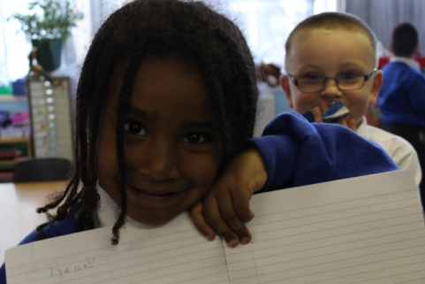
THE TALBOT CHILD IS…
Happy, healthy and confident.
Polite and respectful.
Kind, caring and compassionate.
Independent, resilient and hard working.
Adaptable and able to solve problems.
Sociable and able to work with others.
Ambitious and self motivated to fulfil their potential.
The Talbot Child learns the skills and knowledge needed to lead a successful life.

Slide 2
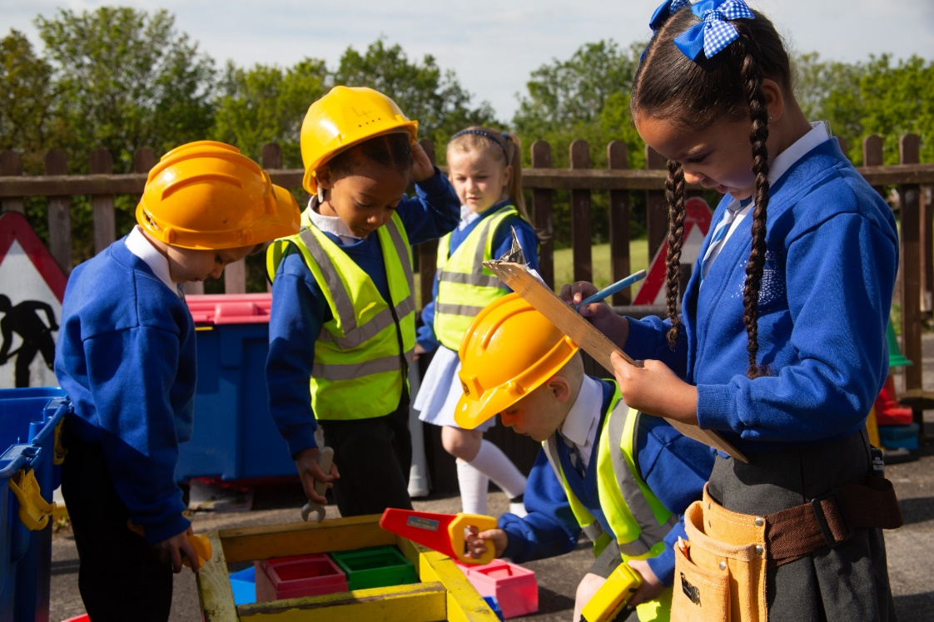
Welcome to
Talbot Primary School

Slide 3
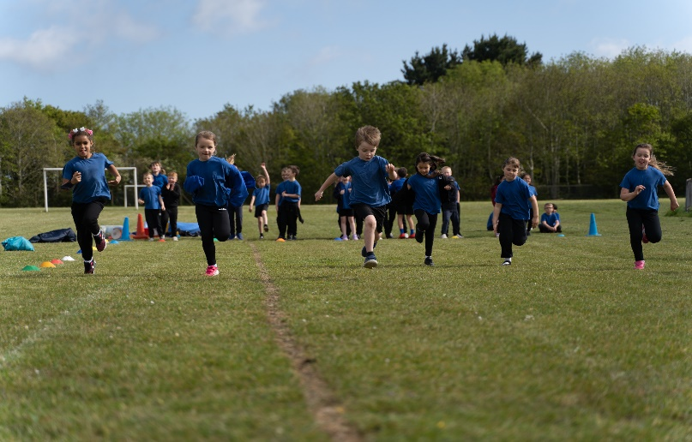
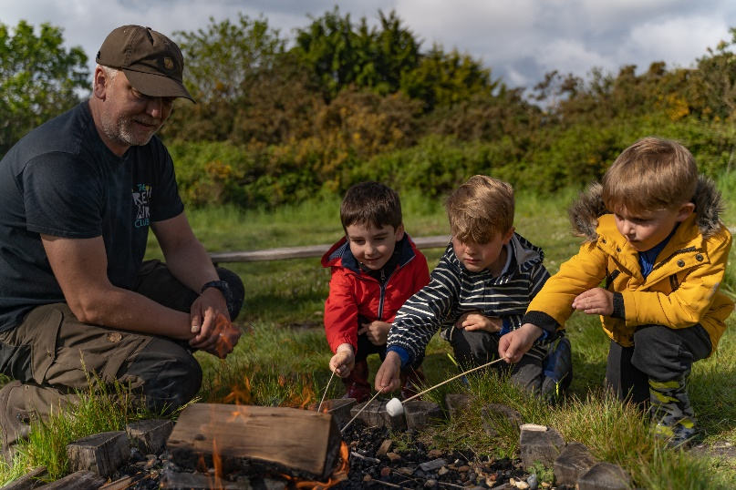
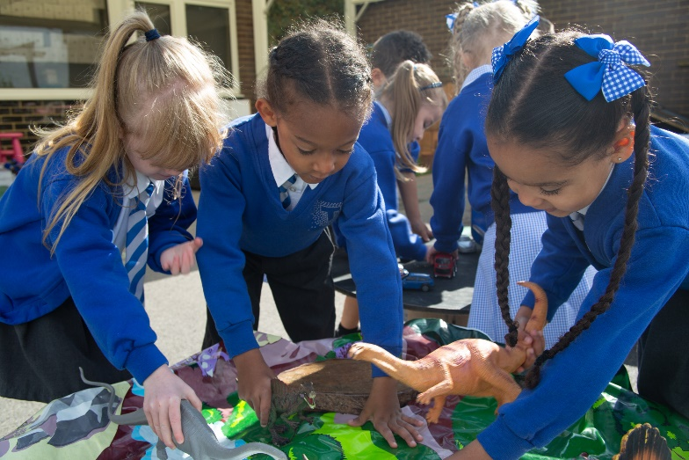

Headteacher’s
Welcome

Slide 4
Introduction
Who will your child work with?
Teachers
Teaching Assistants
Midday Supervisors
Inclusion Leader and Support Agencies
School Nurse, Doctor, Dentist
Other Teachers including Supply Teachers
Visitors to the School, Students, Adult Helpers
Senior Leadership Team
Governors
YOU!
Notes:
Introduce all present staff, explain all of the people that will support their child

Slide 5
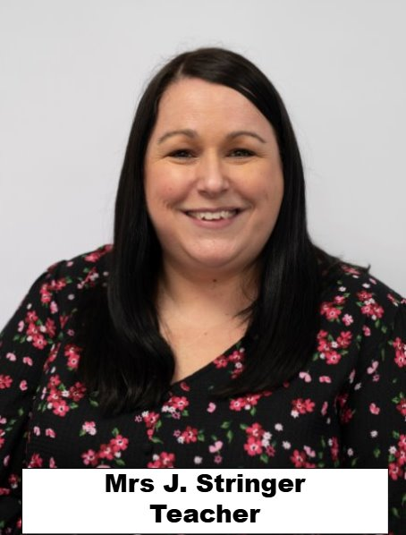
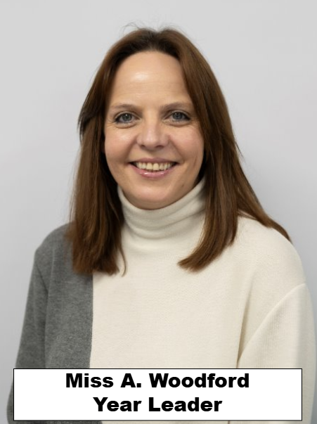
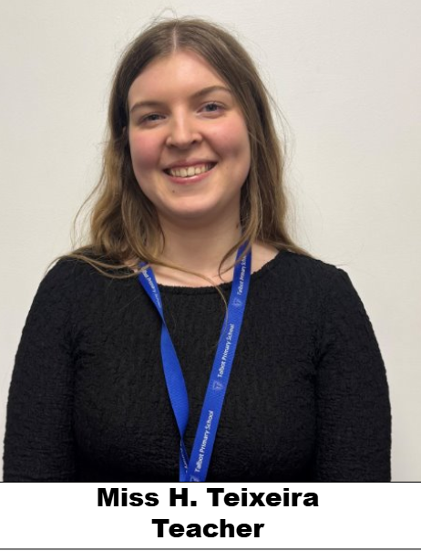
Teaching Staff

Slide 6
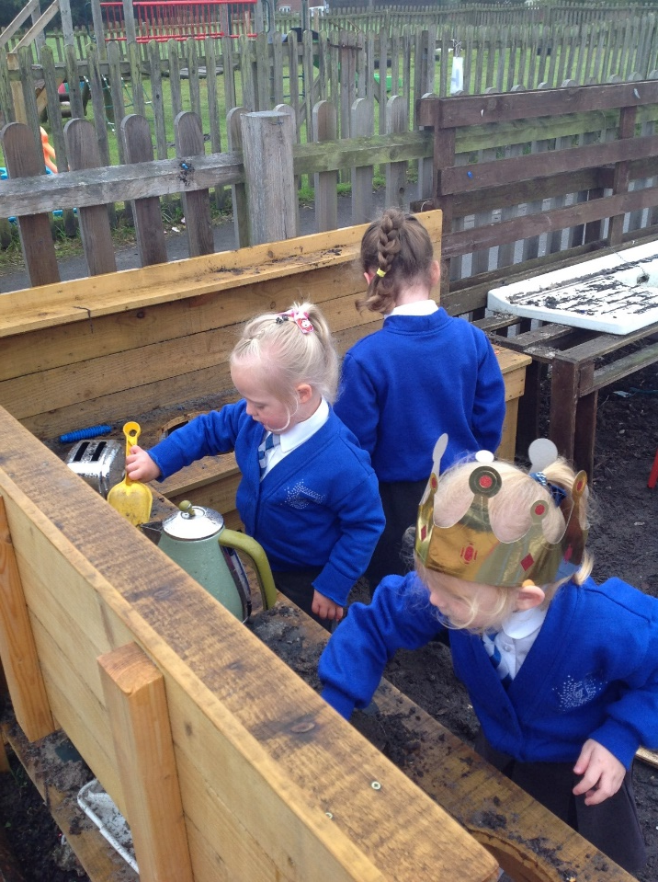
Our Reception Base
Our base is free flowing, we don’t have any doors, except to the outside learning environment
Children will be based in their classroom and have the opportunity to explore the various areas that the classroom provides.
Each child has access to our Creative Area which sees lots of messy and creative activities within.
We have a large outdoor area that the children can use during their Child Initiated Time.

Slide 7
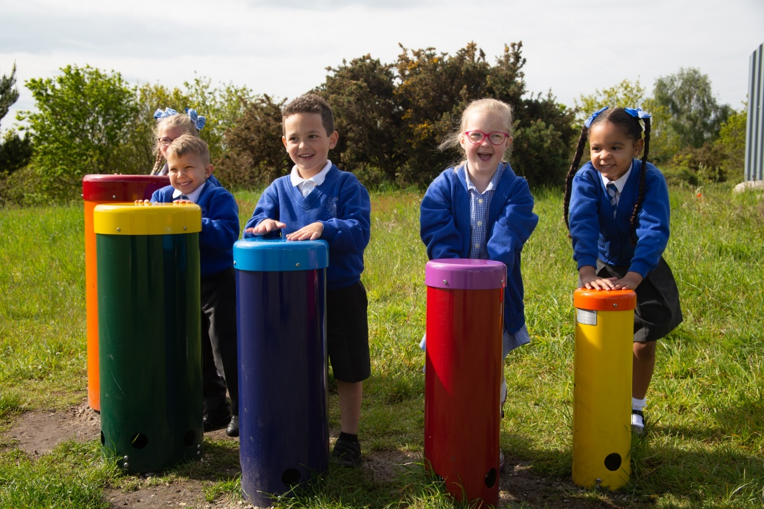
A Day In The Life Of Reception
8.30-8.40 Doors open
8.40-9.00 Drawing Club
9.00-9.20 Phonics
9.20-10.00 Word time
10:00- 10-15- Snack
10. 15- 10.30-Little Wandle Handwriting
10.30- 10.40- Inspire Time
10.40- 11.30- Adventure Time
11.30-11.45- Bright Write
11:45-1.00- Lunch
1.00-1.15- Dough Disco
1.15-1.45-NCETM Number Masters
1.45-2.45 Adventure Time
2.45- Story time and Class discussion
3:10- Home Time

Slide 8
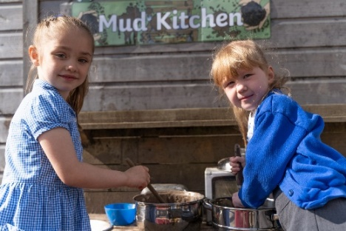
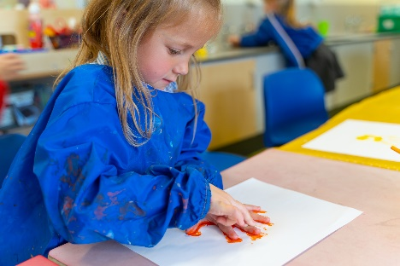
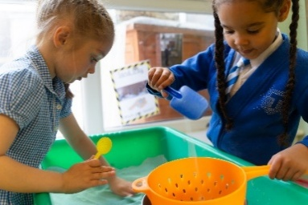
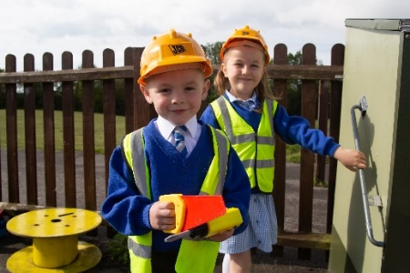
Our Provision
We will use a baseline assessment to identify the children’s start points and then personalise our curriculum to meet their individual needs
All Early Years settings follow Development Matters- Prime areas are: Personal, Social and Emotional development, Communication and Language and Physical Development.
Specific areas are Literacy, Maths, Understanding the World and Expressive Arts and Design.
We assess the children in all of these areas and then plan a curriculum to support individual developmental needs.

Slide 9


Teaching Phonics
At Talbot, we believe all our children can become fluent readers and writers. This is why we teach reading through Little Wandle Letters and Sounds Revised.
We start teaching phonics in Reception and follow the Little Wandle progression, which ensures children build on their growing knowledge of the alphabetic code, mastering phonics to read and spell as they move through school.

Slide 10

Teaching Number and Number Patterns
We follow the NCETM scheme of learning to teach number and number patterns
We strive to ensure that all children should have a deep understanding of numbers to 10 by the time they finish their Reception year

Slide 11
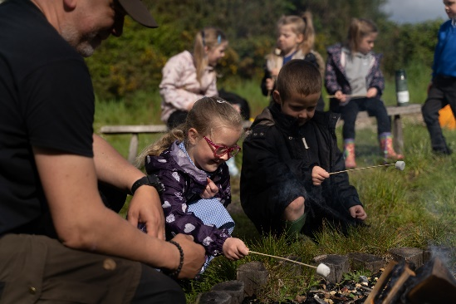
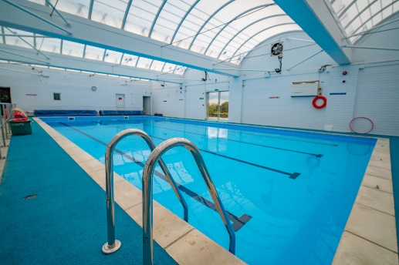
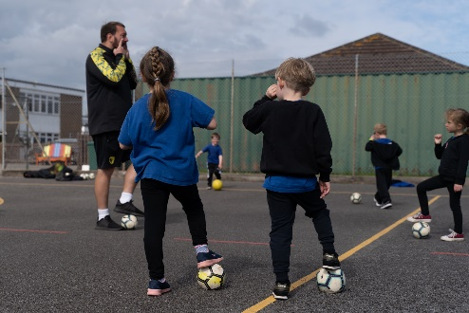
Our Provision
In the Summer Term children will have the opportunity to swim in our school pool with our qualified swimming instructor
We are lucky enough to have our own specialist PE teacher Mr. Bartram who will teach all the children PE
We have access to Forestry school on Talbot Heath all year round
Reception children have increasing opportunities to mix and learn with the wider school, throughout the year, as they grow in confidence.

Slide 12
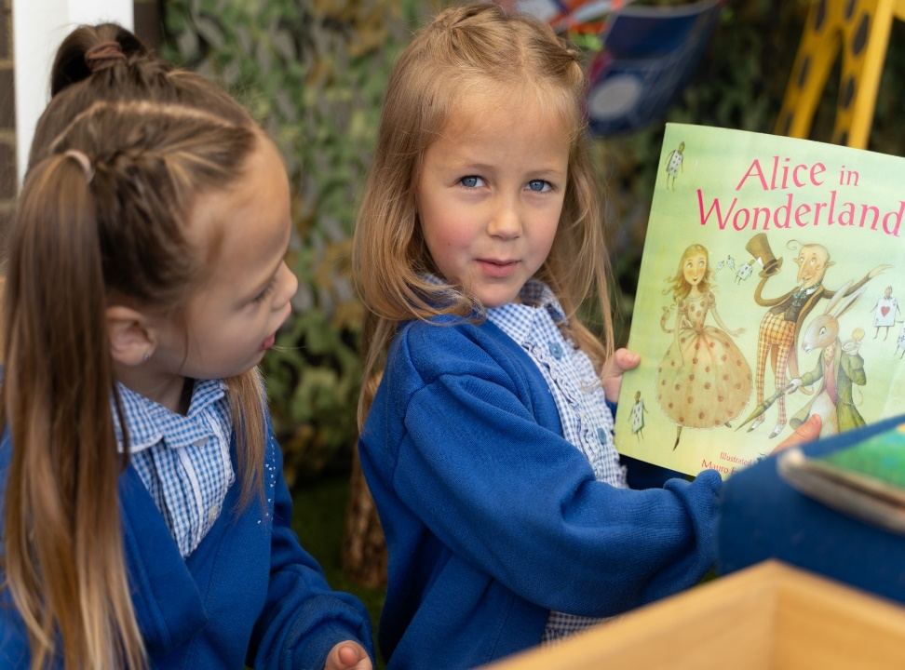


Planning
We plan our provision in collaboration with the children, they have ownership of their learning and engage enthusiastically.
We follow the interests of the children and plan our provision around them. This means we get to teach lots of fun topics such as Superheroes, dinosaurs and traditional tales.
Wiggle to Squiggle
Drawing Club

Slide 13


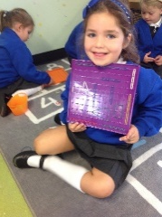
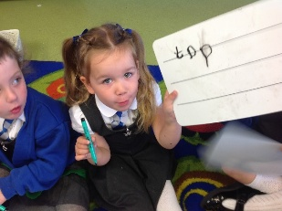
Handwriting
The first skill to forming letters is the development of the muscles that help us to write. Gross motor to fine motor. We will do lots of big writing outside and inside, using various materials and practice making patterns that will help to form letters when the children are ready.
We teach the children letter rhymes to support them with letter formation.
The Little Wandle Handwriting programme is based on the principle of direct teaching of transcription skills. It has been carefully planned to develop the children’s skills in accurate letter formation, with regular review and assessment.

Slide 14
Eating and drinking at school
All children are entitled to free school meals up until the end of Year 2. We encourage parents to make use of this entitlement.
Parents can also choose to provide a packed lunch if your child would prefer.
Distinguished diners!
Children bring in a named water bottle of water to sip throughout the day
Milk and water is provided at lunchtime
Fruit is provided for snacks

Slide 15
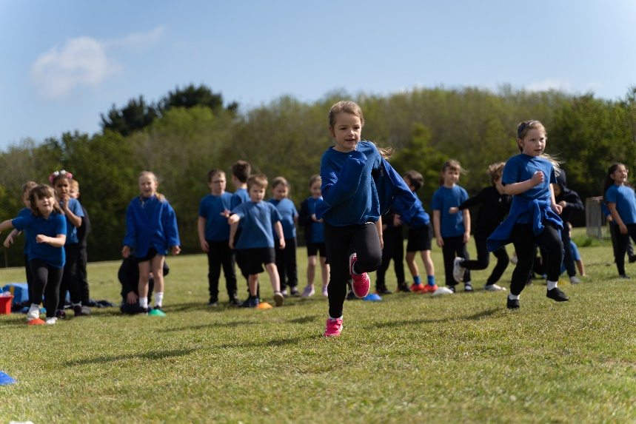
Events
During the Reception year, we go on many school trips. Our local surrounding area trips have been a walk to Talbot Heath and St. Marks Church. Our field trips have seen us take our children to the Light House to watch the Jolly Christmas Postman, Moors Valley, Farmer Palmers, Hengistbury Head and Sandbanks Beach.
In addition to trips we like to keep close links with our parents. We organise phonics and maths workshops so you can see how we teach your child to learn new skills.
Nativity!
Sports day
Forestry School Friday

Slide 16
Clubs
As a school we hold many after school clubs which are all free of charge. There are also some external providers that host paid for clubs
Clubs start for Reception after Christmas. In previous years this has included clubs such as Gymnastics, Multi-Sports, Art & Craft, Numbots and Football
We also hold lunch time clubs such as singing and recorders

Slide 17


How to get ready for school
Eating and Self Care
Use a knife and fork
Open my packed lunch
Wipe my nose
Ask for help when feeling ill
Independence
Put on my shoes and socks
Put on my coat and zip it up
Happy to be away from Mum/ Dad/ Carer
Tidy my belongings and look after my things
Feel confident about starting school

Slide 18


How to get ready for school
Going to the toilet
Use the toilet independently, wipe myself properly and flush
Wash and dry my hands without any help
Sharing and turn taking
Share toys and take turns
Play games with other children

Slide 19
Wrap around care
Talbot Stars is before and after school club for children enrolled at Talbot.
It is a provision for any primary aged child.
Sessions cost £4.50 for Breakfast club and £10.00 for afterschool club.
Children cannot attend the provision unless they have been pre-booked and paid for in advance.
The club is run by members of our school staff, but is independent of school policy.
The school can decline a child attendance at the provision if we feel it is inappropriate for them, or the child behaves in a way that is detrimental to other children attending.

Slide 20
Pupil Premium​ and Free School Meals
Eligible targeted
This covers children in households in receipt of Universal Credit with annual household earnings of £7,400 or less.
These children may attract Pupil Premium and other disadvantage funding for their schools (not ring fenced).
Eligible expanded
This covers children who are in households receiving Universal Credit with annual household earnings exceeding £7,400. Children will be entitled to Free School Meals only.
Once your application has been processed, if you are eligible, we will confirm under which category you are eligible and advise what level of support your child will receive.​
​
​
​

Slide 21
English as an Additional Language
(EAL)
​
​
​

Slide 22
Getting to know your child
Date | Session | Time
Tuesday 16th June | Class Session with parents (Surname A-L) | 1.30pm-2.30pm
Thursday 18th June | Class Session with parents (Surname M-Z) | 1.30pm-2.30pm
Tuesday 23rd June | Class session without parents (Surname A-L) | 1.30pm -2.30pm
Thursday 25th June | Class session without parents ( Surname M-Z) | 1.30pm -2.30pm
Friday 26th June (Transfer Day) | Class session without parents (All Children) | 9.30am- 11am

Slide 23
Starting School at Talbot Primary
week 1 Home visits happen It is a great opportunity for us to meet the children in their home and get to know them.
Children have a staggered start to the school year during week 2 to help them with the transition into school. They then start full time on week 3.

Slide 24
Thank you ☺
For all information regarding your child starting school please visit the school website -Reception Transition 2023
If there are any questions please use the email ReceptionYearGroup@Talbot.poole.sch.uk
or phone the school office on 01202 513981

