Slide 1
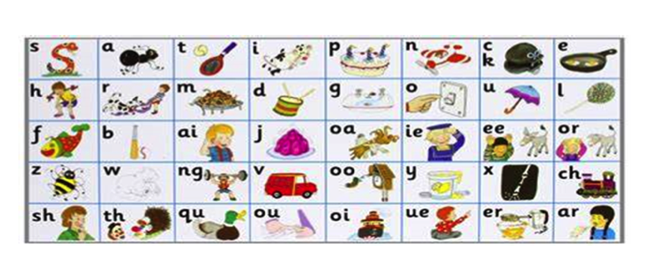
Phonics
WC 08.02.21

Slide 2

Monday 8th February

Slide 3
Recap
ai
or
ow
ee
oa

Slide 4
air

Slide 5

pair

Slide 6

chair

Slide 7

hair

Slide 8
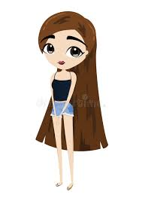
She has long dark hair.

Slide 9
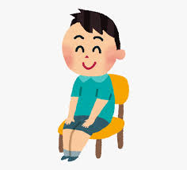
I can sit in the chair.

Slide 10
Tuesday 9th February

Slide 11
Recap
ear
sh
ur
igh
ch

Slide 12
er

Slide 13

tower

Slide 14

ladder

Slide 15

hammer

Slide 16
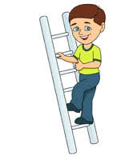
He is up on the ladder.

Slide 17
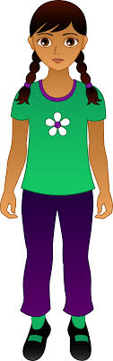

She is bigger than me.

Slide 18
Wednesday 10th February

Slide 19
Recap
qu
oo
oi
th
ng

Slide 20
qu
Consolidate

Slide 21
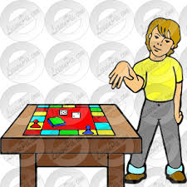
quit

Slide 22

quack

Slide 23
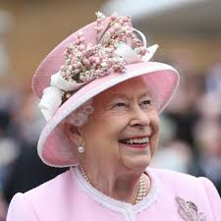
queen

Slide 24
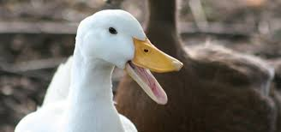
The duck can quack.

Slide 25
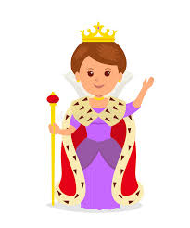

The queen has a ring.

Slide 26
Thursday 11th February

Slide 27
Recap
ur
igh
er
ear
oo

Slide 28
Consolidate
sh

Slide 29

shop

Slide 30
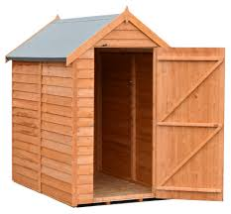
shed

Slide 31


I go to the shop.

Slide 32
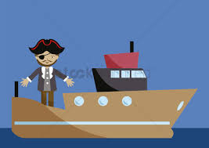
The man is on the ship.

Slide 33
Friday 12th February

Slide 34
Recap
we
he
was
she
me

Slide 35

you

Slide 36

You can see a toad.

Slide 37

Can you get a cup?

Slide 38
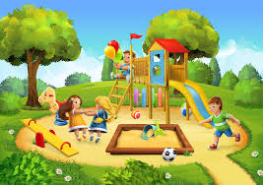
Will you go to the park?

