Slide 1
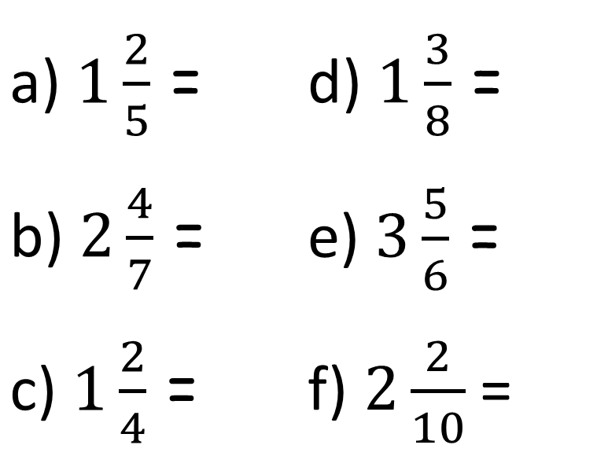
Activity 1 – Write these mixed numbers as improper fractions.
a) $1\frac{2}{5}$ = | d) $1\frac{3}{8}$ =
b) $2\frac{4}{7}$ = | e) $3\frac{5}{6}$ =
c) $1\frac{2}{4}$ = | f) $2\frac{2}{10}$ =
Remember, find out how many pieces there are in the whole numbers first, then add on the ‘extra bit’.
If you finish quickly, try to write and answer some of your own questions.

Slide 2
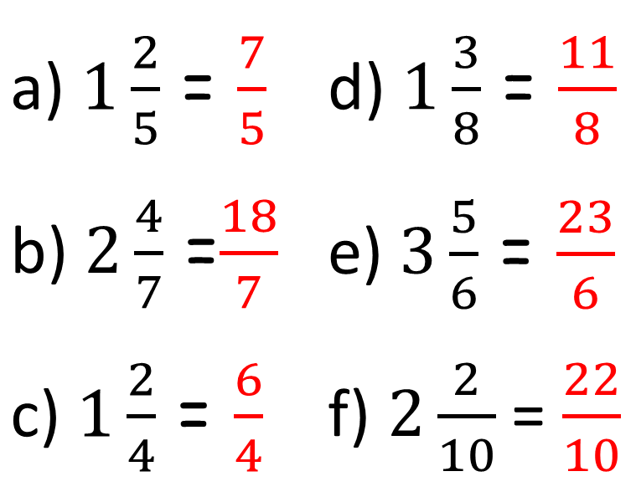
Activity 1 – Write these mixed numbers as improper fractions.
a) $1\frac{2}{5}$ = $\frac{7}{5}$ | d) $1\frac{3}{8}$ = $\frac{11}{8}$
b) $2\frac{4}{7}$ =$\frac{18}{7}$ | e) $3\frac{5}{6}$ = $\frac{23}{6}$
c) $1\frac{2}{4}$ = $\frac{6}{4}$ | f) $2\frac{2}{10}$ = $\frac{22}{10}$
Remember, find out how many pieces there are in the whole numbers first, then add on the ‘extra bit’.
If you finish quickly, try to write and answer some of your own questions.

Slide 3
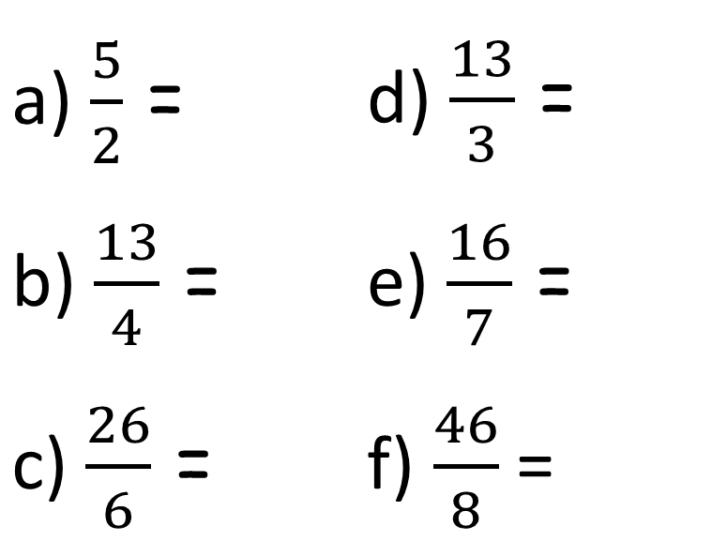
Activity 2 – Write these improper fractions as mixed numbers.
a) $\frac{5}{2}$ = | d) $\frac{13}{3}$ =
b) $\frac{13}{4}$ = | e) $\frac{16}{7}$ =
c) $\frac{26}{6}$ = | f) $\frac{46}{8}$ =
Remember, find out how many whole numbers you have by splitting the fraction into groups.
Then find out how many parts there are left over.
A fact box will help you to do this!

Slide 4
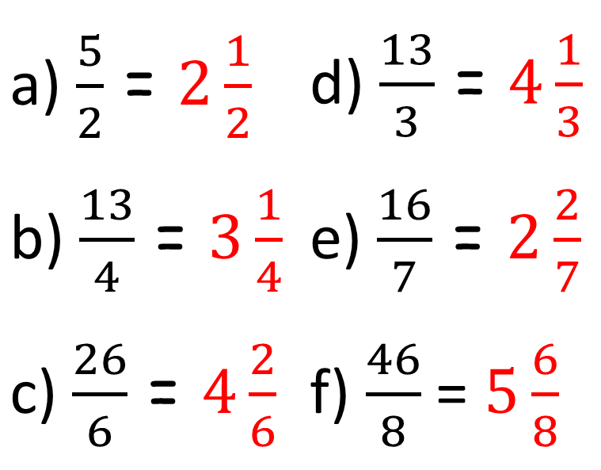
Activity 2 – Write these improper fractions as mixed numbers.
a) $\frac{5}{2}$ = $2\frac{1}{2}$ | d) $\frac{13}{3}$ = $4\frac{1}{3}$
b) $\frac{13}{4}$ = $3\frac{1}{4}$ | e) $\frac{16}{7}$ = $2\frac{2}{7}$
c) $\frac{26}{6}$ = $4\frac{2}{6}$ | f) $\frac{46}{8}$ = $5\frac{6}{8}$
Remember, find out how many whole numbers you have by splitting the fraction into groups.
Then find out how many parts there are left over.
A fact box will help you to do this!

