Slide 1

Handwriting
Spring 2 Lesson 1

Slide 2
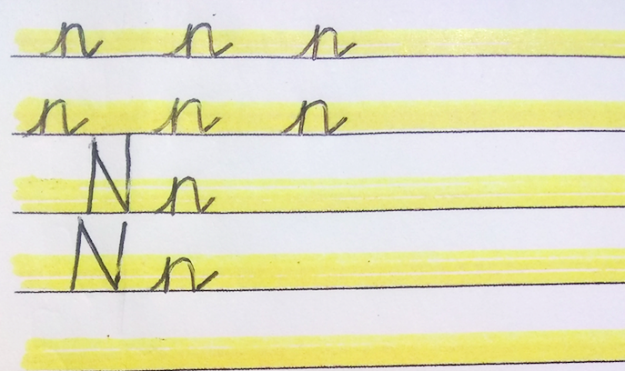
Look carefully at my example.
Practice two rows of capital letter N and cursive ‘n’. Make sure you make the capital letter reach the top of the line.
Practice writing two rows of cursive ‘n’.

Slide 3
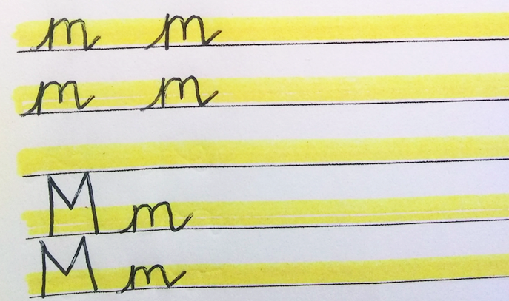
Look carefully at my example.
Practice writing two rows of cursive ‘m’.
Practice two rows of capital letter M and cursive ‘m’. Make sure you make the capital letter reach the top of the line.

Slide 4
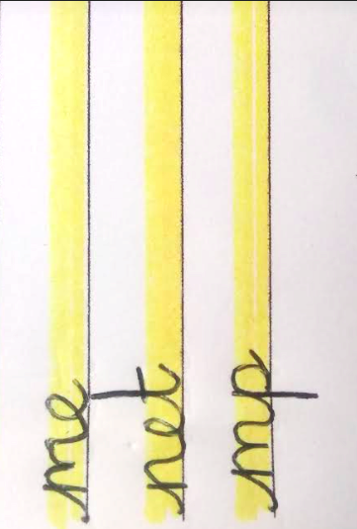
Next try these common joins.

Slide 5
Handwriting
Spring 2 Lesson 2

Slide 6
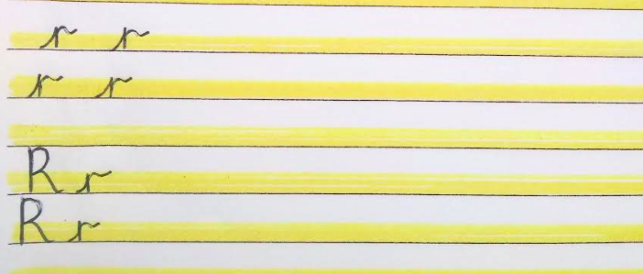
Look carefully at my example.
Practice two rows of capital letter R and cursive r. Make sure you make the capital letter reach the top of the line.

Slide 7
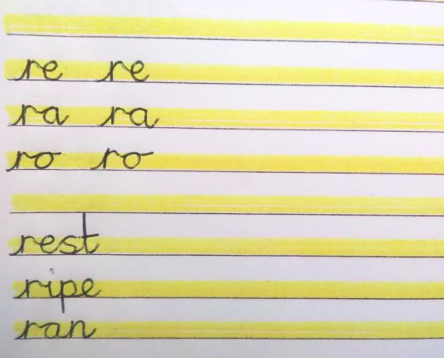
Next try these common joins from the ‘r’ to a vowel.
Finally, try joining these words.

Slide 8
Handwriting
Spring 2 Lesson 3

Slide 9
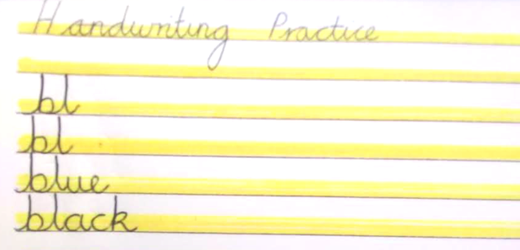
Look carefully at my example.
Practice two rows of the join ‘b’ to the letter ‘l’.
Practice writing the words ‘blue’ and ‘black’ in cursive.

Slide 10
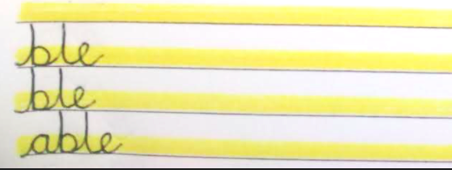
Next, practice joining the letters, ‘ble’ for two rows.
Finally, try joining the suffix, ‘able’. Can you think of any words that end in this suffix?

Slide 11
Handwriting
Spring 2 Lesson 4

Slide 12
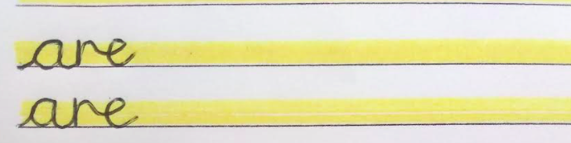
Look carefully at my example.
Practice two rows of the letters, ‘are’

Slide 13
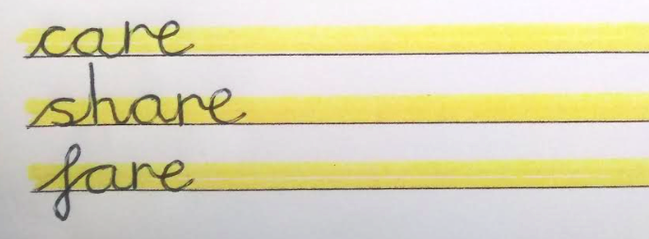
Look carefully at my example.
Practice two rows of the words, ‘care’, ‘share’ and ‘fare.’

Slide 14
Handwriting
Spring 2 Lesson 5

Slide 15
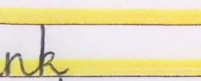
Look carefully at my example.
Practice two rows of the join from the letter ‘n’ to the letter ‘k’.

Slide 16
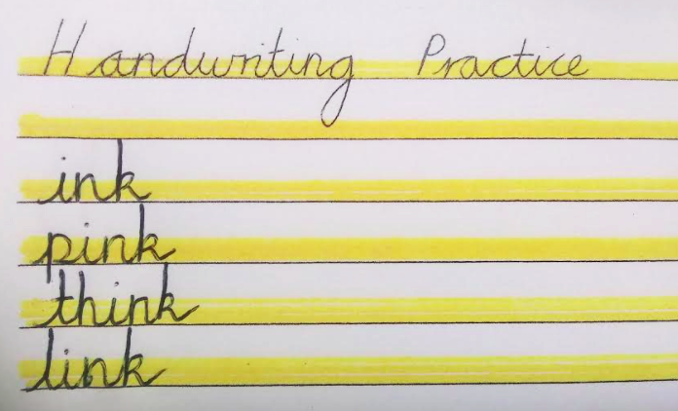
Look carefully at my example.
Practice writing the following words in cursive.

Slide 17
Handwriting
Spring 2 Lesson 6

Slide 18
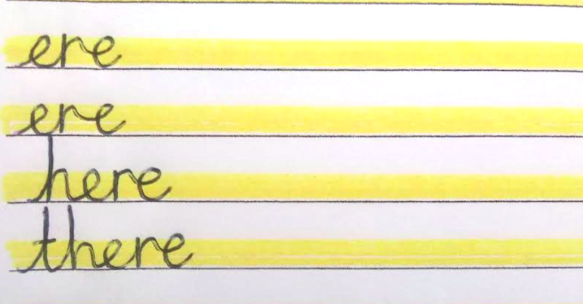
Look carefully at my example.
Practice two rows of the letters, ‘ere’
Practice writing the words ‘there’ and ‘here’ in cursive.

