Slide 1



Slide 2

The Mysteries of Harris Burdick

Slide 3
What do you know about mystery stories?
Have you ever encountered a mystery and tried to solve it?
Which mystery stories have you read?
What are the features in common with mystery stories?

Slide 4
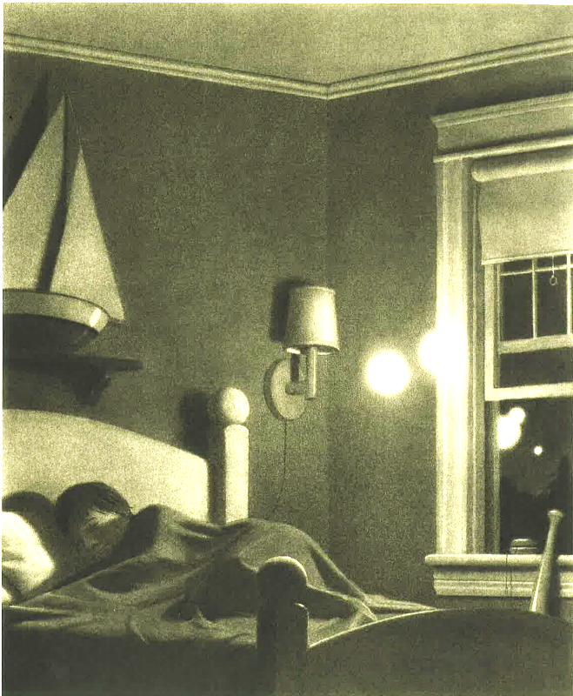
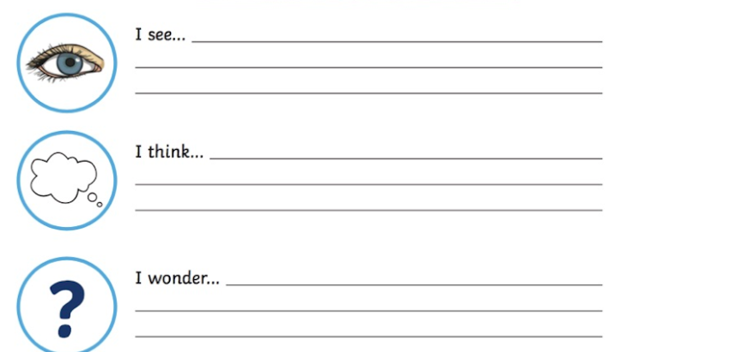
Monday 25th April 2022
LO:To infer and ask questions about an image.
I see
I think
??

Slide 5
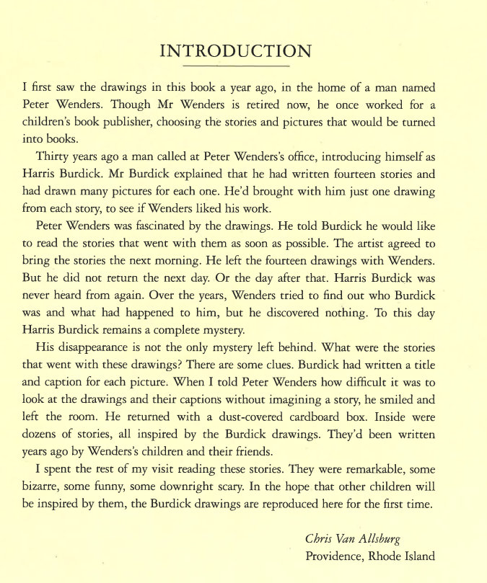

Slide 7
Spelling Practice for whenever it fits in best…
Discuss the meaning of the words and the fact the ch spelling makes a /j/ or /sh/ sound. They are all French words.

Slide 8


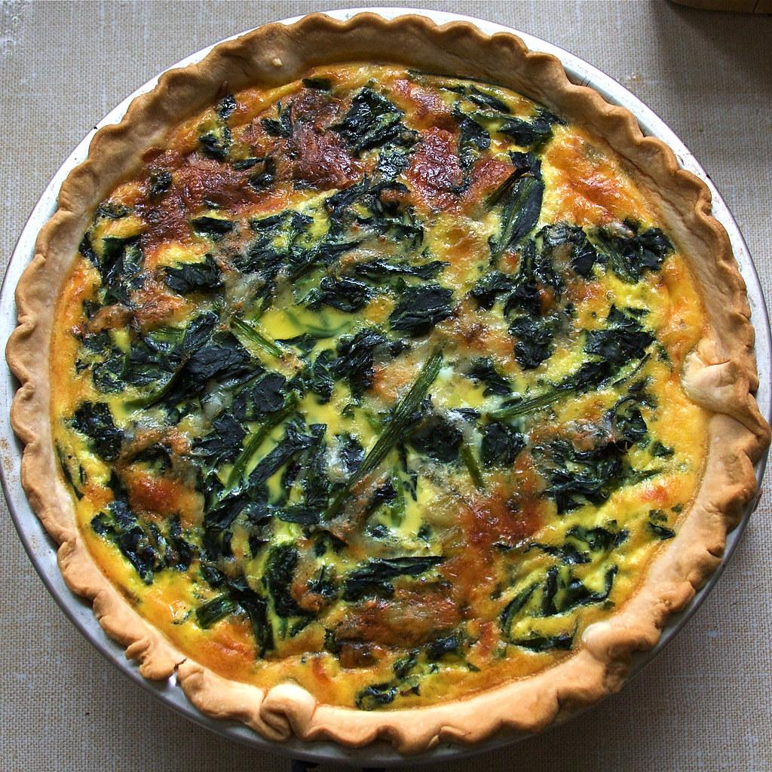
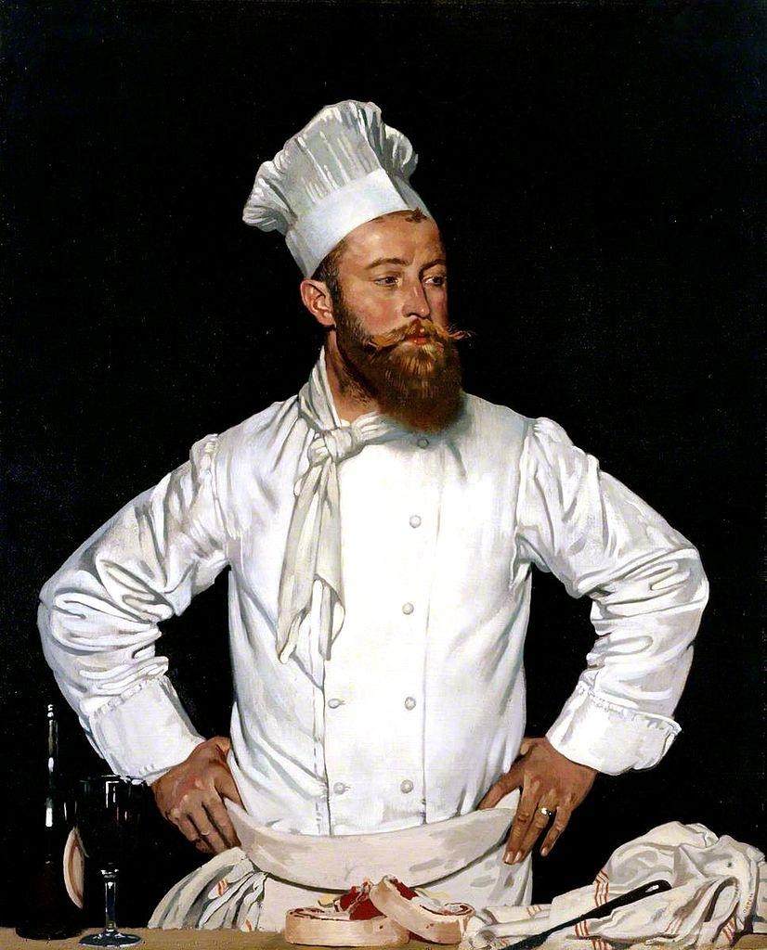
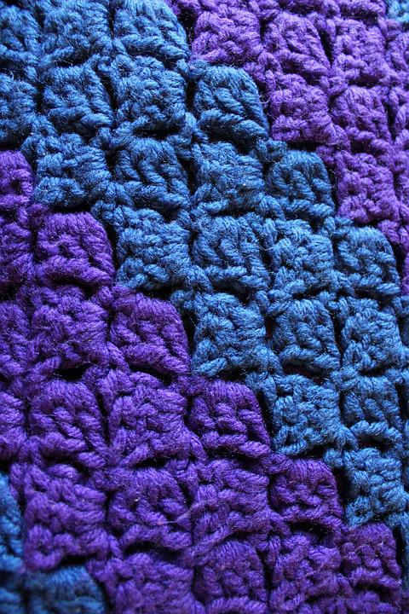
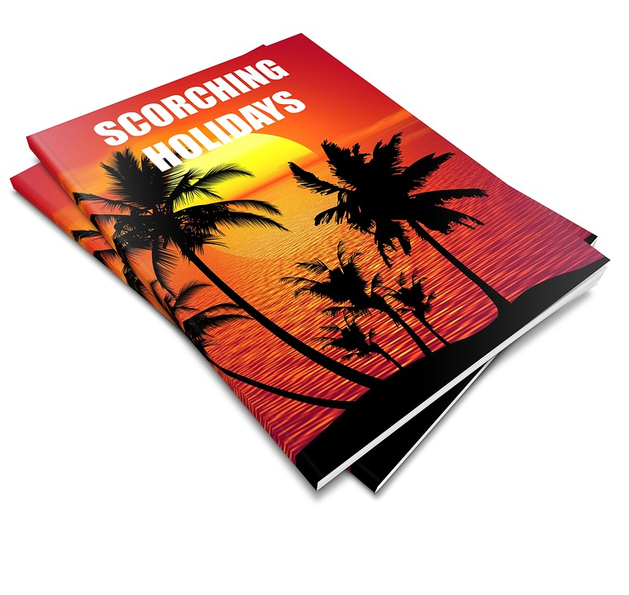
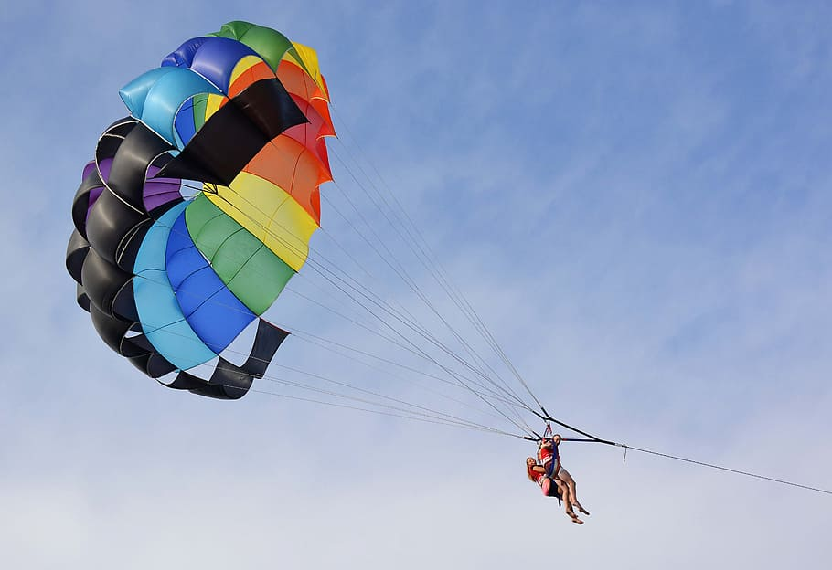
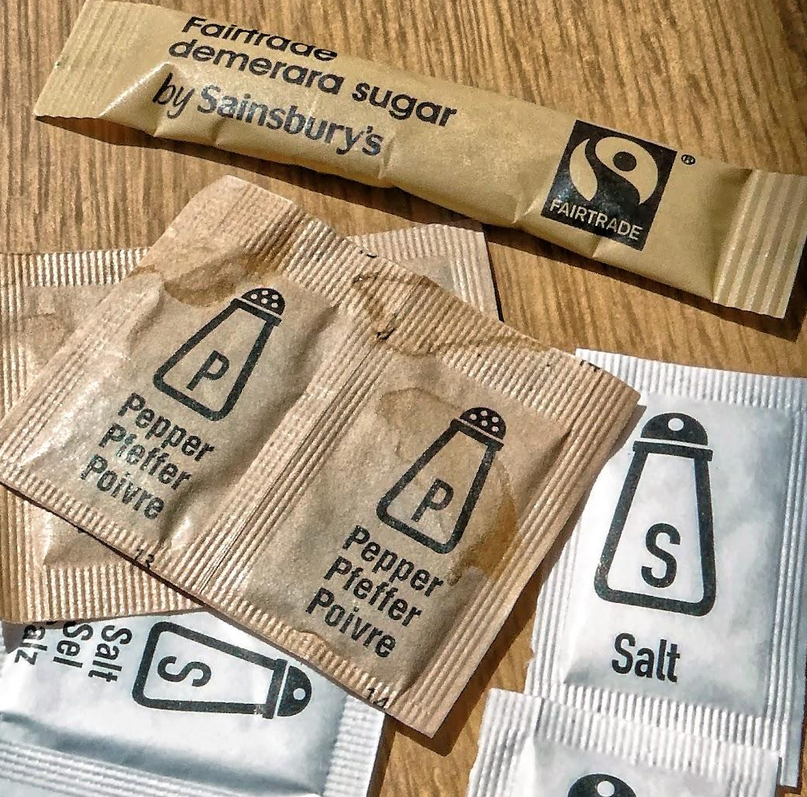
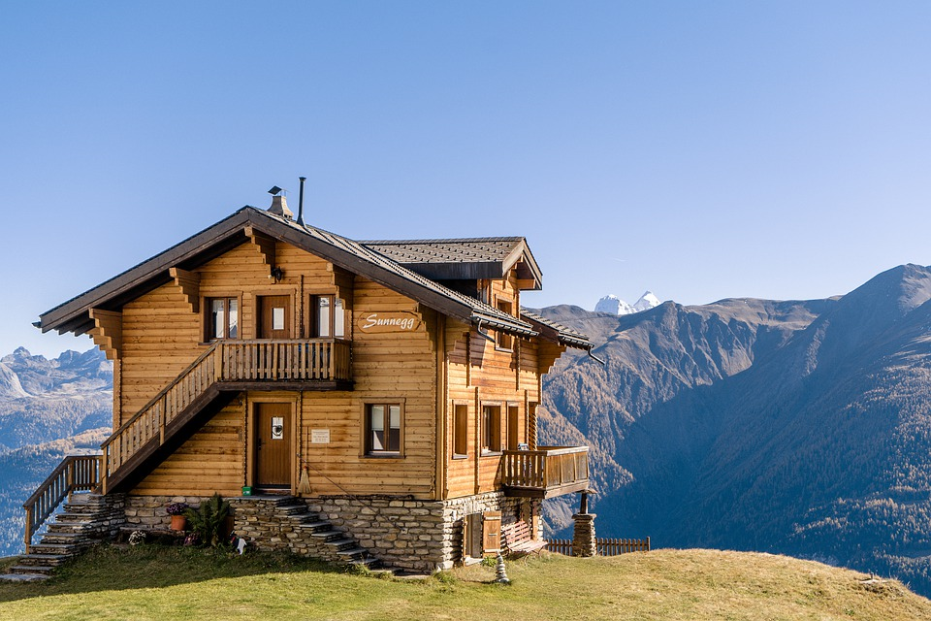
crochet
moustache
chef
quiche
champagne
chalet
parachute
brochure
sachet

Slide 9
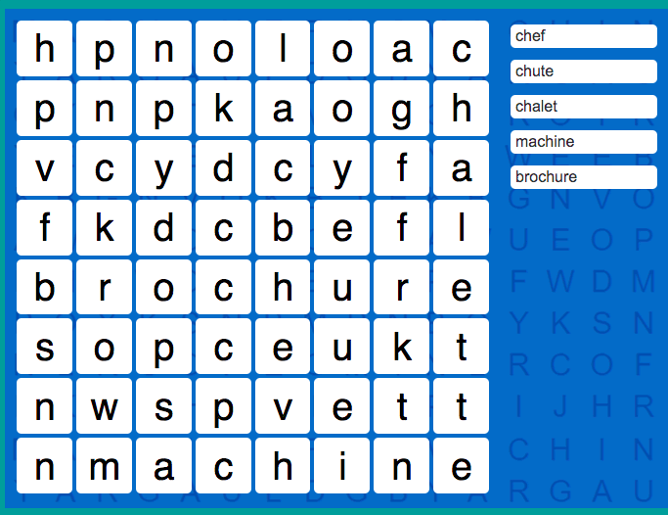
https://www.spellzone.com/word_lists/games-105.htm
https://www.spellzone.com/word_lists/games-105.htm

Slide 10
Tuesday 26th April 2022
LO:To create noun phrases using the preposition ‘of’

Slide 11
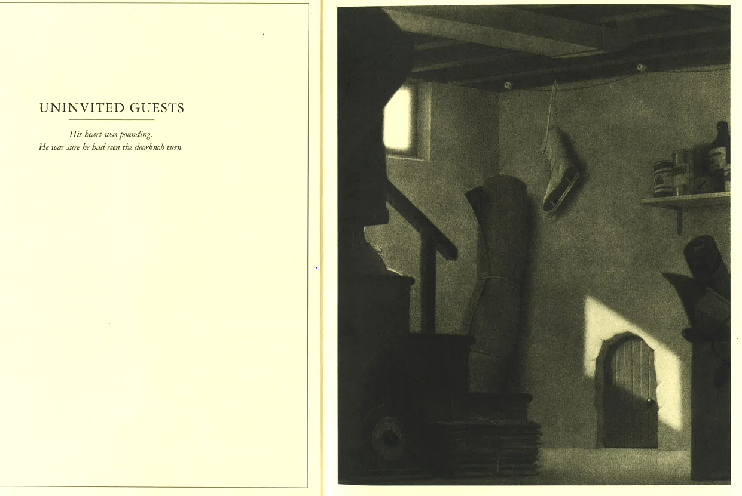

Slide 12
Let’s label the nouns in
this picture. What are the objects made from? Can we add an adjective?
leather ice-skating boot

Slide 13
What sound might the door make? Can you think of a verb (ending in ing) to describe the sound and add it to the start of this phrase?
Free Door Squeaking Sound Effects | MP3 Download | FStudios (fesliyanstudios.com)
_________ of the metal hinge
creaking of the metal hinge
squeaking of the metal hinge
scraping of the metal hinge

Slide 14
Tuesday 26th April 2022
LO:To create noun phrases using the preposition ‘of’
Task:
Describe the objects in the room using:
verb + of + noun phrase.
Use the word bank created together on slide 9 and the ‘ing’ verb word bank as support.
EXAMPLE:
I could hear the squeaking of the metal hinges.

Slide 16
LO:To use prepositions to join noun phrases.
Who would like to share their best sentence from yesterday’s lesson?
Did they remember to use this structure?
verb + of + noun phrase.

Slide 17
What is a preposition?
A preposition can tell the reader where or when something happens.
Today we are going to improve these sentences further by including prepositions instead of beginning with ‘I could hear…’ every time.
An example of a when preposition is ‘At midnight’.Can you think of another example?
An example of a where preposition is ‘above’.Can you think of another example?
https://www.bbc.co.uk/bitesize/topics/zwwp8mn/articles/zw38srd

Slide 18
Now let’s improve our sentences using prepositions. Use the word bank on your table.
I could hear the squeaking of the metal hinges.
At midnight, I could hear the squeaking of the metal hinges.
All around the room, I could hear the squeaking of the metal hinges.
Remember you can try moving the preposition to end of the sentences too.

Slide 19
Now let’s improve our sentences using prepositions. Use the word bank on your table.
I could hear the scraping of a leather ice-skating boot.
Hanging above the door, I could hear the scraping of a leather ice-skating boot.
In a dark corner, I could hear the scraping of a leather ice-skating boot against the wall.

Slide 20
LO:To use prepositions to join noun phrases.
Task:
Rewrite your sentences from yesterday’s lesson including prepositions to improve them.
Use the preposition word bank as support.
EXAMPLE:
All around the room, I could hear the squeaking of the metal hinges.

Slide 22
LO: To create mysterious openers using noun phrases and prepositions.
This week we have been learning to describe a scene using this sentence structure:
verb + of + noun phrase.
As well as the use of prepositions to add further detail.
Today you are going to repeat the same process with a different image from the book. You can choose between these two pictures…

Slide 23
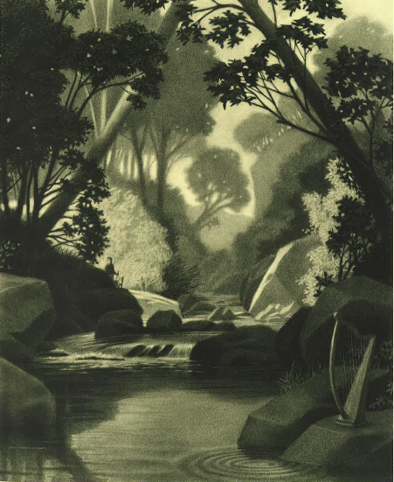
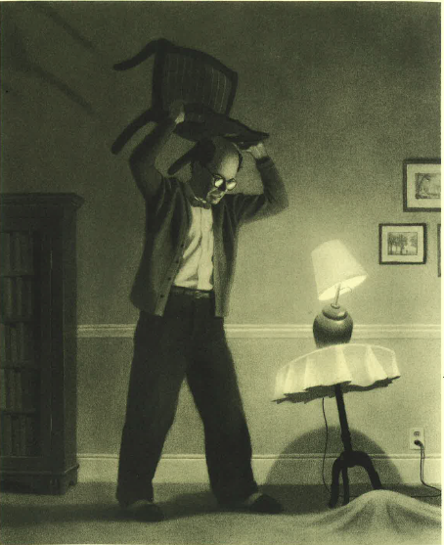

Slide 24
Once you have copied the date/LO into your books, choose and stick in ONE of these images. Label what you can see in the pictures with noun phrases.
golden harp

Slide 25
After you have your noun phrases, think about the sounds that you might hear in the picture (use the sounds word bank from last lesson). Create 2 or 3 sentences using the structure of:
verb + of + noun phrase.
Write the sentences underneath your picture.
an angry, old man
EXAMPLE:
I could hear the bellowing of an angry, old man.

Slide 26
Finally, can you improve your 2 or 3 sentences by adding prepositions? Use the preposition word bank to help you.
Leave a couple of lines, then write your new and improved sentences into your books.
an angry, old man
EXAMPLE:
In the living room, I could hear the bellowing of an angry, old man.

Slide 27
Who would like to share their best sentence from today’s lesson?
Who can spot the prepositional phrases?

Slide 29
Notes:
Session 6 had a difficult task so I’ve just included the main teaching point (about present perfect) as a warm up for the following lesson and skipped on to session 7.

Slide 30
Spelling Test
Answer box

Slide 31
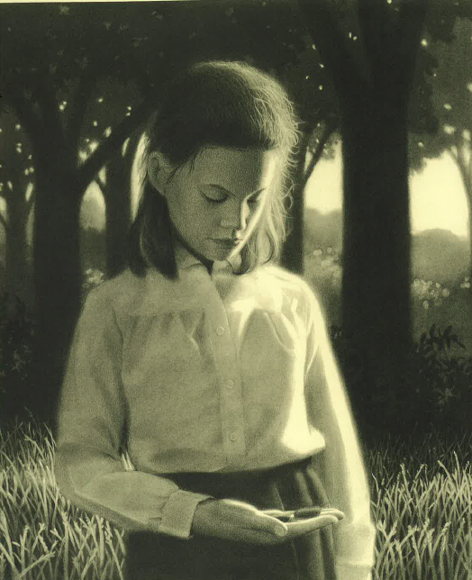
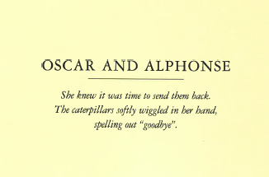
The caterpillars wriggled in my hand.
The caterpillars wriggle in my hand.
The caterpillars have just wriggled in my hand.
How do we know what tense these sentences are in? How does it change the meaning?

Slide 32
Past
Recent past
Now
Past Tense
Present Perfect Tense
Present Tense
The caterpillars have just wriggled in my hand.
The caterpillars wriggle in my hand.
The caterpillars wriggled in my hand.

Slide 33
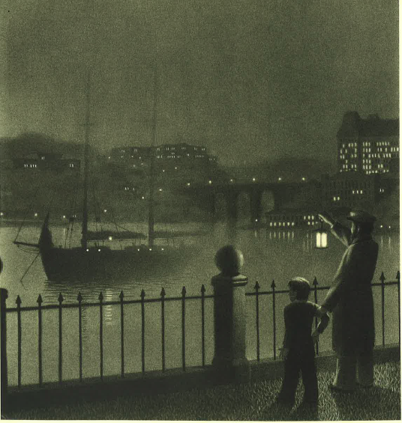
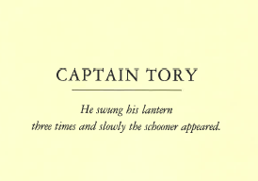
LO:To create dialogue that describes action.
What might the boy and the captain be called? What might they be talking about?

Slide 34
“
“What are you doing?” asked the boy inquisitively.
speech marks
question mark
reporting clause
adverb

Slide 35
First complete the speech bubbles. Next try rewriting the conversation using correct punctuation for direct speech. Remember a new speaker = a new line!

