Slide 1
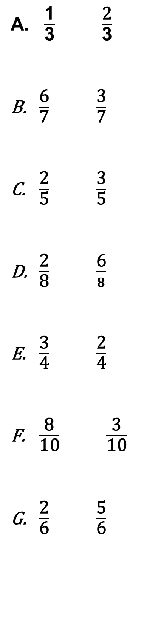
28/04/22
LO: Can I compare fractions?
WTS
$\frac{\text{1}}{\text{3}}$ $\frac{\text{2}}{\text{3}}$
$\frac{\text{6}}{\text{7}}$ $\frac{\text{3}}{\text{7}}$
$\frac{\text{2}}{\text{5}}$ $\frac{\text{3}}{\text{5}}$
$\frac{\text{2}}{\text{8}}$ $\frac{\text{6}}{8}$
$\frac{\text{3}}{\text{4}}$ $\frac{\text{2}}{\text{4}}$
$\frac{\text{8}}{\text{10}}$ $\frac{\text{3}}{\text{10}}$
$\frac{\text{2}}{\text{6}}$ $\frac{\text{5}}{\text{6}}$

Slide 2
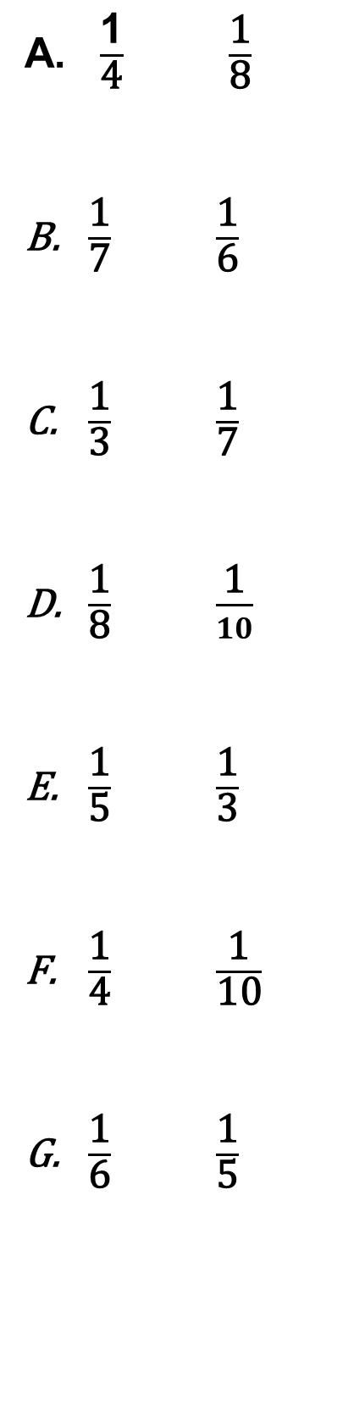
WTS - EXTENSION
$\frac{\text{1}}{\text{4}}$ $\frac{\text{1}}{\text{8}}$
$\frac{\text{1}}{\text{7}}$ $\frac{\text{1}}{\text{6}}$
$\frac{\text{1}}{\text{3}}$ $\frac{\text{1}}{\text{7}}$
$\frac{\text{1}}{\text{8}}$ $\frac{\text{1}}{10}$
$\frac{\text{1}}{\text{5}}$ $\frac{\text{1}}{\text{3}}$
$\frac{\text{1}}{\text{4}}$ $\frac{\text{1}}{\text{10}}$
$\frac{\text{1}}{\text{6}}$ $\frac{\text{1}}{\text{5}}$

Slide 3
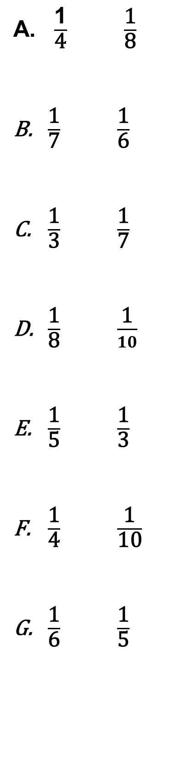
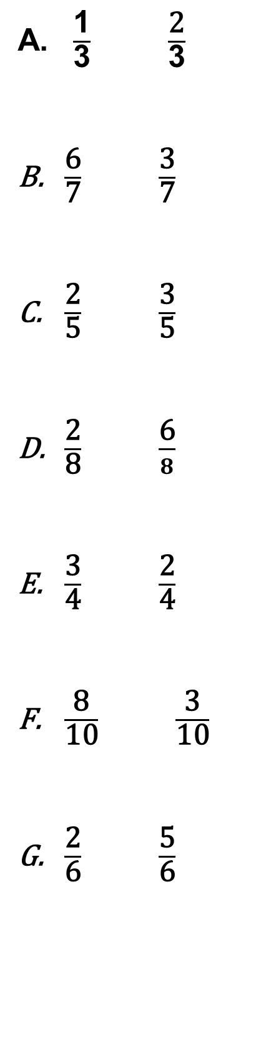
28/04/22
LO: Can I compare fractions?
ARE
$\frac{\text{1}}{\text{3}}$ $\frac{\text{2}}{\text{3}}$
$\frac{\text{6}}{\text{7}}$ $\frac{\text{3}}{\text{7}}$
$\frac{\text{2}}{\text{5}}$ $\frac{\text{3}}{\text{5}}$
$\frac{\text{2}}{\text{8}}$ $\frac{\text{6}}{8}$
$\frac{\text{3}}{\text{4}}$ $\frac{\text{2}}{\text{4}}$
$\frac{\text{8}}{\text{10}}$ $\frac{\text{3}}{\text{10}}$
$\frac{\text{2}}{\text{6}}$ $\frac{\text{5}}{\text{6}}$
$\frac{\text{1}}{\text{4}}$ $\frac{\text{1}}{\text{8}}$
$\frac{\text{1}}{\text{7}}$ $\frac{\text{1}}{\text{6}}$
$\frac{\text{1}}{\text{3}}$ $\frac{\text{1}}{\text{7}}$
$\frac{\text{1}}{\text{8}}$ $\frac{\text{1}}{10}$
$\frac{\text{1}}{\text{5}}$ $\frac{\text{1}}{\text{3}}$
$\frac{\text{1}}{\text{4}}$ $\frac{\text{1}}{\text{10}}$
$\frac{\text{1}}{\text{6}}$ $\frac{\text{1}}{\text{5}}$

Slide 4
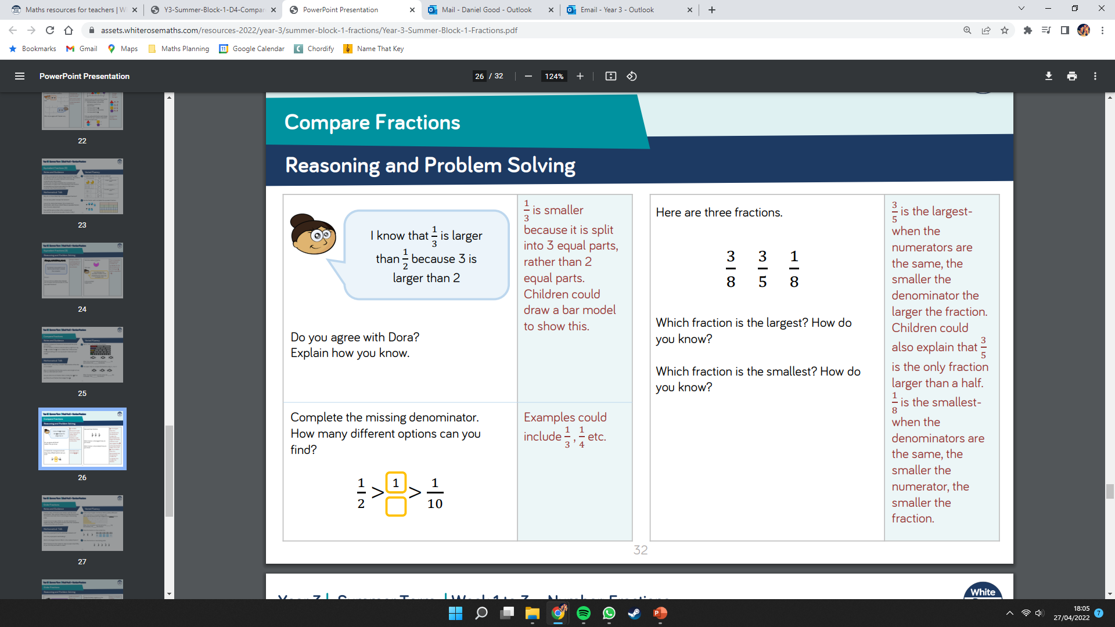
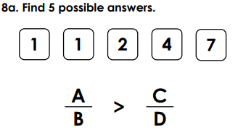
YELLOW

