Slide 1
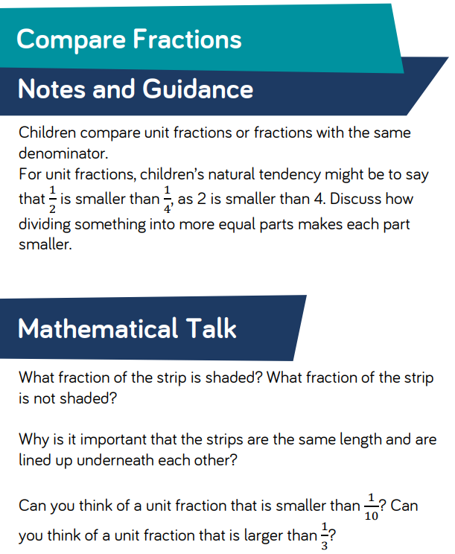
Starter
Warm Up Qs
Guess The Number
ACTIVITY
WTS colour in bars to help solve problems.
Rest of class have same problems but are to copy and complete in their books.
Once completed they can move on to yellow questions.

Slide 2
13 - 4 = ??
9 x 4 = ??
10 + 12 + 10 = ??
Add 43 and 18
How many quarters are equivalent to one half?
What is 3/4 of 20cm?
76 x 3 = ??
½ = 0.?
¼ = ?/8
How many visitors were there all weekend?
Day | Number of Visitors
Saturday | 493
Sunday | 413

Slide 3
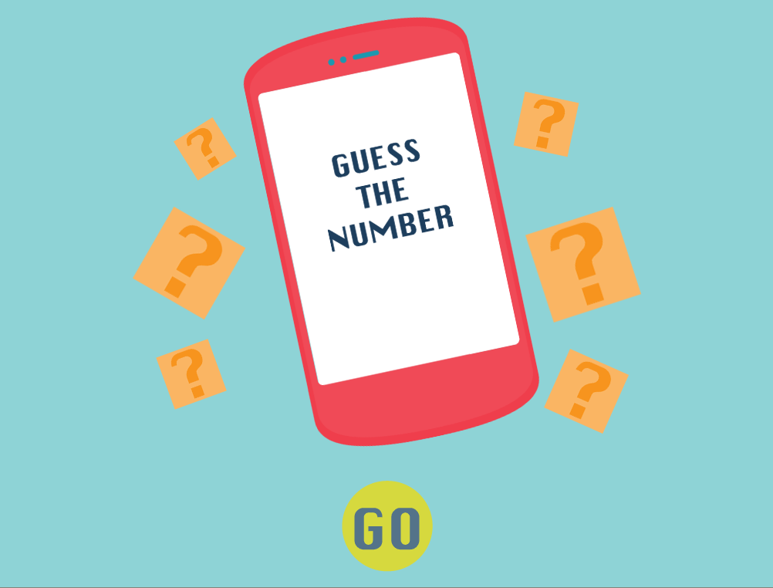
https://www.abcya.com/games/guess_the_number

Slide 4


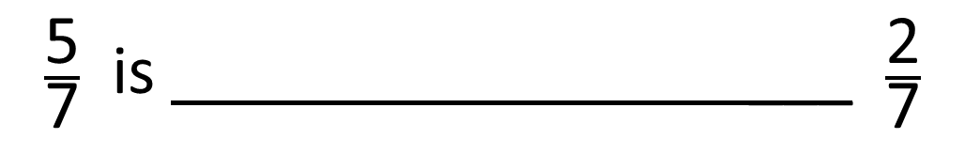
$\frac{\text{5}}{\text{7}}$ $\frac{\text{2}}{\text{7}}$
$$>$$
$\frac{\text{5}}{\text{7}}$ is ___ $\frac{\text{2}}{\text{7}}$
greater than

Slide 5


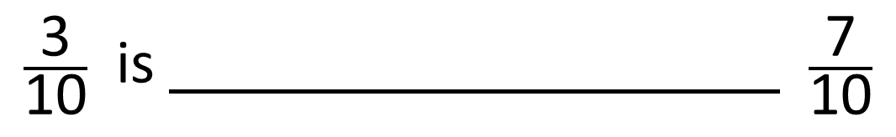
$\frac{\text{3}}{\text{10}}$ $\frac{\text{7}}{\text{10}}$
$$<$$
$\frac{\text{3}}{\text{10}}$ is $\frac{\text{7}}{\text{10}}$
less than

Slide 6


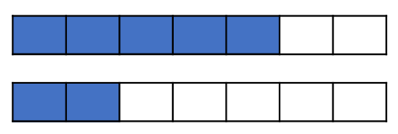
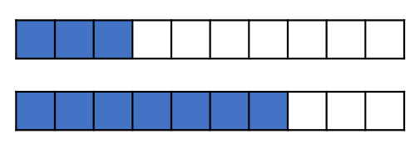
What do you notice?
When the denominators are the same,
the the numerator, the the fraction.
greater
greater
smaller
smaller

Slide 7


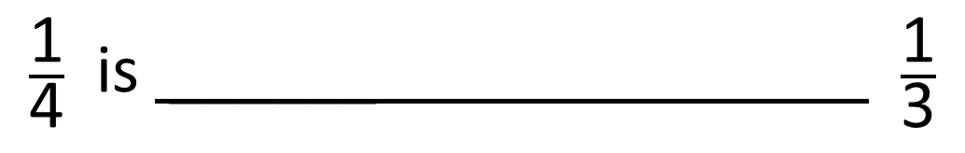
$\frac{\text{1}}{\text{4}}$ $\frac{\text{1}}{\text{3}}$
$$<$$
$\frac{\text{1}}{\text{4}}$ is ______ $\frac{\text{1}}{\text{3}}$
smaller than

Slide 8


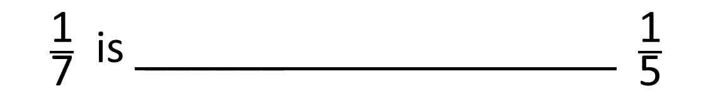
$\frac{\text{1}}{\text{7}}$ $\frac{\text{1}}{\text{5}}$
$$<$$
$\frac{\text{1}}{\text{7}}$ is ______ $\frac{\text{1}}{\text{5}}$
smaller than

Slide 9
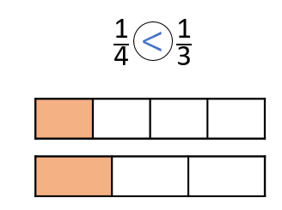
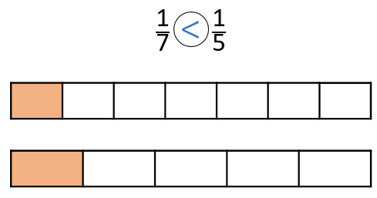
What do you notice?
When the numerators are the same,
the the denominator, the the fraction.
greater
smaller
smaller
greater

Slide 10
28/04/22
LO: Can I compare fractions?
Copy in date and LO
Copy in questions unless you are given a sheet to work on.
Remember our presentation rules for fractions – especially 3DG!

