Slide 1




Challenge Weeks
All elements of this scheme are copyright © The Spelling Shed Ltd and may not be redistributed without permission.
20/10/18

Slide 2
This pack contains a set of activities and games which can be used throughout the year groups during the ‘Challenge Week’ lists. These activities can be used with spellings in any stage.
Each activity comes with an instruction page for children and teacher’s notes where necessary. This can be shared on the board for the children to read rather than printed.
To conserve ink and reduce costs the resources will work effectively in black and white.
1. Battleships
2. Alphabetical Order
3. Define it!
4. The Spelling Web
5. The Synonym Shed
6. Scrabble
7. Memory Challenge
Spelling Search
Cross Words

Slide 3
Battleships
Place your spelling words on your ‘Battleship Grid.’, You can write them in any direction – horizontally, vertically or diagonally.
Take turns to call out a coordinate by calling out a letter and a number.
If your partner calls out a coordinate and there is a letter there mark it with an ’X’.
If someone scores a hit then they can continue to call out letters until they miss.
The winner is the first to sink all of their words.
Teacher Note:
You may want some children to add fewer words to their grid if time is tight during the lesson.
Extension: If a player scores a hit their partner reveals what the letter is. They not down the letters and try to unscramble the hit letters.

Slide 4
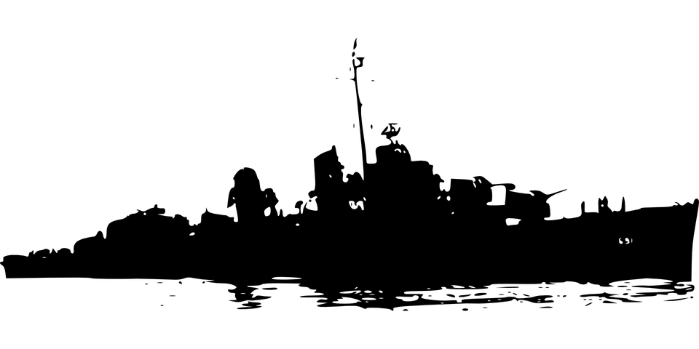
Battleships
My Spelling Ships
12
11
10
9
8
7
6
5
4
3
2
1
 | a | b | c | d | e | f | g | h | i | j | k
My Partner’s Spelling Ships
12
11
10
9
8
7
6
5
4
3
2
1
 | a | b | c | d | e | f | g | h | i | j | k

Slide 5
Alphabetical Order
Place your spelling words in order alphabetically.
If you have more than one word starting with the same letter then you need to look at the next letter.
‘apple’ comes before ‘cucumber’ because a comes before c.
‘apple’ comes after ’alphabet’ because the 2nd letter p comes after the second letter l
a b c d e f g h i j k l m n o p q r s t u v w x y z

Slide 6
Alphabetical Order
Copy your spelling words into the grid on the left.
Rewrite the spellings into the grid on the right in alphabetical order.
My Spellings
Alphabetical Order
a b c d e f g h i j k l m n o p q r s t u v w x y z

Slide 7
Define it!
Find your word in the dictionary and read its definition.
Use the dictionary to create a definition in your own words.
Teacher Note: Online dictionaries are available. We recommend the COBUILD dictionary which is available here: https://www.collinsdictionary.com/

Slide 8
Define it!
Spelling Word | Definition
________________
________________
________________
________________
________________
Spelling Word | Definition
________________
________________
________________
________________
________________

Slide 9
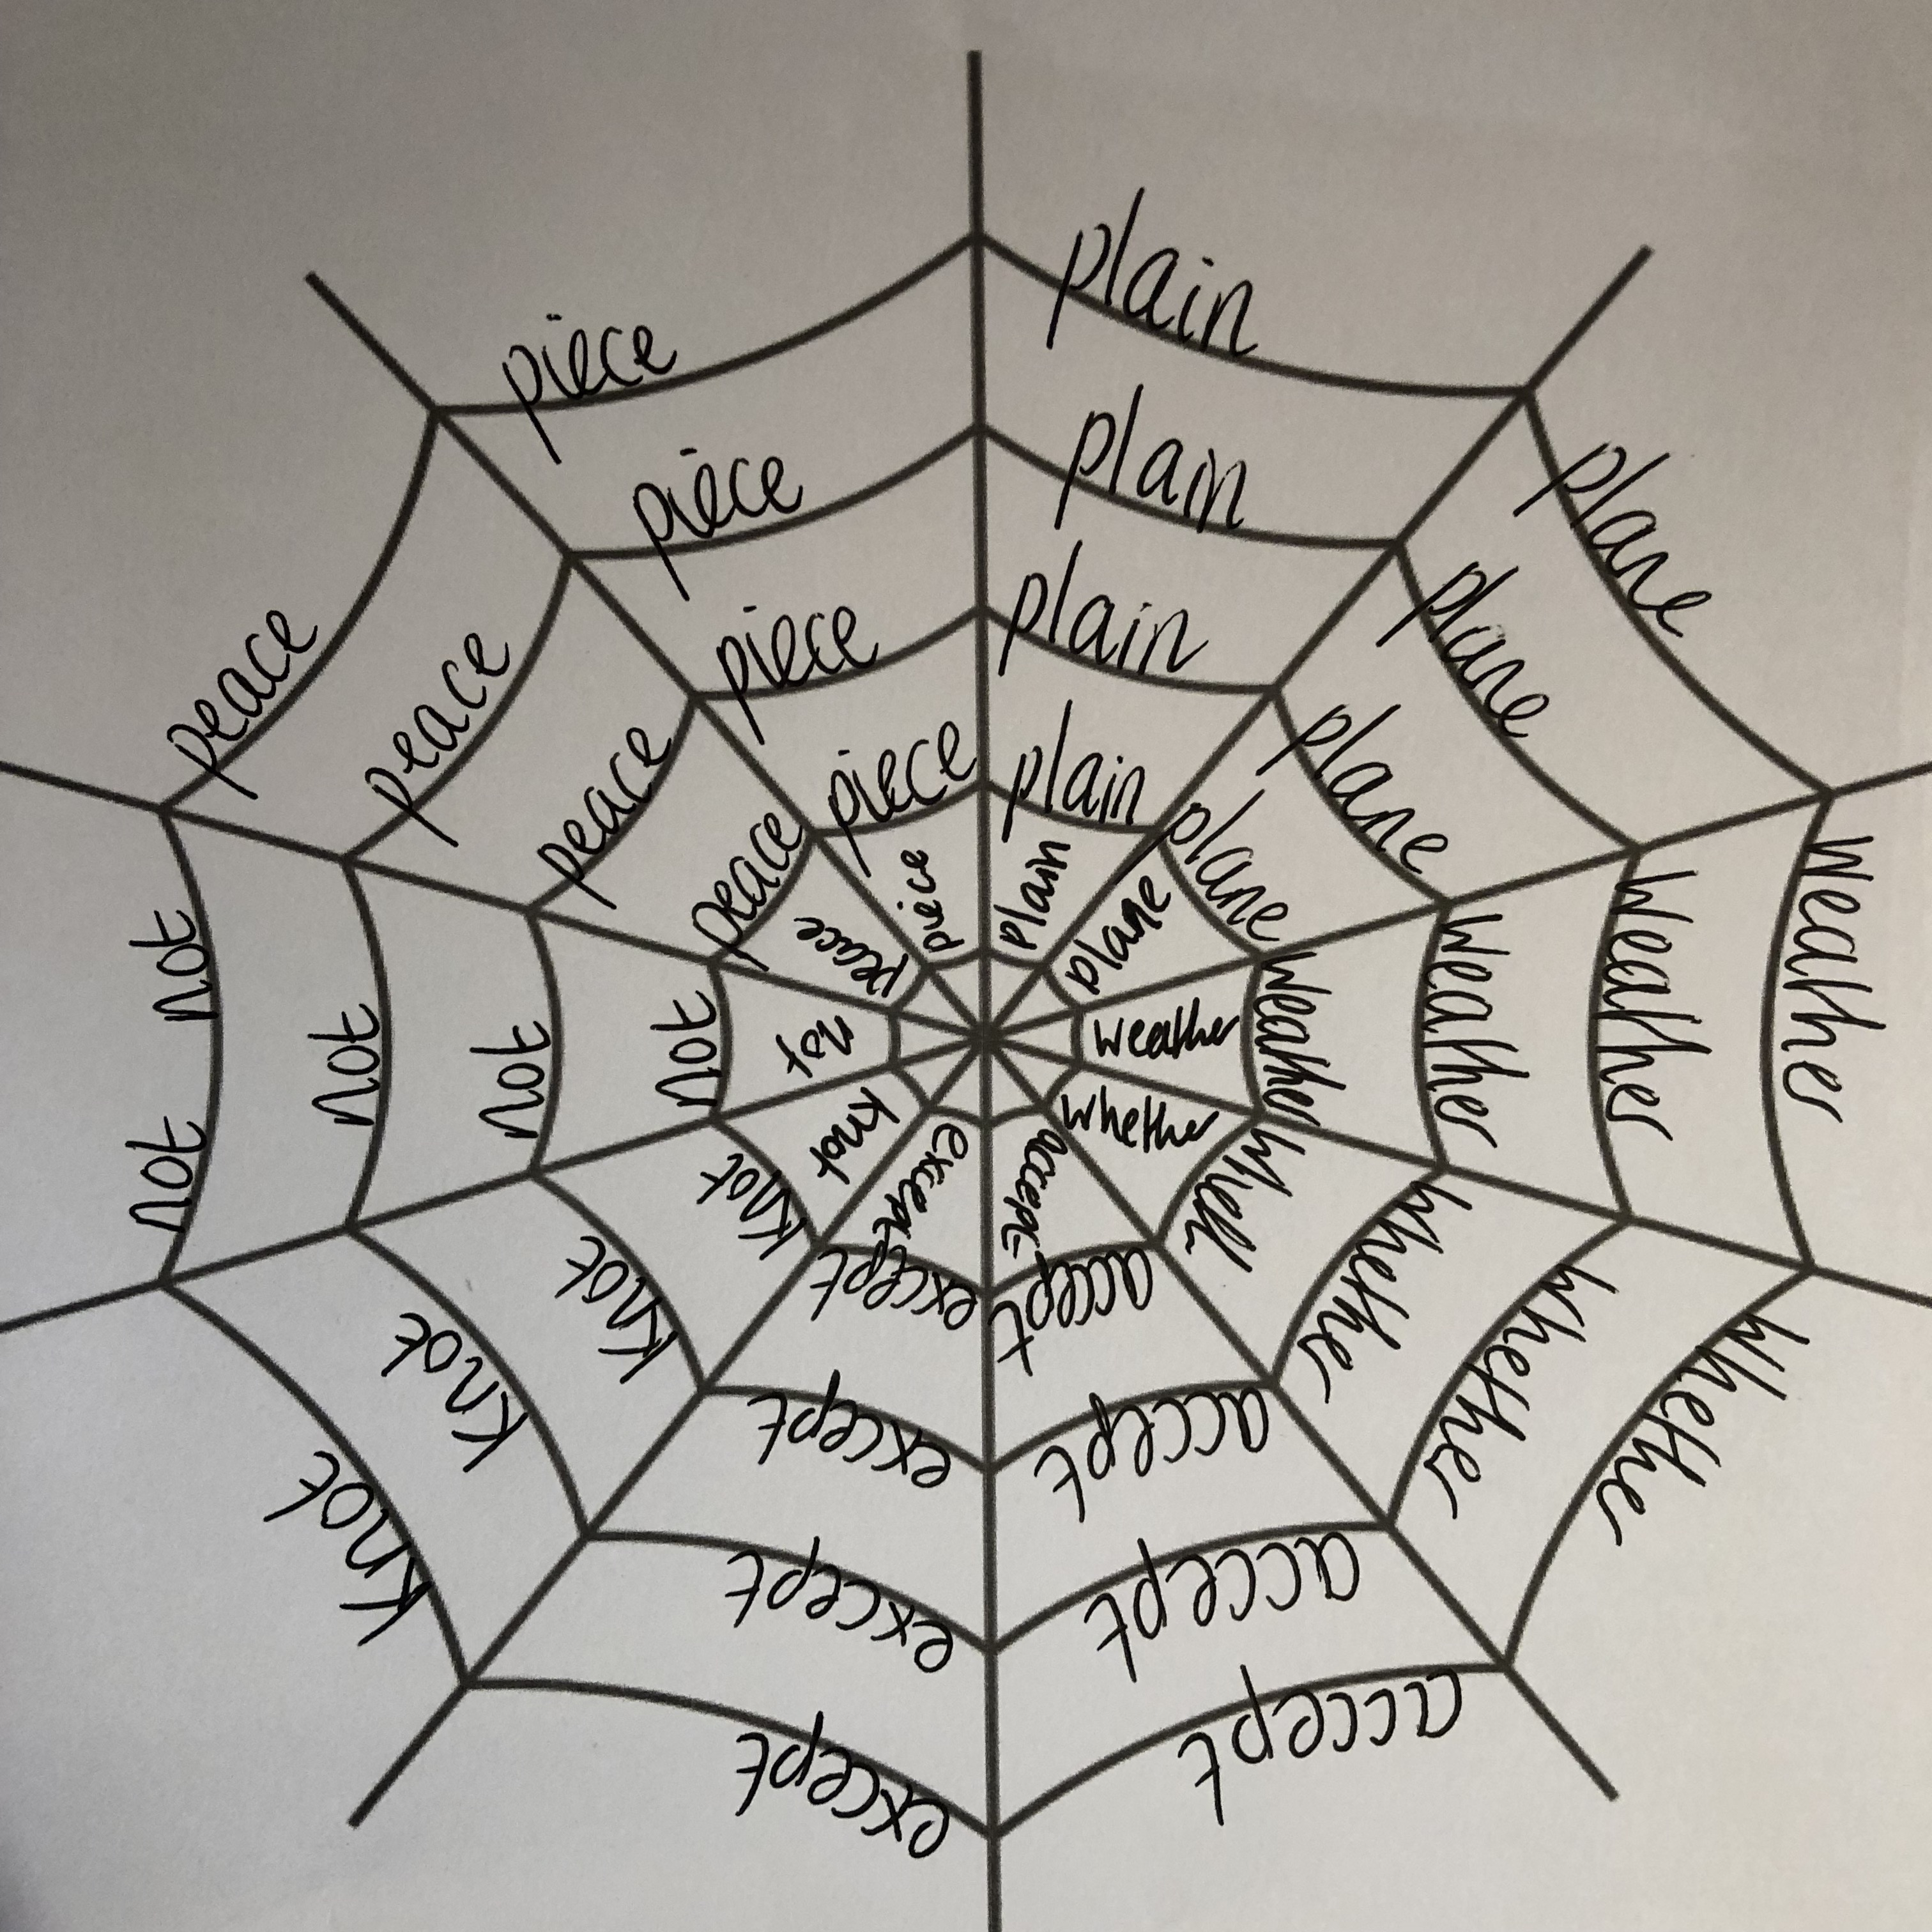
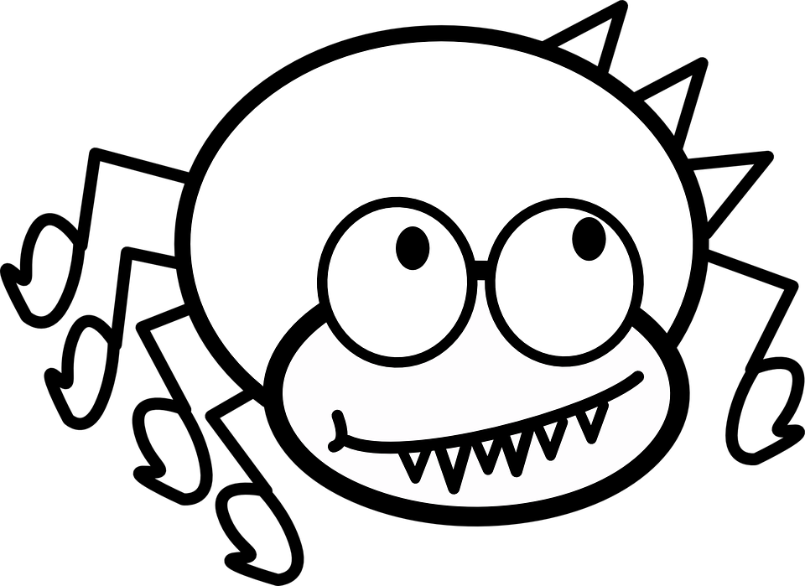
The Spelling Web
Can you help this spelling spider and fill his web with tasty spelling words.
Copy each of your spellings into the web 5 times or more.
You may want to use coloured pencils to make your web stand out.
Ask a partner to check your spellings for you.

Slide 10

The Spelling Web

Slide 11


The Synonym Shed
Welcome to The Synonym Shack here we like to find different words that have
the same meaning.
Put your spelling words on the shack roof and fill it with
words that mean the same.
happy
jolly
cheery
joyful
gleeful
merry

Slide 12
The Synonym Shed

Slide 13

Scrabble
In the game of ‘Scrabble’ letters are given a score.
You can see the scores on the tiles below. A is worth 1 and B is worth 3…
The word bank is worth B – 3 points, A – 1 point, N – 1 point and K – 5 Points so 10 points.
Can you find the score
for each of your words?
Challenge questions
Can you find a word which scores more than 20?
Can you find a word which scores more than 50 or 100?
Can you add a suffix or prefix to one of your spelling words to make them score higher?

Slide 14
Scrabble
Spelling Word | Scrabble Score
________________
________________
________________
________________
________________
Spelling Word | Scrabble Scorer
________________
________________
________________
________________
________________

Slide 15
Memory Challenge
In this game you will play against a partner.
Copy 5 – 10 of your spellings onto a whiteboard.
Allow your partner 30 seconds to study your spellings.
After 30 seconds, secretly rub out one of the spellings, can your partner identify which word is missing?
If they guess it right then they receive a point. If they guess incorrectly then you get a point.
Take turns of writing down the spellings.

Slide 16
Memory Challenge
Teacher Notes
A variation on this game would be for one child to write down 5-8 spellings. In this case, add a word and their partner guesses which word has been added.
They could scramble the letters of one of the words and their partner guesses what the word is.
Children could rub out single letters in one of their words and their partners have to say which letters have been missed out.

Slide 17
Spelling Search
Create a word search of this week’s spellings and challenge one of your friends to solve them.
Can you find where their words are hidden before they find yours?
Step 1. Add the words to the grid. You can add them in any direction – vertically, horizontally, diagonally and even backwards.
Step 2: Add in letters at random to fill in the grid.
Tip: Using letters that are used in the spelling words makes finding the real words more difficult.

Slide 18
Spelling Search

Slide 19
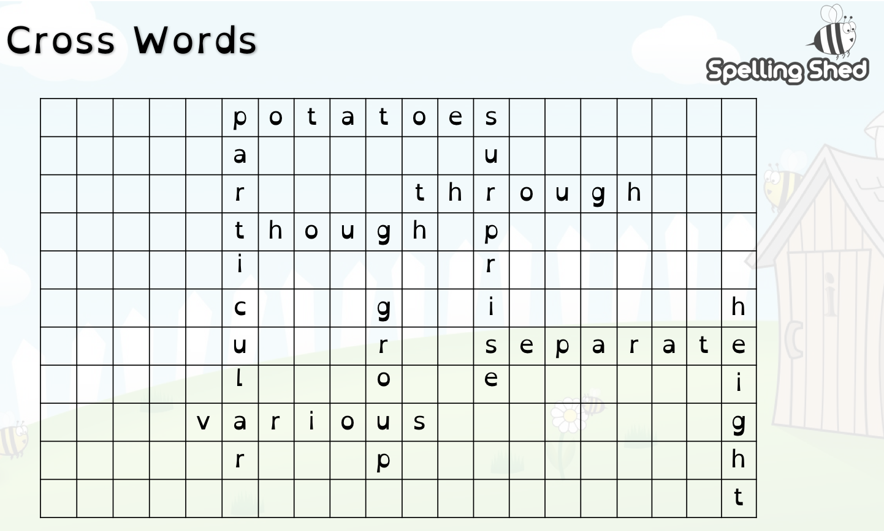
Crosswords
Can you link your words to make a cross word?
Complete the grid by adding your words to link as many words from your list as possible.
Tip: Practise joining words on a whiteboard first, this way you can move them around.
Remember: Your words can be positioned
horizontally, vertically and diagonally.
Example

Slide 20
Cross words

