Slide 1
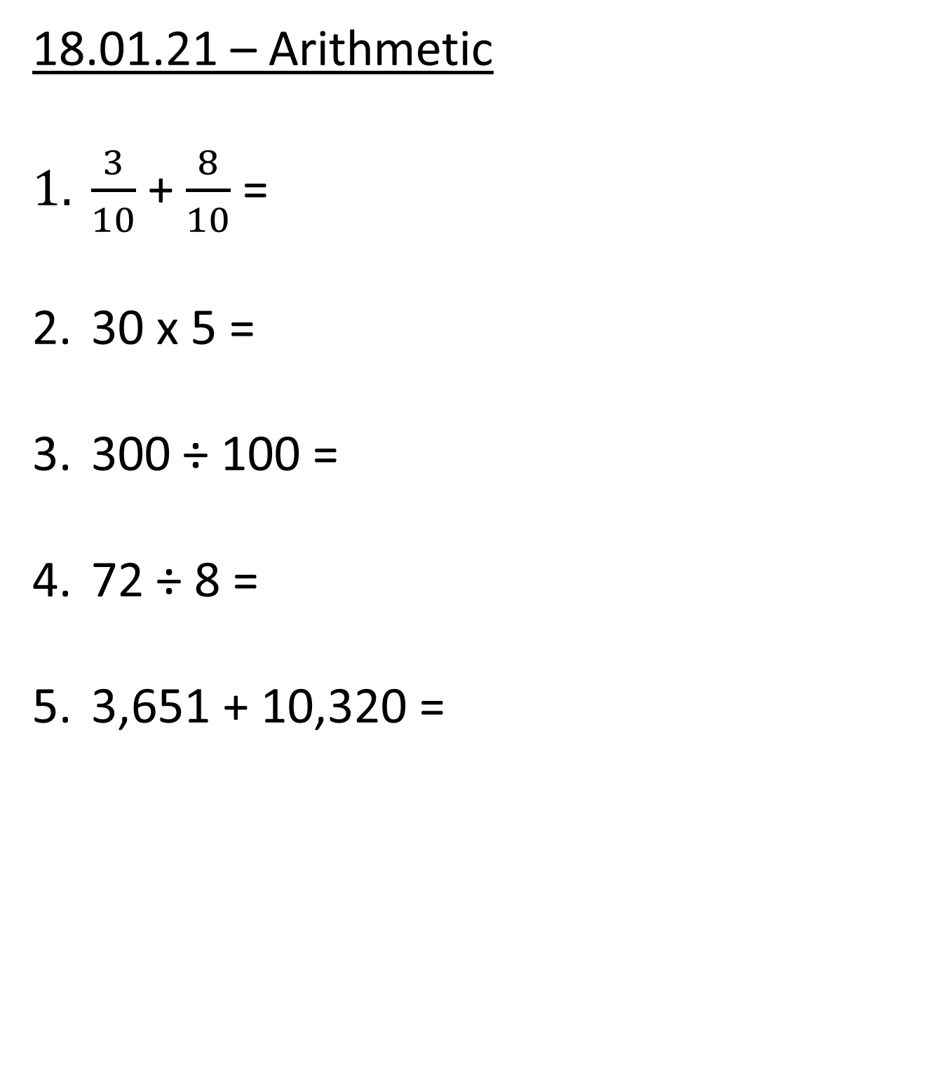
18.01.21 – Arithmetic
$\frac{3}{10}$ + $\frac{8}{10}$ =
30 x 5 =
300 ÷ 100 =
72 ÷ 8 =
3,651 + 10,320 =

Slide 2
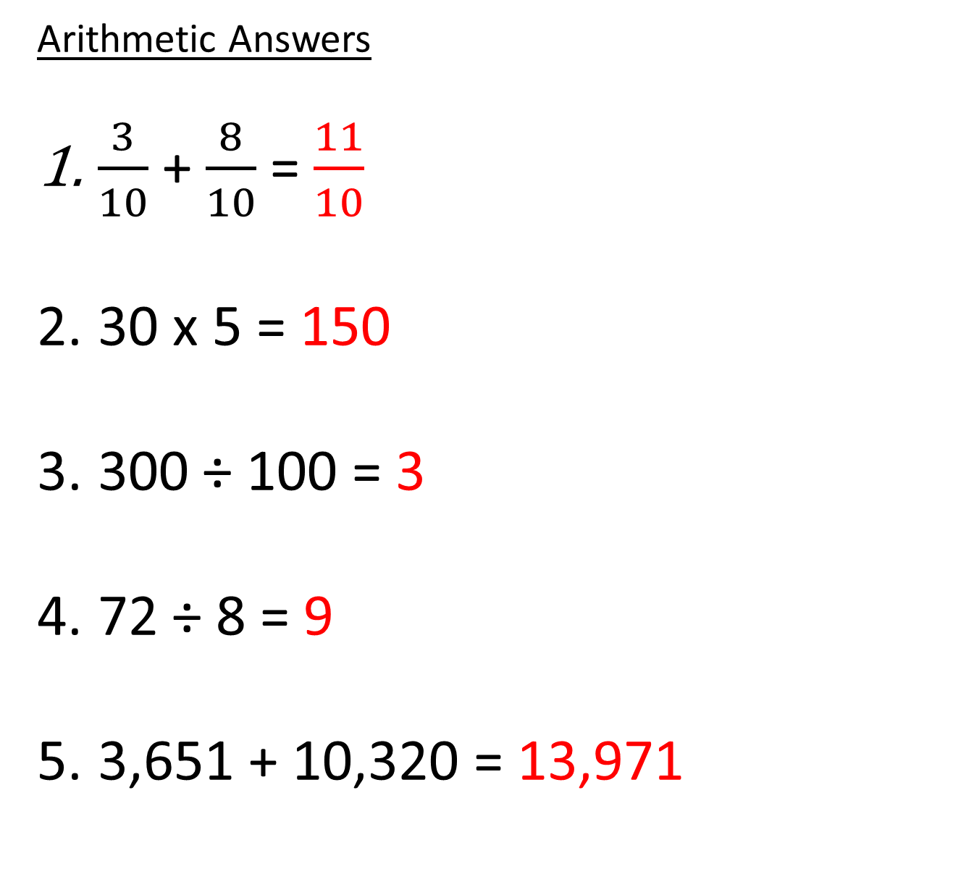
Arithmetic Answers
$\frac{3}{10}$ + $\frac{8}{10}$ = $\frac{11}{10}$
30 x 5 = 150
300 ÷ 100 = 3
72 ÷ 8 = 9
3,651 + 10,320 = 13,971

Slide 3


Slide 5




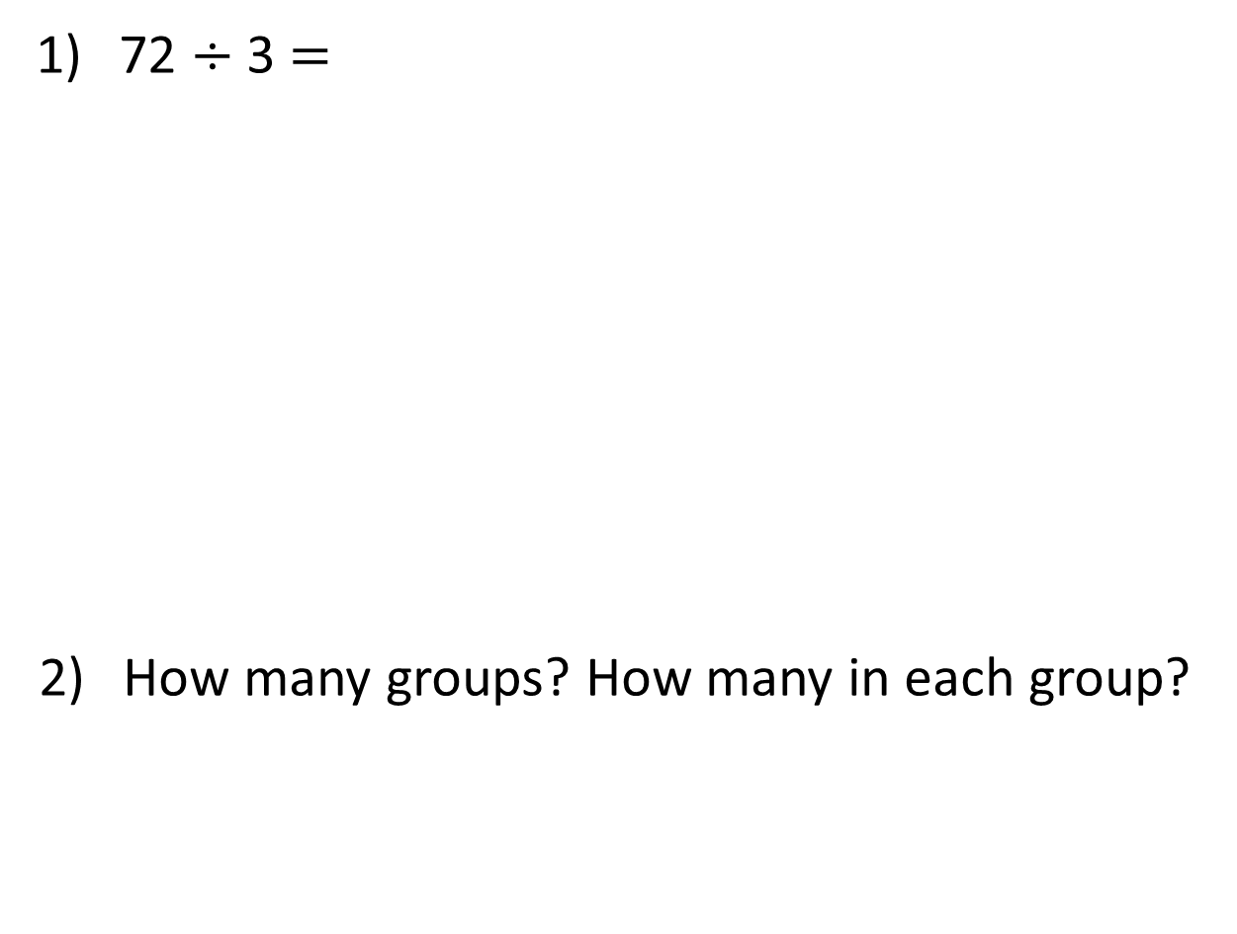
72 $÷$ 3 $=$
How many groups? How many in each group?
Tens | Ones

Slide 6
72 $÷$ 3 $=$
How many groups? How many in each group?
24
Tens | Ones
4 groups
3 in each
3 groups
4 in each

Slide 8

16 ÷ 2
16
There are cubes altogether.
There are groups of 2
16 ÷ 2 =
8
8

Slide 9
16 ÷ 4
There are 16 cubes altogether.
There are groups of 4
16 ÷ 4 =
4
4

Slide 10
16 ÷ 5
There are 16 cubes altogether.
There are groups of 5
There is cube remaining.
16 ÷ 5 = remainder
3
1
3
1

Slide 11

16 ÷ 6
Have a think
There are 16 cubes altogether.
There are groups of
There are cubes remaining.
÷ = remainder
2
6
4
16
6
2
4

Slide 12
Have a go at the questions 1 – 3 on the worksheet

Slide 13
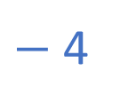
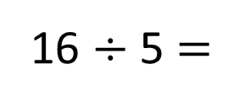
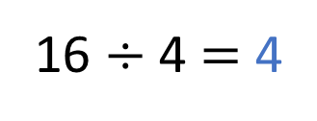
16 ÷ 4 $=$ 4
$−$ 4
0
1
2
3
4
5
6
7
8
9
10
11
12
13
14
15
16
16 ÷ 5 $=$
3
remainder 1
0
1
2
3
4
5
6
7
8
9
10
11
12
13
14
15
16

Slide 14
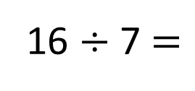
Have a think
16 ÷ 7 $=$
2
remainder 2
0
1
2
3
4
5
6
7
8
9
10
11
12
13
14
15
16

Slide 15

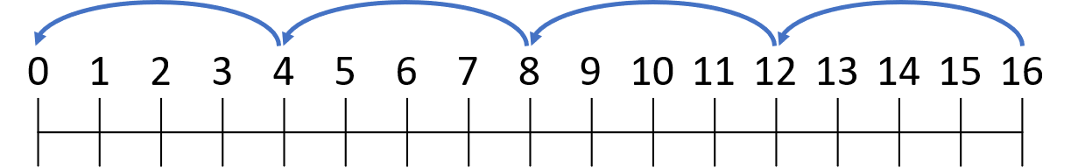
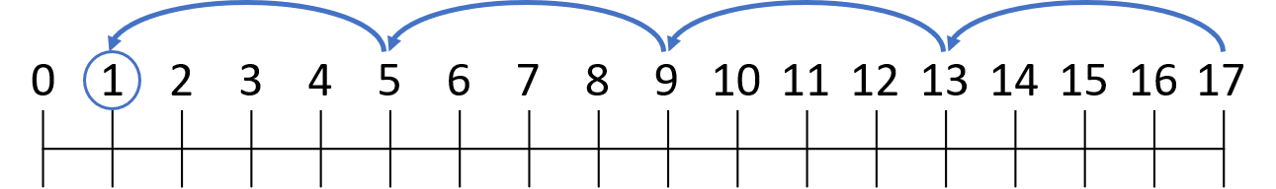
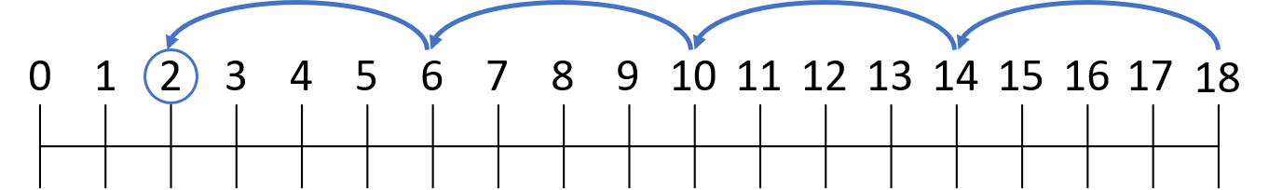
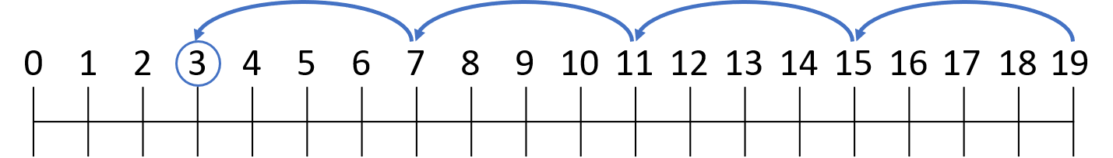
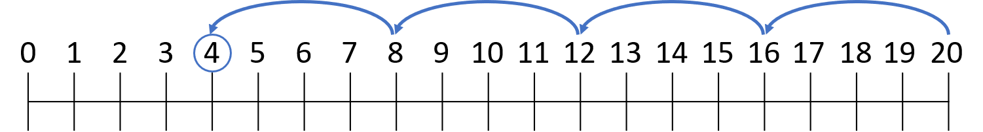
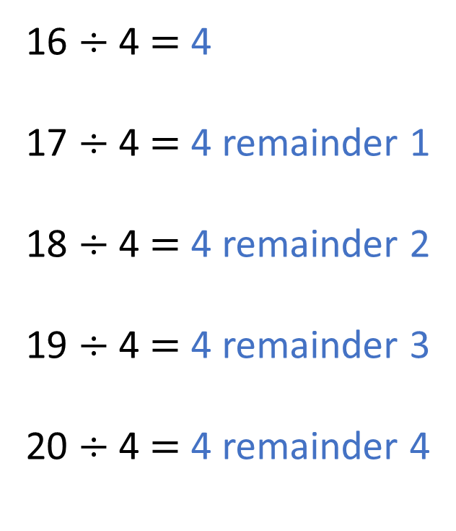
Do you agree with Tiny?
Have a think
16 ÷ 4 $=$ 4
17 ÷ 4 $=$ 4 remainder 1
18 ÷ 4 $=$ 4 remainder 2
19 ÷ 4 $=$ 4 remainder 3
20 ÷ 4 $=$ 4 remainder 4
5

Slide 16
Have a go at the questions 4 – 5 on the worksheet

Slide 17
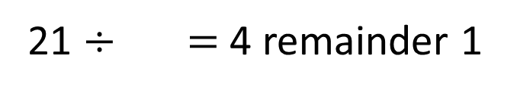
21 $÷$ $=$ 4 remainder 1
5

Slide 18
73 ÷ 3 =
24
remainder 1
Tens | Ones

Slide 19
Have a go at the rest of the questions on the worksheet

