Slide 1
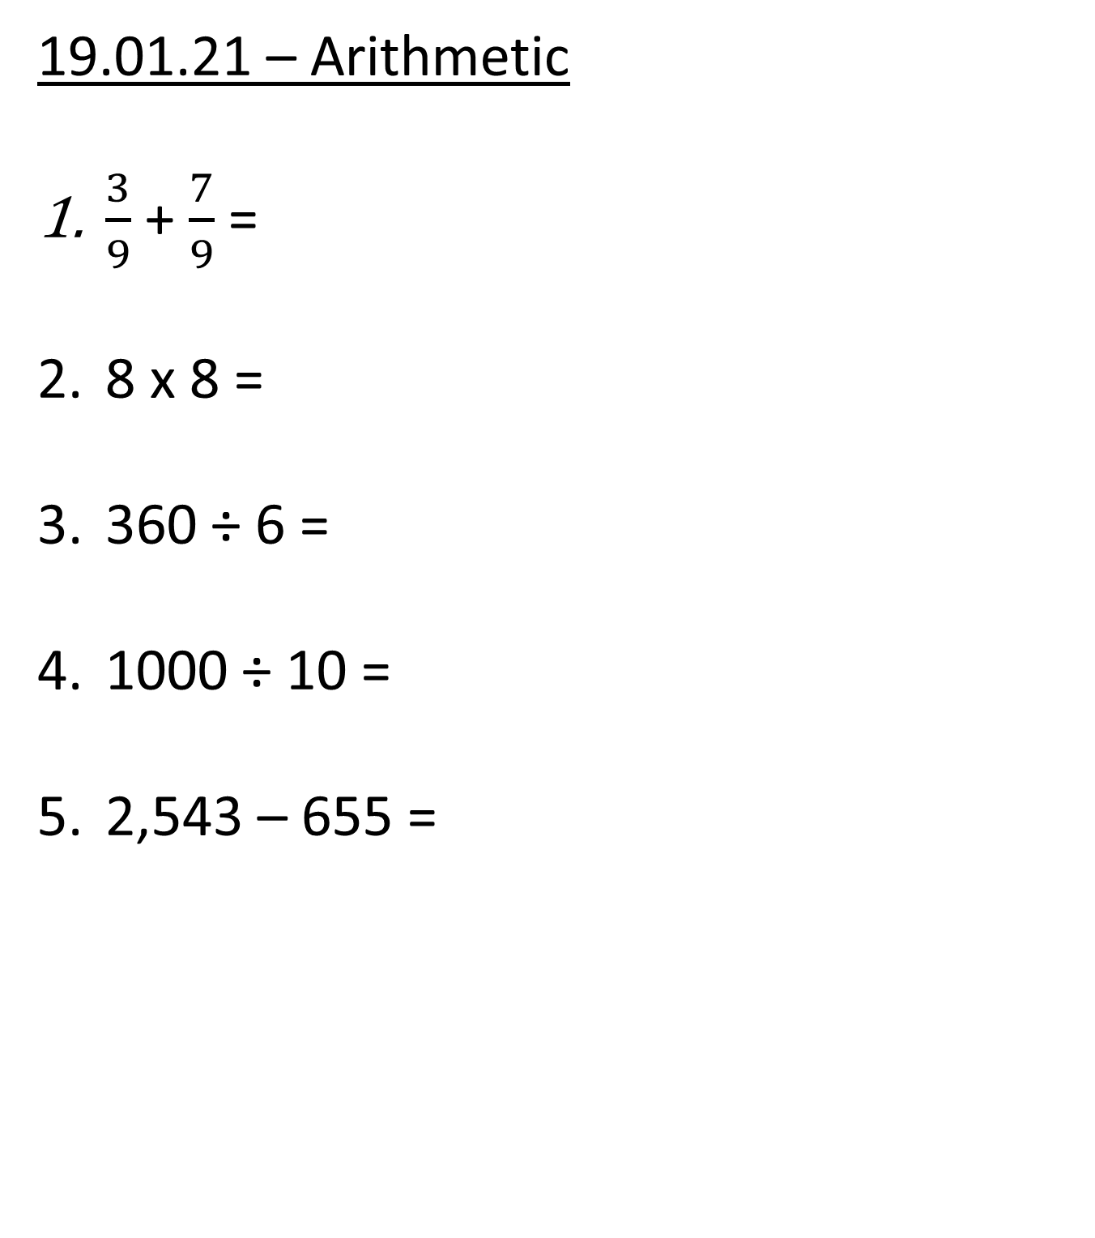
19.01.21 – Arithmetic
$\frac{3}{9}$ + $\frac{7}{9}$ =
8 x 8 =
360 ÷ 6 =
1000 ÷ 10 =
2,543 – 655 =

Slide 2
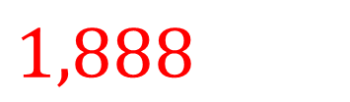
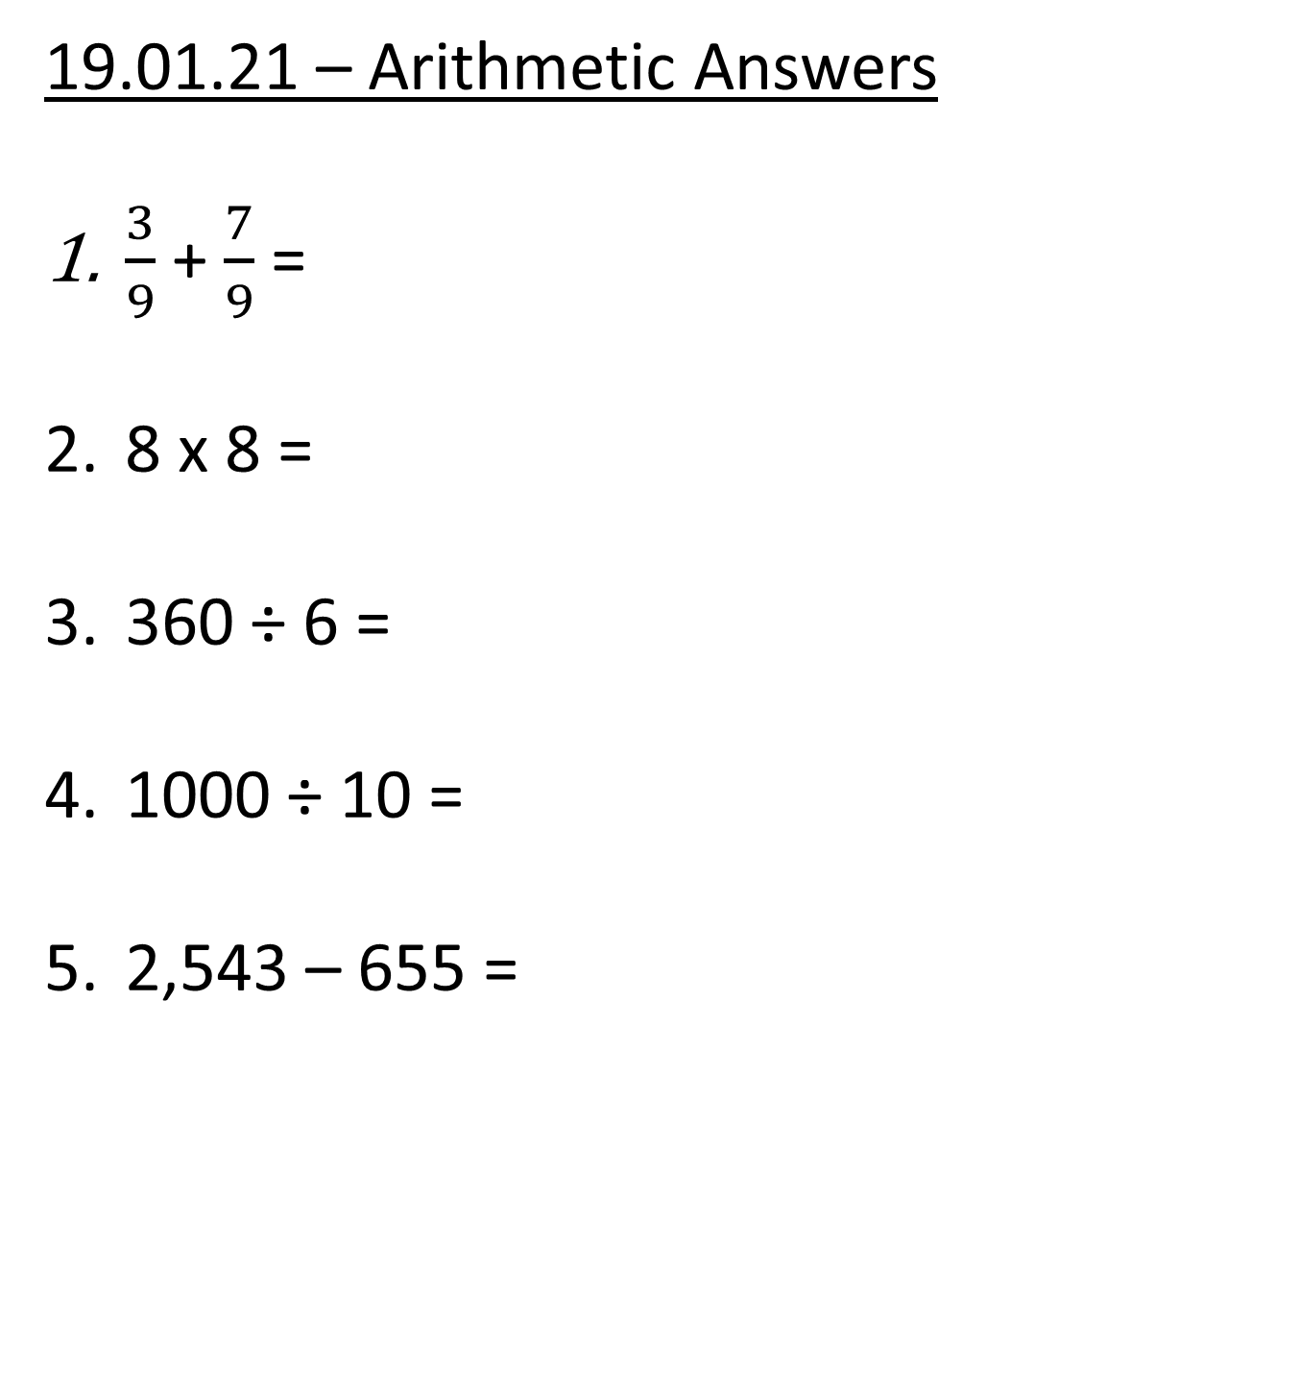



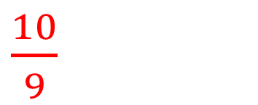
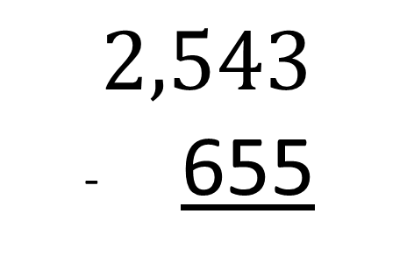
19.01.21 – Arithmetic Answers
$\frac{3}{9}$ + $\frac{7}{9}$ =
8 x 8 =
360 ÷ 6 =
1000 ÷ 10 =
2,543 – 655 =
$\frac{10}{9}$
$64$
$$2,543$$
- 655
$60$
$100$
$1,888$

Slide 3


19.01.21 – LI: 2 digits by 1 digit division with remainders
67 ÷ 3
= 22 r 1
T | O
60
7
÷ 3
÷ 3
20
2 r 1

Slide 4
19.01.21 – LI: 2 digits by 1 digit division with remainders
81 ÷ 6
= 13 r 3
T | O
60
21
÷ 6
÷ 6
10
3 r 3

Slide 5
19.01.21 – LI: 2 digits by 1 digit division with remainders
97 ÷ 6
= 16 r 1
97 ÷ 6
= 16 r 1
90
7
60
37
÷ 6
÷ 6
÷ 6
÷ 6
15
1 r 1
10
6 r 1

Slide 6
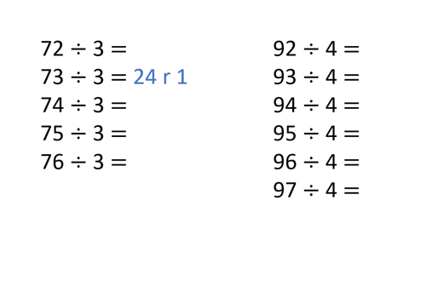

23

Slide 7
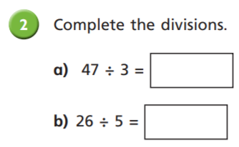
19.01.21 – LI: 2 digits by 1 digit division with remainders

