Slide 1
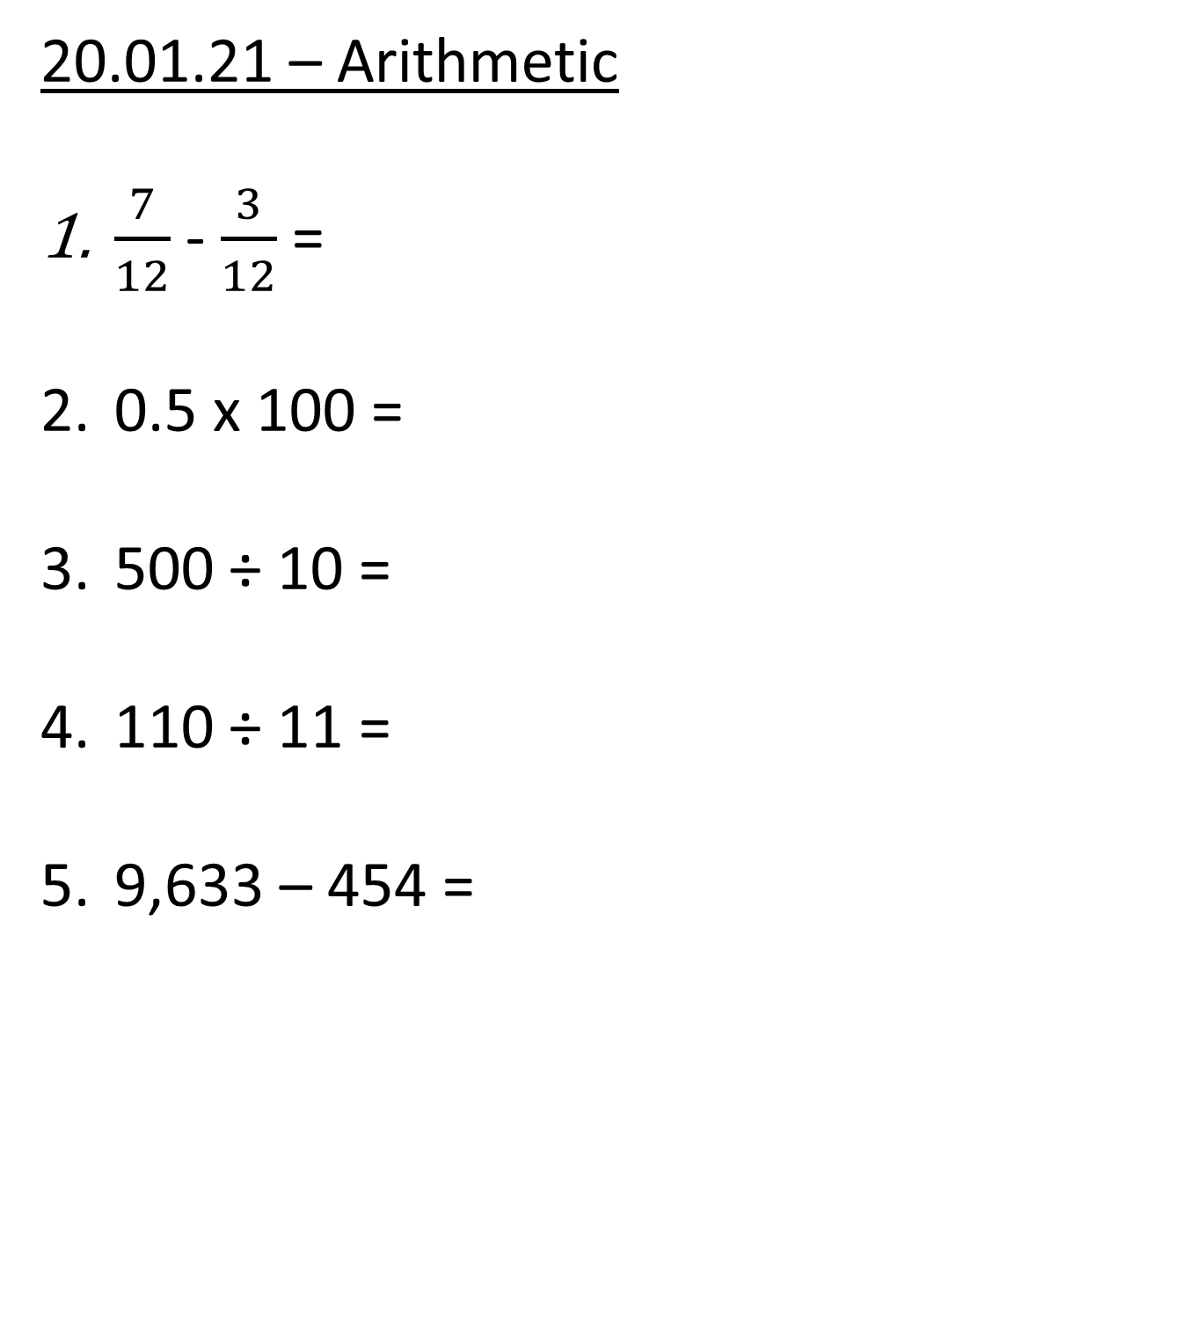
20.01.21 – Arithmetic
$\frac{7}{12}$ - $\frac{3}{12}$ =
0.5 x 100 =
500 ÷ 10 =
110 ÷ 11 =
9,633 – 454 =

Slide 2
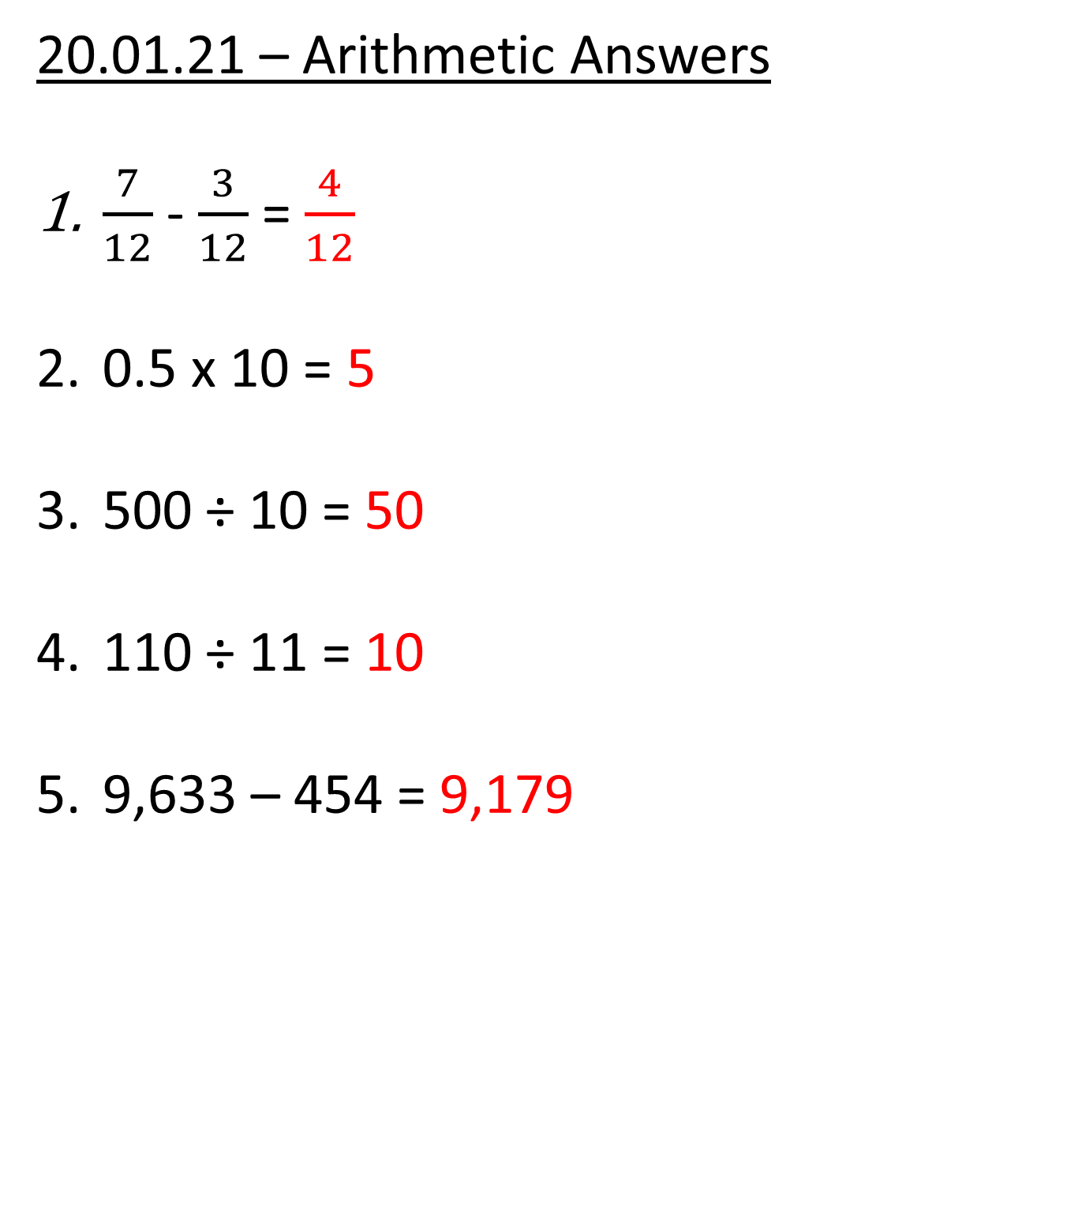
20.01.21 – Arithmetic Answers
$\frac{7}{12}$ - $\frac{3}{12}$ = $\frac{4}{12}$
0.5 x 10 = 5
500 ÷ 10 = 50
110 ÷ 11 = 10
9,633 – 454 = 9,179

Slide 3


Slide 5
1) 84 ÷ 3 =
2) 85 ÷ 3 =
3) 83 ÷ 3 =
4) 490 ÷ 7 =

Slide 6
1) 84 ÷ 3 =
2) 85 ÷ 3 =
3) 83 ÷ 3 =
4) 490 ÷ 7 =
28
84
28 r 1
60
24
27 r 2
÷ 3
÷ 3
20
8
70

Slide 8


609 ÷ 3 =
2
0
3
H | T | O

Slide 9

576 ÷ 4 =
144
H | T | O
576
400
16
160
÷ 4
÷ 4
÷ 4
100
4
40

Slide 10
115 ÷ 5 =
23
H | T | O
115
100
15
÷ 5
÷ 5
20
3

Slide 11

765 ÷ 5 =
153
Have a think
67
2) 201 ÷ 3 =
H | T | O
H | T | O
201
765
500
15
180
21
250
÷ 3
÷ 5
÷ 3
÷ 5
÷ 5
100
3
60
50
7

Slide 12
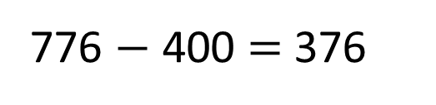
776 ÷ 4 =
194
776 $−$ 400 = 376
776
400
16
360
÷ 4
÷ 4
÷ 4
100
4
90

Slide 13
Have a go at questions
1 - 5 on the worksheet

Slide 14
638 ÷ 3 =
212 r 2
638
638
600
8
600
2
30
36
÷ 3
÷ 3
÷ 3
÷ 3
÷ 3
÷ 3
200
2 r 2
200
r 2
10
12

Slide 15
Have a think
1) 708 ÷ 7 =
101 r 1
2) 865 ÷ 4 =
216 r 1
708
865
700
8
800
25
0
40
÷ 7
÷ 7
÷ 4
÷ 4
÷ 7
÷ 4
100
1 r 1
200
6 r 1
0
10

Slide 16
Have a think
Tom has £317
He gives each of his 5 grandchildren an equal amount of whole pounds.
How much money does Tom have left?
£2
317 ÷ 5 =
63 r 2
300 ÷ 10 =
30
317
30 × 2 =
60
300
17
÷ 5
÷ 5
60
3 r 2

Slide 17
Have a go at questions
6 - 9 on the worksheet

